Slide 1

Neurodiversity in the Classics Classroom
Dr Cora Beth Fraser
The Open University
CoraBeth.Fraser@open.ac.uk

Slide 2
Four Neurodiversity Initiatives: what did we learn?
Asterion
The Relaxed Tutorial Project
NESTL Toolkit (Oxford)
ACCLAIM

Slide 3
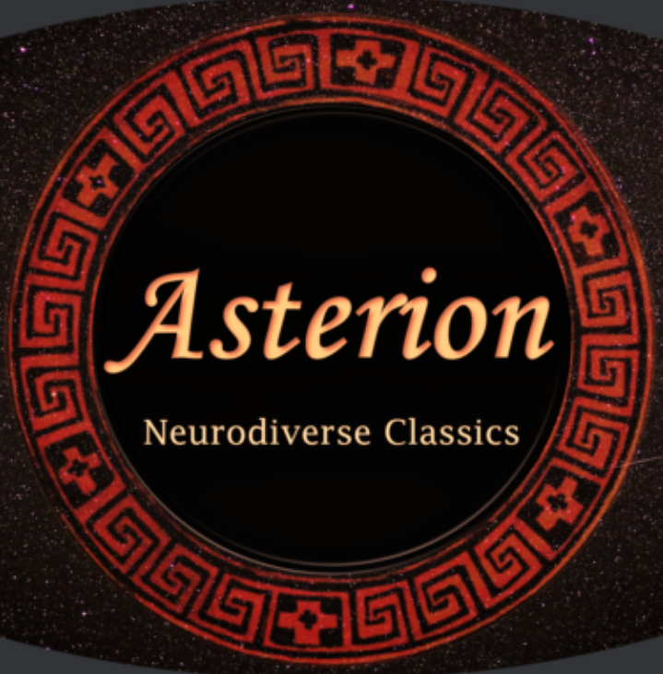
Asterion

Slide 4
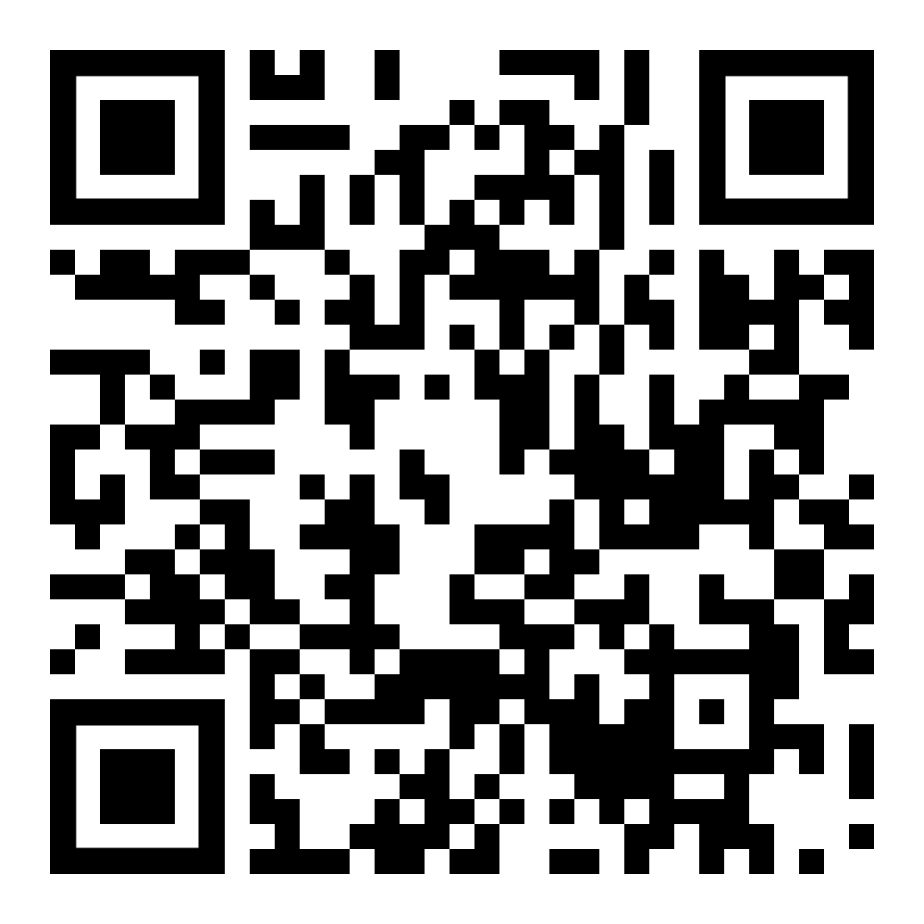
Asterion
What we did…
  Invited contributions from neurodivergent teachers of Classics.
  Developed a series of Classroom Resources to highlight challenges and solutions for particular needs, from teachers with a combination of personal lived experience and professional experience.
  Focused on the teaching of Classics and Ancient History. What challenges are specific to our discipline?

Slide 5
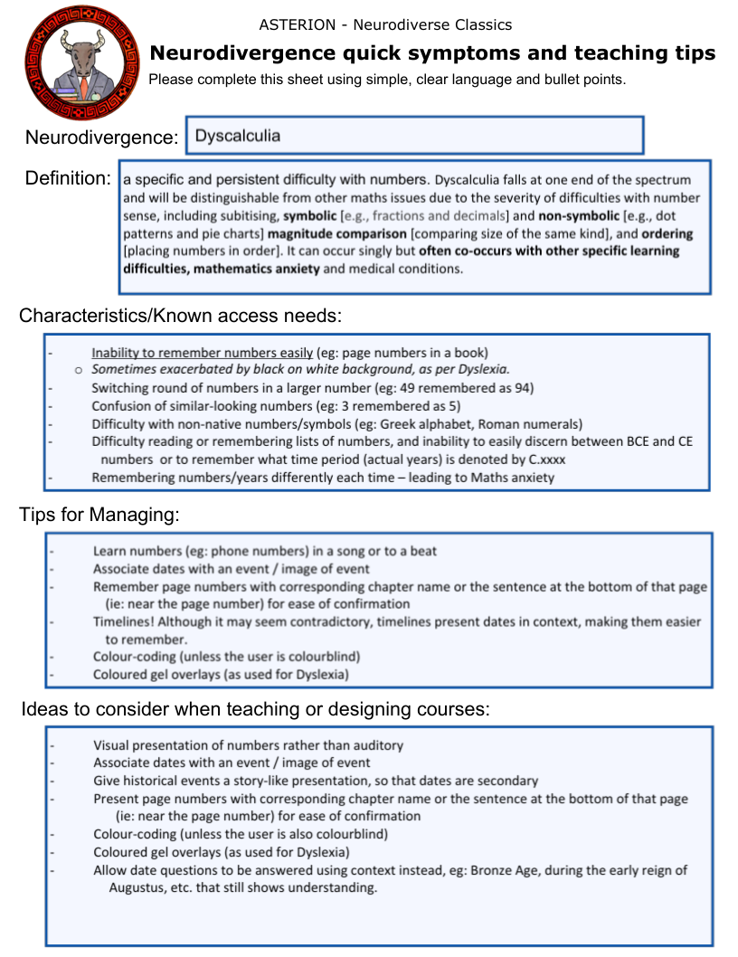
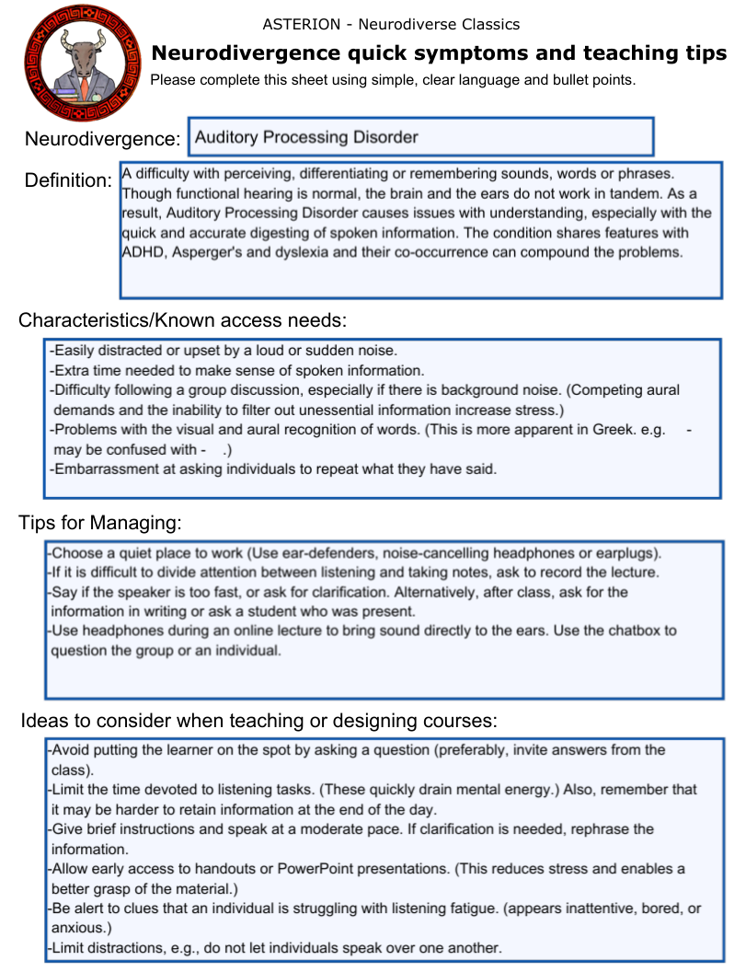

Slide 6
One thing we learned…
Embarrassment is a big factor – many neurodivergent students won’t admit to struggling because they’re stuck on something that looks “easy”.

Slide 7
Top Tip for Teachers
Many neurodivergent students process and remember information in context. Provide as much context as you can, in different modes, e.g. graphic/spoken/written.

Slide 8

Relaxed
Tutorials

Slide 9
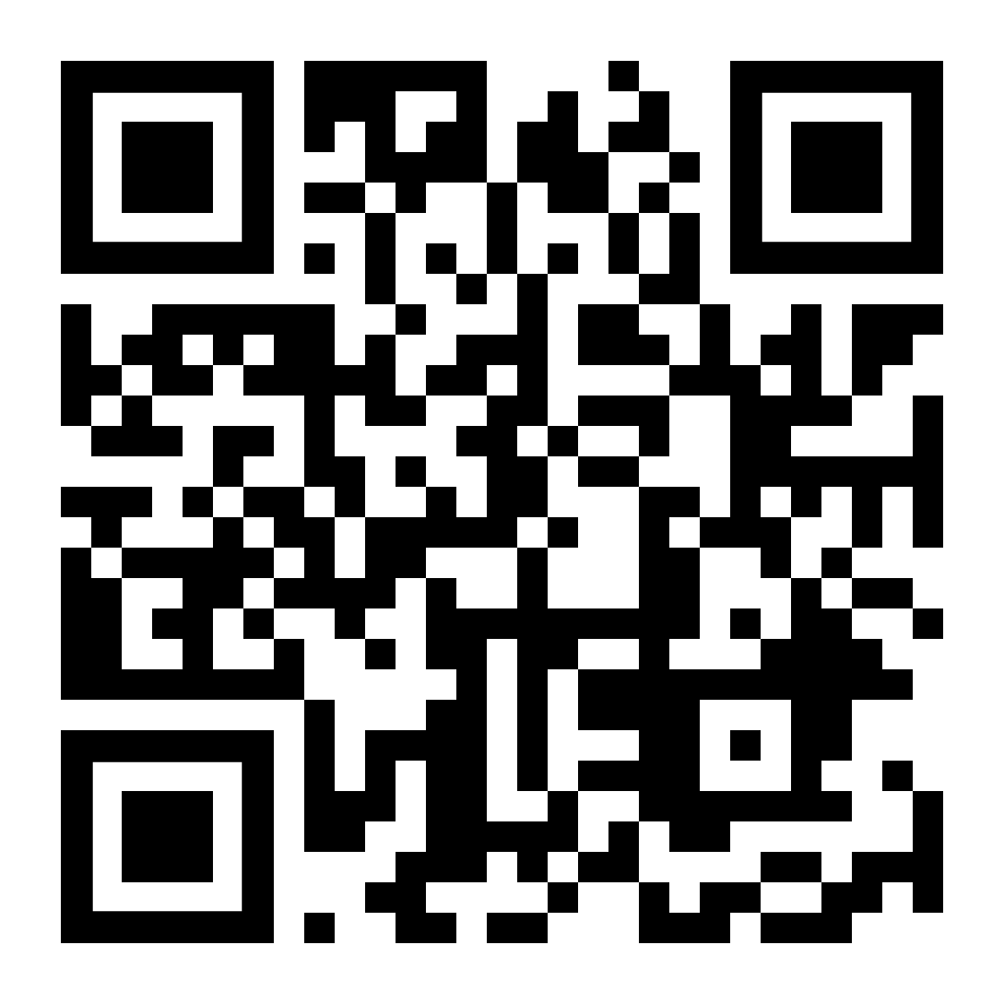
The Relaxed Tutorial Project
What we did…
  Looked at adjustments we could make to the online teaching context, WITHOUT changing the content of sessions.
  Identified problem areas for autistic students, like breakout rooms and webcams.
  Designed a new set-up badged as a ‘relaxed tutorial’.
  Noted that this was not a universal adjustment (settings that worked for autistic students did not work for dyslexic students).

Slide 10
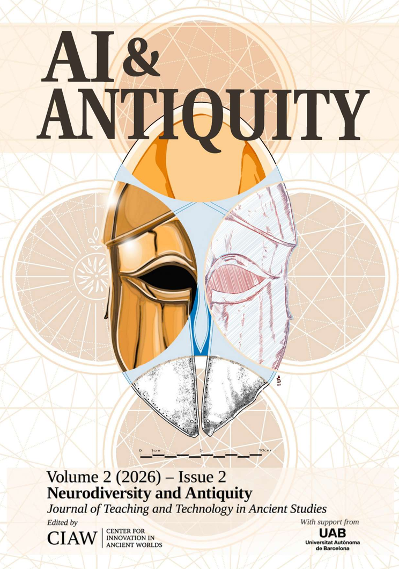
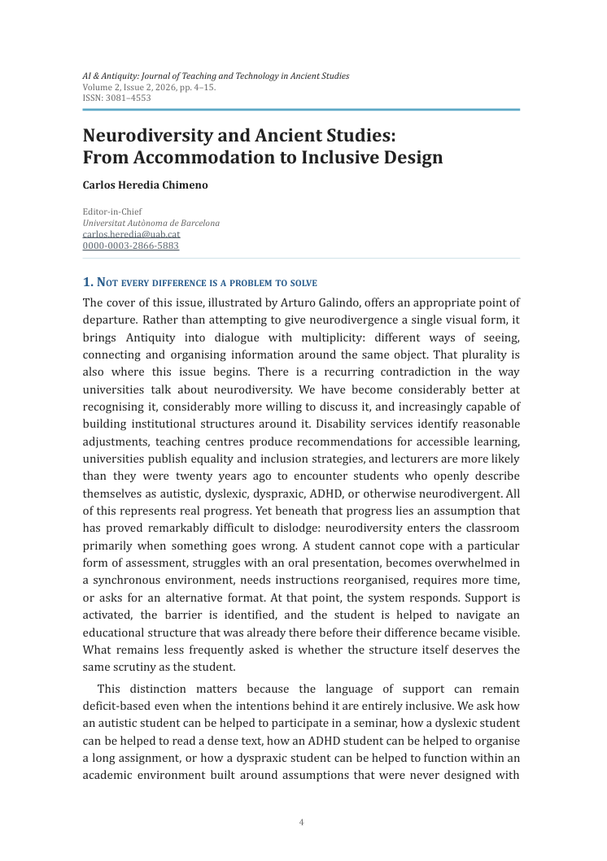

Slide 11
One thing we learned…
Adjusting the sensory and social environment can go a long way towards reducing neurodivergent anxiety.

Slide 12
Top Tip for Teachers
Anxiety is the main force that shapes neurodivergent experiences of education. Address the anxiety by being reliable and consistent.

Slide 13
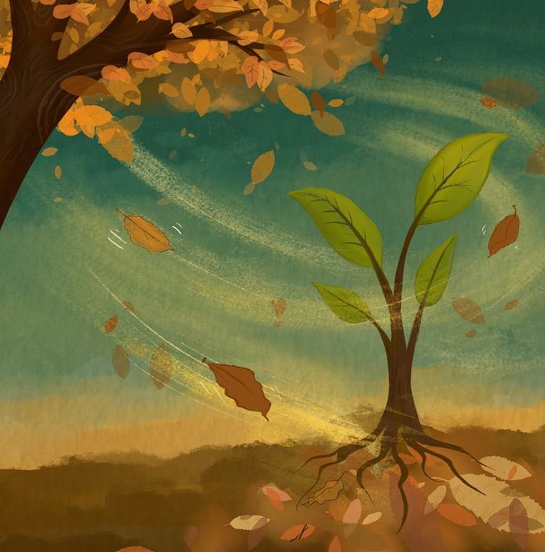
NESTL

Slide 14
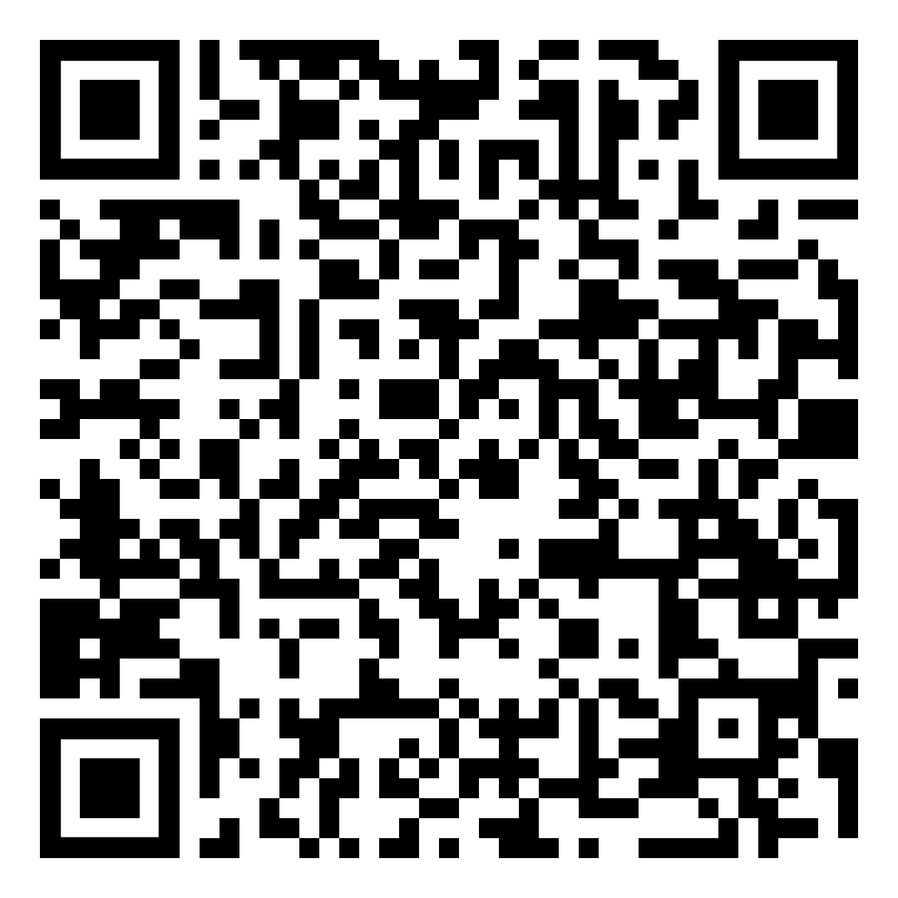
NESTL: Neurodivergent Education for Students, Teaching & Learning
What we did…
  Gathered a team of staff and students and an advisory board with lived experience.
  Developed resources to support staff working with neurodivergent students.
  Focused on mythbusting, student voices and practical suggestions.

Slide 15
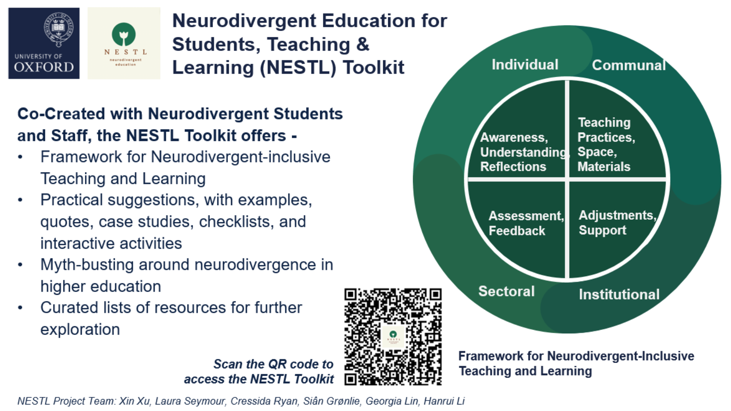

Slide 16
One thing we learned…
One understanding teacher isn’t enough. Good teaching practices need institutional backing – so neurodiversity awareness has to be systems-wide.

Slide 17
Top Tip for Teachers
Good practice needs to be shared. Check out the Journal of Classics Teaching, which is now online and open access: maybe consider writing a report on any initiative or approach that might be helpful to other teachers.

Slide 18
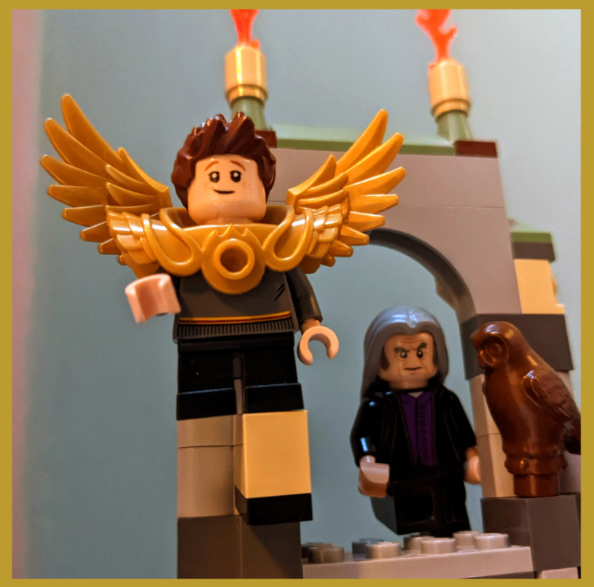
ACCLAIM

Slide 19
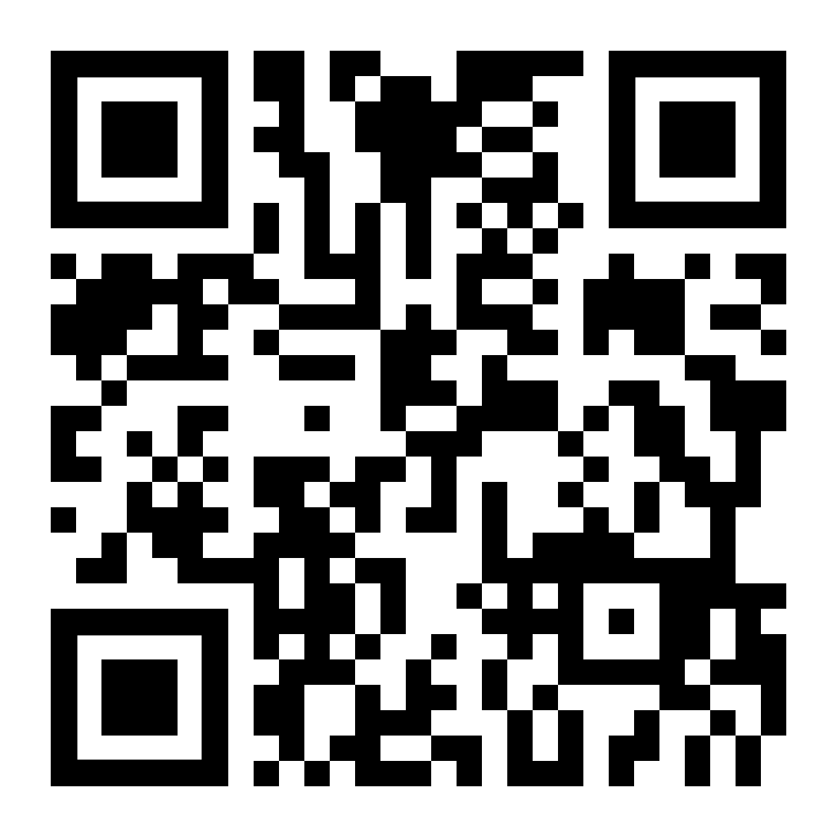
ACClaIM: Autism Connecting with CLAssically-Inspired Myth Network
What we did…
  Prof Susan Deacy produced the first book on Autism and Classical Myth, called ‘What Would Hercules Do? Lessons for Autistic Children Using Classical Myth’, along with classroom resources.
  Members of the group investigated the potential classroom use of other myths, to explore benefits for autistic and otherwise neurodivergent students.

Slide 20
One thing we learned…
Classical myth has huge and almost untapped potential for exploring and explaining neurodiversity.

Slide 21
Top Tip for Teachers
Myth has always been used to reflect on strengths, challenges and differences at a safe distance. Consider how you could use familiar myths to explore different ways of seeing the world.

Slide 22
Do get in touch!
CoraBeth.Fraser@open.ac.uk
www.linkedin.com/in/corabethfraser
https://classicalstudies.support/
https://fraut.co.uk/

