Slide 1
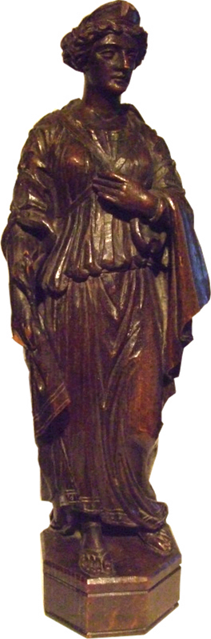
When is a Princess not a Princess?
The Curious Case of Princess Claudia

Slide 2




From Newcastle to South Shields
…and back again

Slide 3
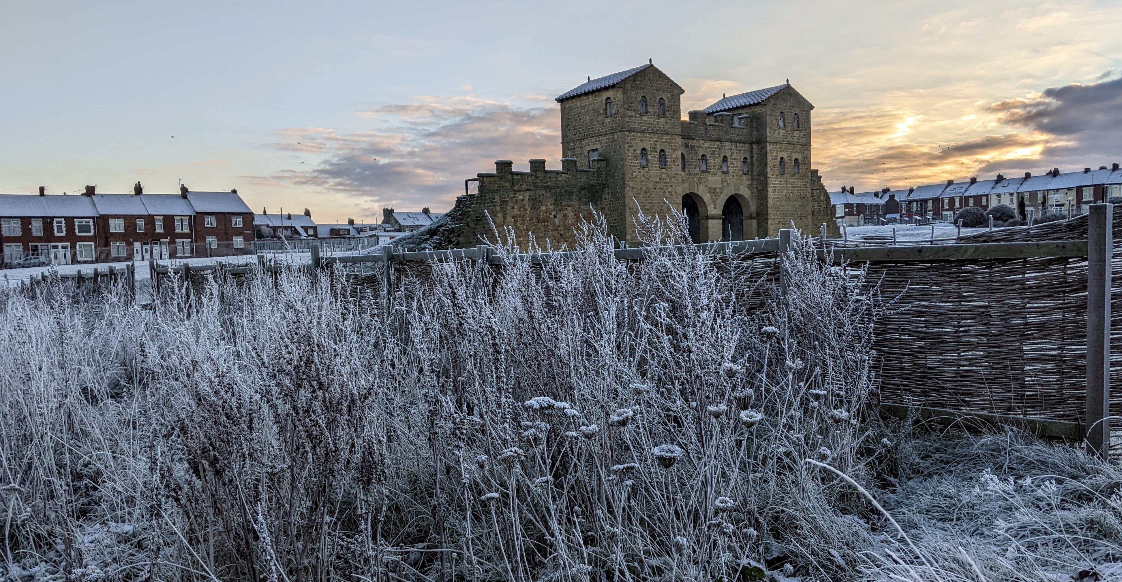

Slide 4
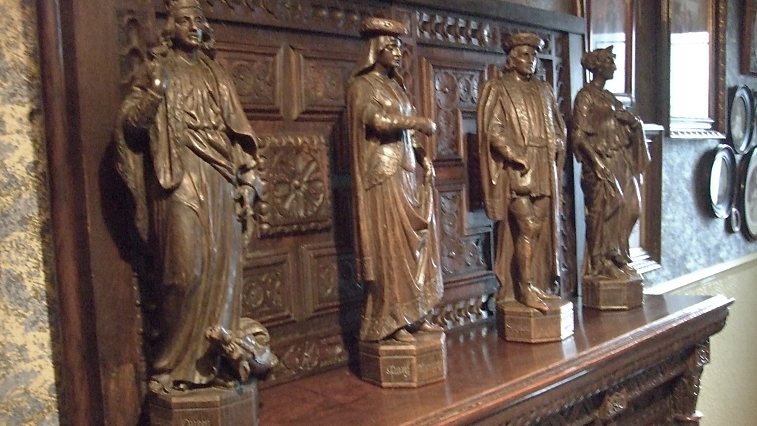

Slide 5
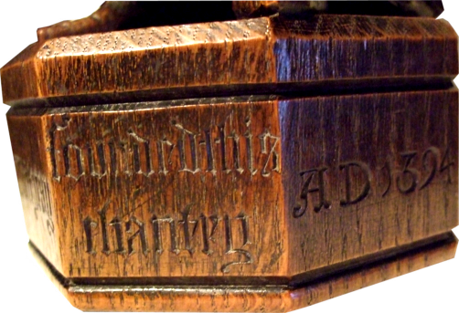

Slide 6
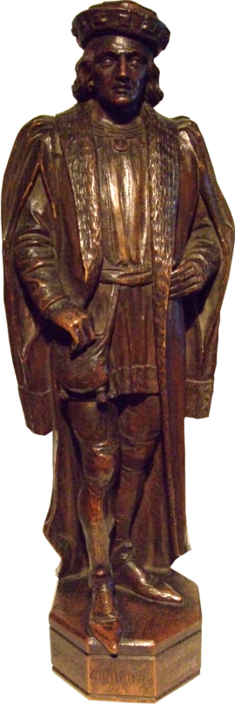
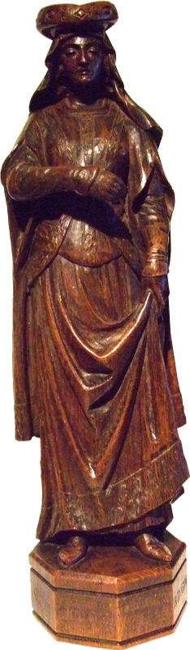
Stephen and Mary Whitgray
Offices Held
Bailiff, Newcastle-upon-Tyne Mich. 1369-72; mayor 1384-5.3
Collector of taxes, Newcastle-upon-Tyne Nov. 1377.
Collector of customs, Newcastle-upon-Tyne 24 Aug. 1386 Nov. 1392.
From the time of his election as bailiff of Newcastle-upon-Tyne in 1369, Whitgray played a prominent part in local affairs. He owed much of his influence to his position in the mercantile community, where for many years he was a leading figure. He dealt in a wide variety of products, including iron, dye-stuffs, salt and cloth; but his principal interest lay in wool, which he shipped in large quantities down the Tyne. Between July 1373 and September 1374, for example, he and a small group of merchants obtained licences from the Crown for the export of 420 sacks of wool; and the customs accounts for the next ten years reveal that he also dealt extensively in hides and sheepskins. Without doubt, his appointment as a collector of customs at Newcastle in 1389 worked greatly to his personal advantage, since he was thus ideally placed to further his own commercial interests.
As befitted a former mayor of Newcastle who had represented the borough in at least three Parliaments, Whitgray was anxious to leave a lasting memorial behind him. In April 1393 an inquisition ad quod damnum was held to determine if he and his wife, Mary, could alienate property worth ten marks a year for the foundation of a chantry in the church of St. Nicholas. The jury found that since the Whitgrays would be left with tenements to the same value, held of the Crown, there would be no loss of royal rights; and in the following February Richard II granted the couple formal authority to make their endowment, in return for a substantial cash payment of 40 marks. No more is heard of Whitgray after this date, and we do not know when he died. Some years later, in 1414, references occur to property in the Northumbrian villages of Whitburn and Boldon previously occupied by Stephen Whitgray and an associate in the right of their wives as feudal tenants of the bishop of Durham, it looks as if he was able to make a good marriage.

Slide 7


Slide 8


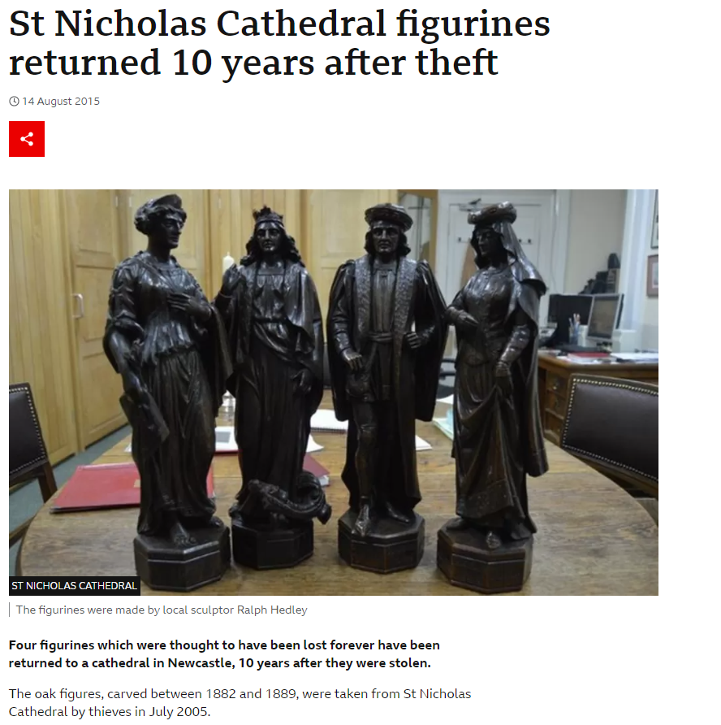
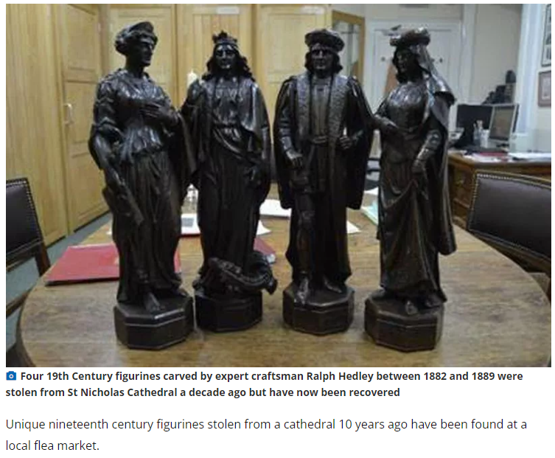

Slide 9
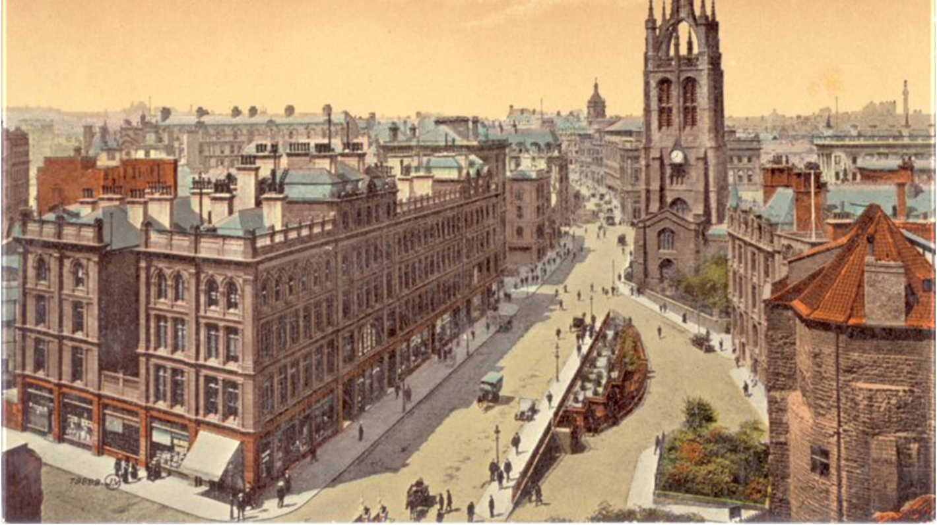

But why were there chantry statues in St. Nicholas’ Cathedral?
Who put them there, and for what reason?

Slide 10
Church History
St. Nicholas’ Church was built in Newcastle in the twelfth century.
Nine or ten chantries (chapels financed by a family, in return for prayers) were added in the thirteenth and fourteenth centuries, some requiring alterations to the building itself.
The Chantries Act of 1547 made chantries illegal, so the church was stripped of its chantry fittings.
The church remodelling in 1783 stripped all interior fittings, leaving just the shell of the old church.
St. Nicholas’ Church was granted Cathedral status in 1882, at which time a grand programme of renovations was devised, in keeping with its new importance.

Slide 11
Problems for the Victorian designers...
The Gothic Revival style clearly seemed appropriate for the nineteenth century refit, because of the medieval origins of the church - and it was also the current fashion.
However, the Catholic cathedral of Newcastle, built thirty years earlier, had been designed by the famous Gothic architect Augustus Welby Pugin. How could north-east designers compete with that?

Slide 12


Slide 13
Turning to the local past
The ‘new’ cathedral’s unique selling point was its long and local history, so designers turned to old records and stories for their inspiration.
They moved away from the generic Gothic Revival style, towards a revival of the specific history of the area.
There was also an emphasis on the heritage of the site, going all the way back to Roman times.

Slide 14
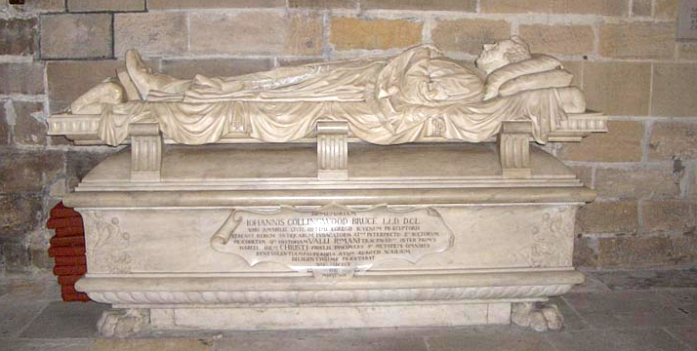

Slide 15
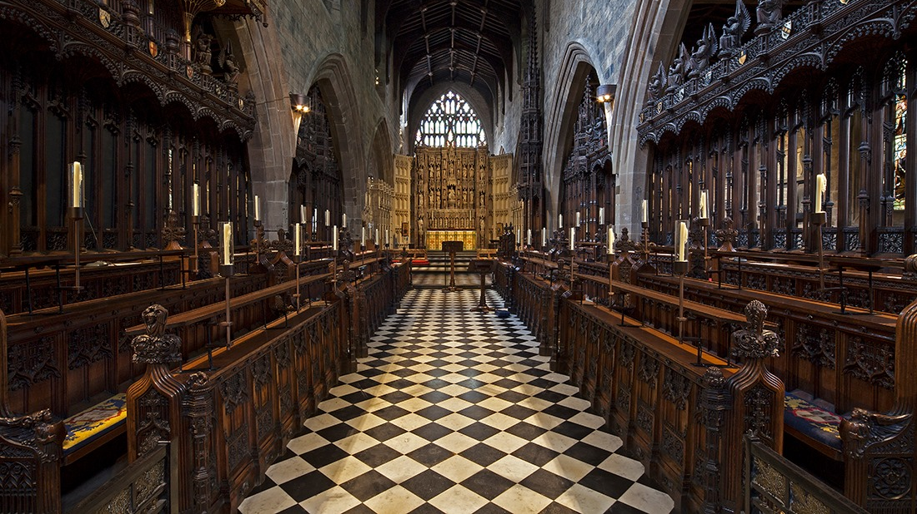
Reimagining a Chantry
Who was involved and what were their instructions?

Slide 16

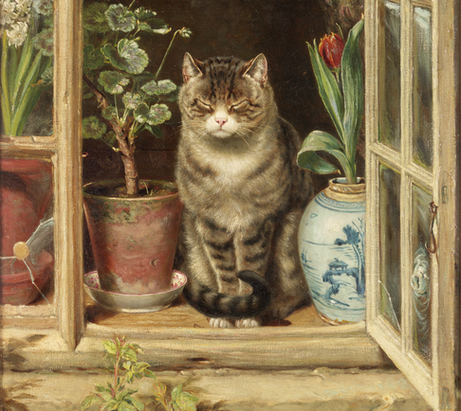
Chantry Reconstruction
The Newcastle firm of Ralph Hedley was hired to take charge of the woodwork in the new cathedral.
(This is Ralph’s cat.)

Slide 17
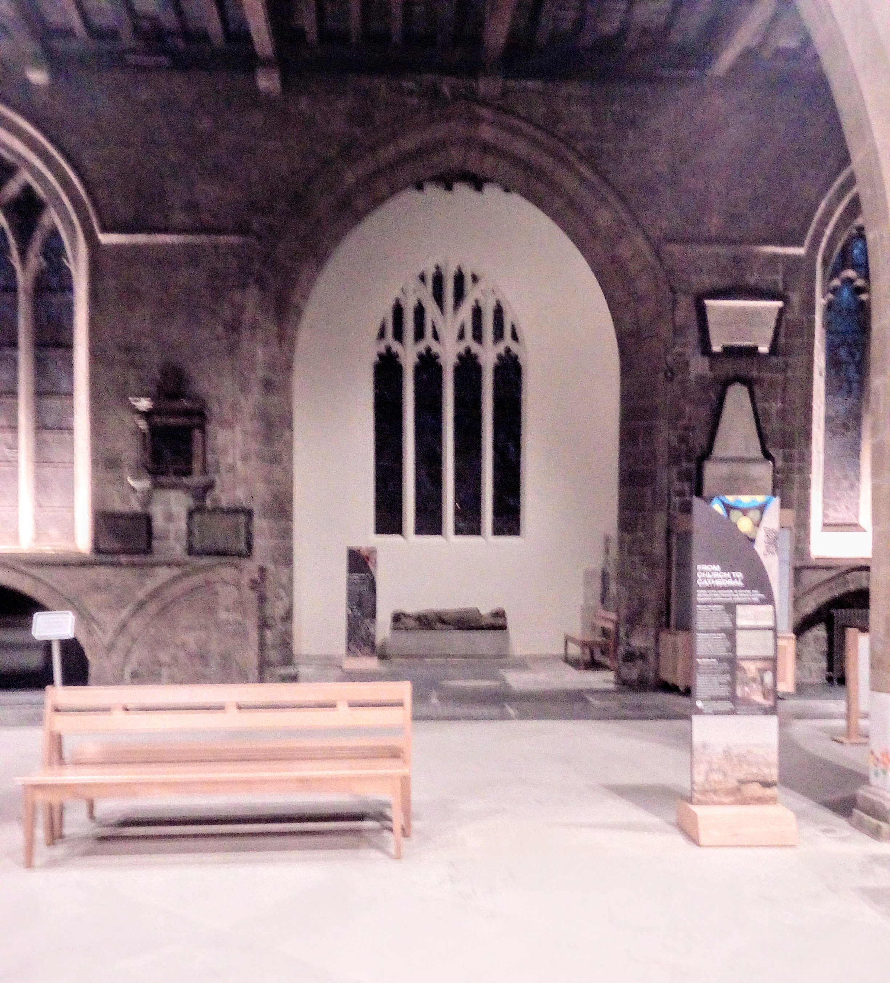
The Chantry of St. Margaret
One of the original chantries left a quirk in the structure of the church: an alcove created by knocking a hole through the regular arches of the south wall.
Records of this chantry were preserved: it was set up by a married couple, Stephen and Mary Whitgray, and dedicated to St. Margaret in 1394. The bequest included fixtures and fittings, and money for a priest.
The chantry was decommissioned in 1547, and all of its fittings were removed and either sold or destroyed. Nothing was left but a hole in the wall.
At some point in the nineteenth century refit, the decision was taken to restore this chantry, with appropriate fittings and with statues to commemorate the original local donors, the Whitgrays.

Slide 18
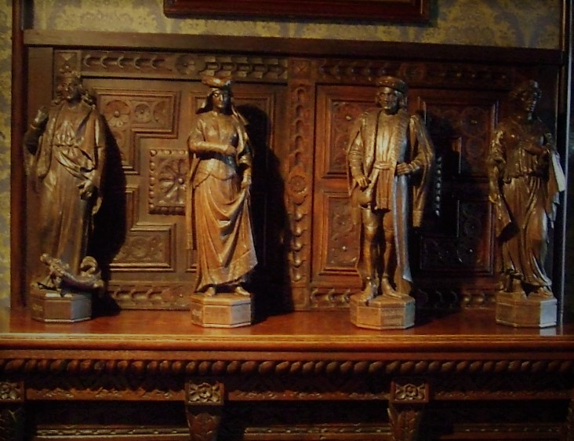
Chantry Reconstruction
Hedley reconstructed St. Margaret’s chantry with a heavily carved altar, rails, riddle posts and four oak statues, accompanied by inscriptions in Gothic lettering.
The statues were named ‘Stephen Whitgray’, ‘Mary Whitgray’, ‘St. Margaret, Queen’ and ‘Claudia’. Only the first two are straightforward!

Slide 19

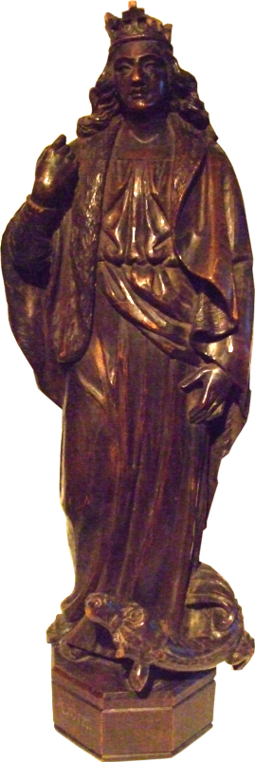
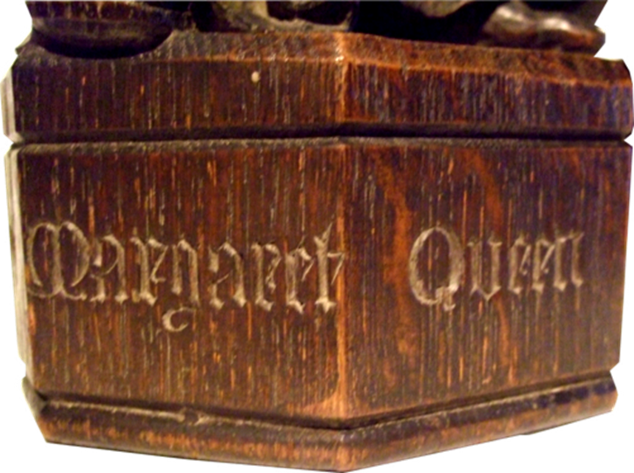
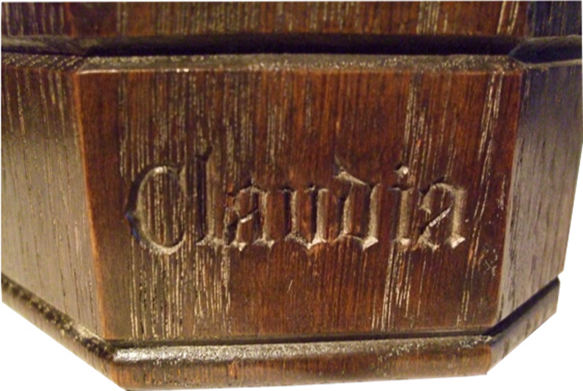
Who is St. Margaret, Queen?

Slide 20
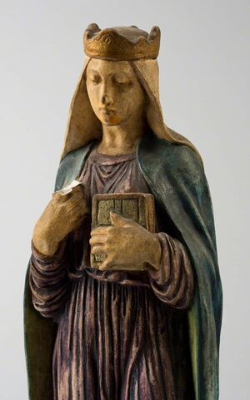
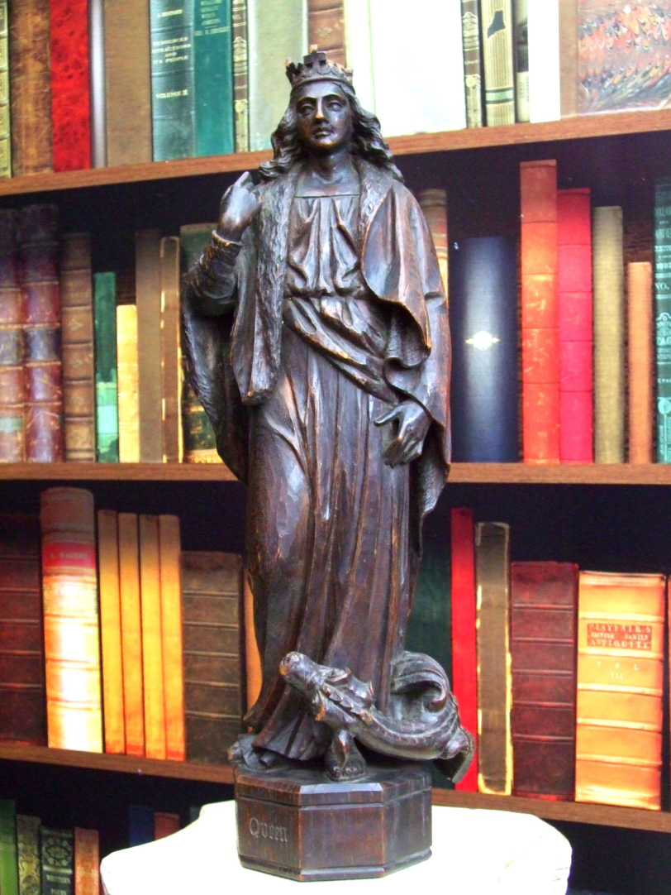
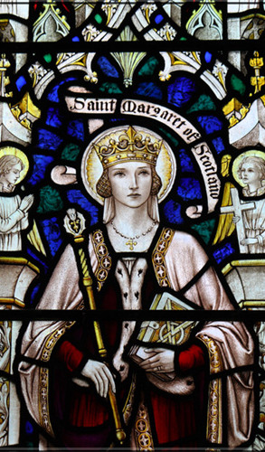

Slide 21
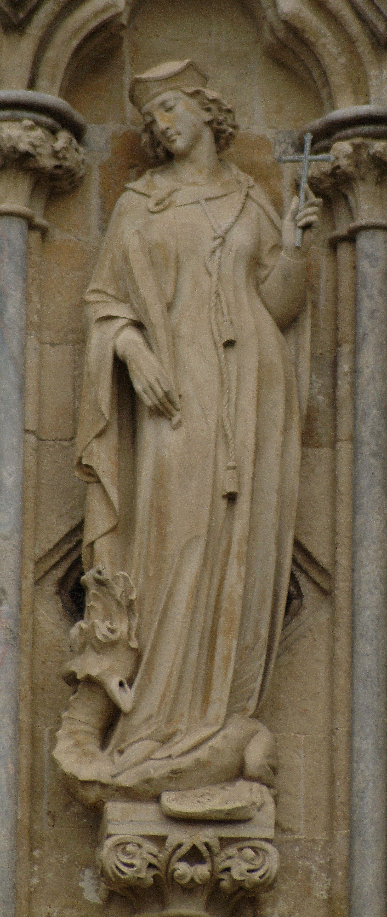
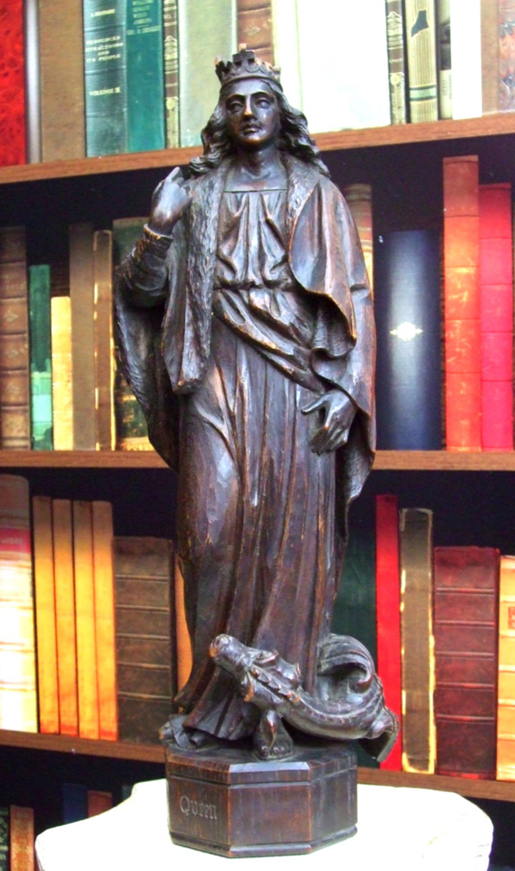
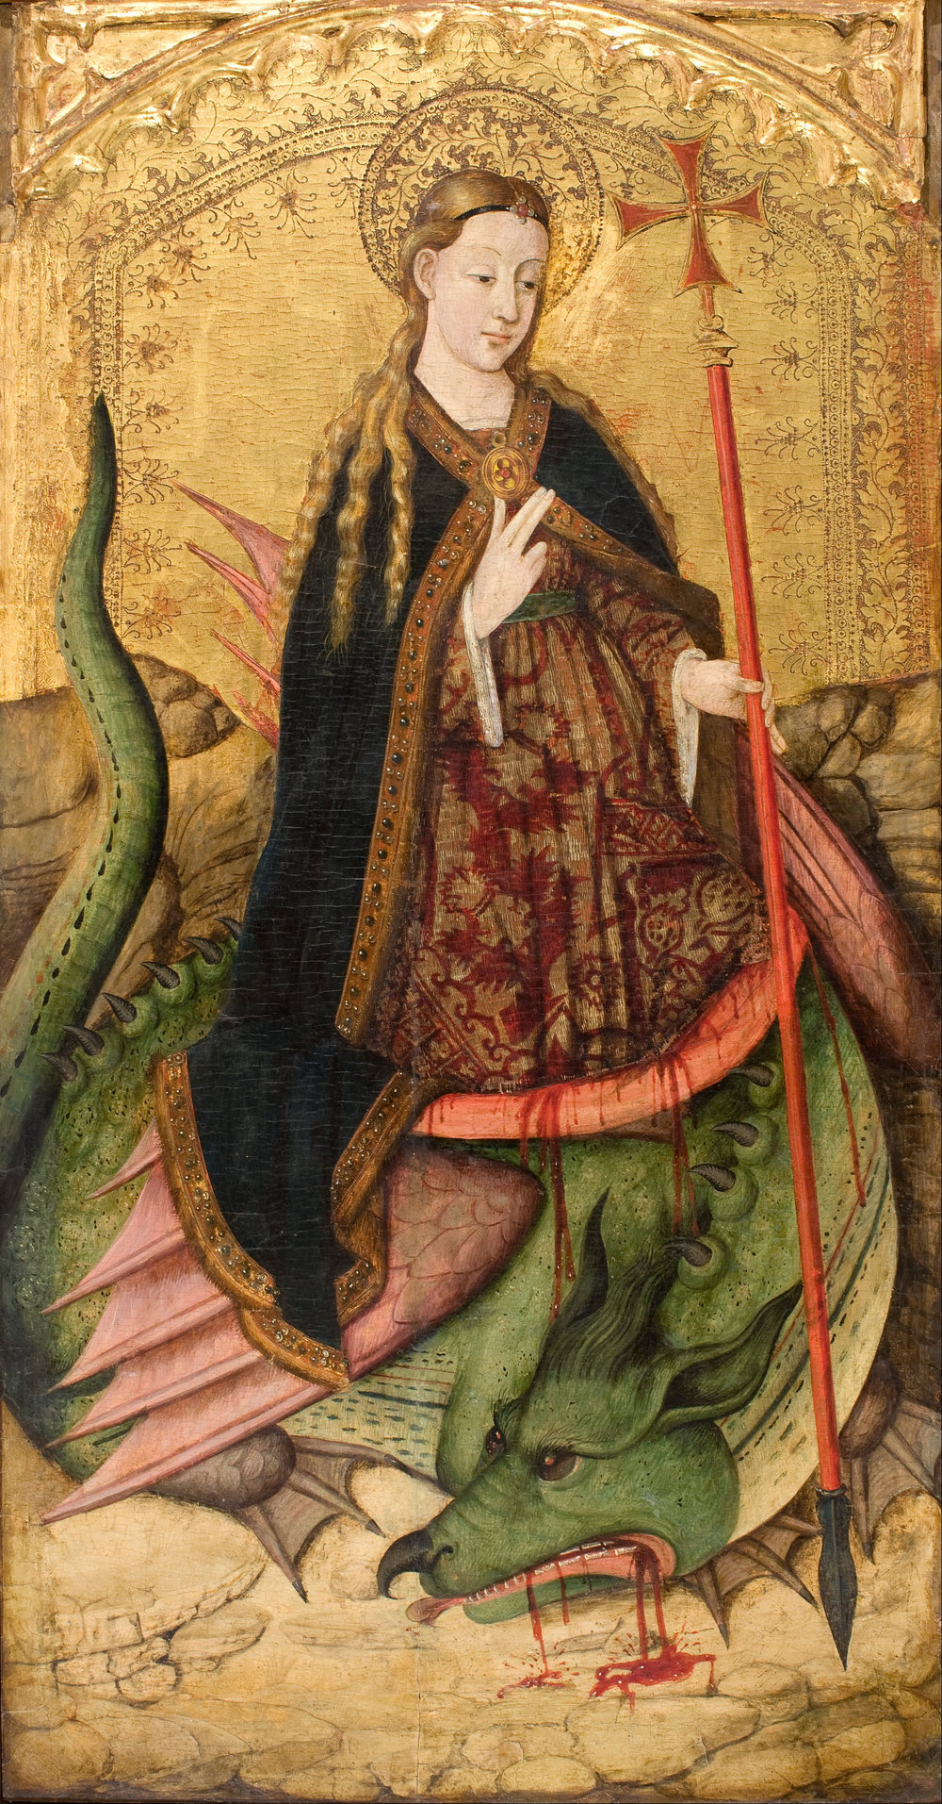

Slide 22
Who is Claudia?
St Claudia Procula?
St Claudia, mother of St Eugenia?
St Claudia, also known as Princess Claudia, of Britain?

Slide 23
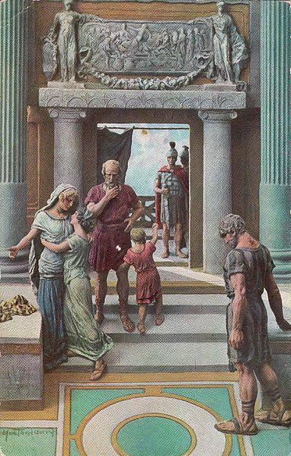
The case for Princess Claudia of Britain
Where did the ‘Princess Claudia’ idea come from, how did it catch on, and why did it disappear from the historical record?

Slide 24

A Claudia in the Bible
St. Paul’s letter to Timothy (2 Timothy 4.21):
Ἀσπάζεταί σε Εὔβουλος καὶ Πούδης καὶ Λίνος καὶ Κλαυδία καὶ οἱ ἀδελφοὶ πάντες.
‘Eubulus greets you, and Pudens, and Linus, and Claudia, and all the brothers’.
The letter suggests that a woman named Claudia and a man named Pudens are known to Paul (although he doesn’t mention them again). These two names pop up somewhere else…

Slide 25
A Claudia in Martial’s Epigrams
IV.13: mentions a Claudia Peregrina, who is about to be married to Martial’s friend Pudens.
Claudia, Rufe, meo nubit Peregrina Pudenti:
macte esto taedis, o Hymenaee, tuis.
Tam bene rara suo miscentur cinnama nardo,
Massica Theseis tam bene uina fauis;
Nec melius teneris iunguntur uitibus ulmi,
nec plus lotos aquas, litora myrtus amat.
Candida perpetuo reside, Concordia, lecto,
tamque pari semper sit Venus aequa iugo:
diligat illa senem quondam, sed et ipsa marito
tum quoque, cum fuerit, non uideatur anus.
Claudia Peregrina, Rufus, is about to be married to my friend Pudens. Be propitious, Hymen, with your torches. As fitly is precious cinnamon united with nard, and Massic wine with Attic honey. Nor are elms more fitly wedded to tender vines, the lotus more love the waters, or the myrtle the river's bank. May you always hover over their couch, fair Concord, and may Venus ever be auspicious to a couple so well matched. In after years may the wife cherish her husband in his old age; and may she, when grown old, not seem so to her husband.

Slide 26
A Claudia in Martial’s Epigrams
XI.53: mentions Claudia Rufina, a beautiful married British lady.
Claudia caeruleis cum sit Rufina Britannis
edita, quam Latiae pectora gentis habet!
Quale decus formae! Romanam credere matres
Italides possunt, Atthides esse suam.
Di bene quod sancto peperit fecunda marito,
quod sperat generos quodque puella nurus.
Sic placeat superis, ut conjuge gaudeat uno
et semper natis gaudeat illa tribus.
Although born among the woad-stained Britons, how fully has Claudia Rufina the intelligence of the Roman people! What beauty is hers! The matrons of Italy might take her for a Roman; those of Attica for an Athenian. The gods have kindly ordered that she proves fruitful to her revered husband, and that, while yet young, she may hope for sons-in-law and daughters-in-law! May heaven grant her ever to rejoice in one single husband, and to exult in being the mother of three children.

Slide 27
A Claudia in Martial’s Epigrams
(there’s another Claudia, in VIII: 60, but strangely she’s never mentioned…!)
Summa Palatini poteras aequare Colossi,
si fieres breuior, Claudia, sesquipede.
You would have been able to match the height of the colossus on the Palatine,
if you had been shorter, Claudia, by a foot and a half.

Slide 28
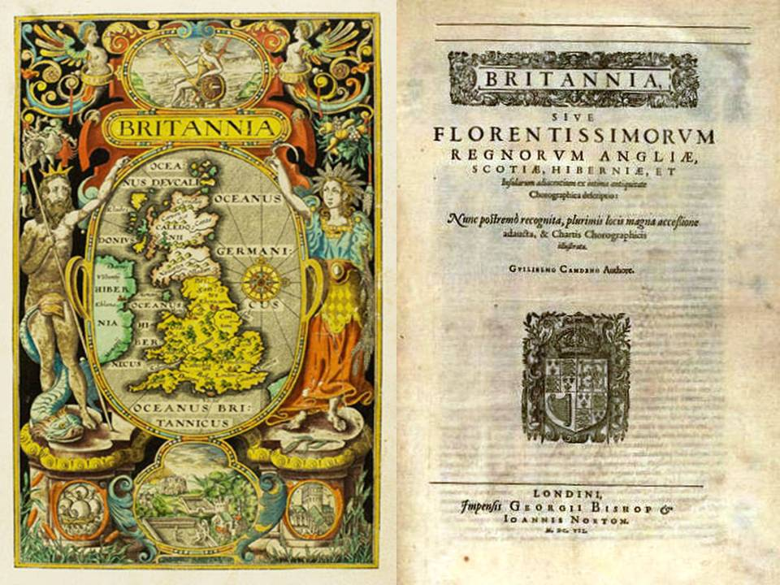
Notable Publications
Alexander, W. L. 1799. The Ancient British Church: being an Inquiry into the History of Christianity in Britain previous to the Establishment of the Heptarchy, The Religious Tract Society, London
Bowles, W.L. 1839. Pudens and Claudia of St. Paul. On the Earliest Introduction of the Christian Faith to these Islands, through Claudia, Certainly a British Lady, Supposed Daughter of Caractacus, Bristol
Camden, W. 1586. Britannia, London
Howorth, H.H. 1885. ‘Christianity in Roman Britain’, Transactions of the Royal Historical Society Vol 2, pp.117-172, Cambridge University Press
Stillingfleet, E. 1840. Origines Britannicae: A New Edition, London
Williams, J. 1848. Claudia and Pudens: An Attempt to Show that Claudia, mentioned in St. Paul’s Second Epistle to Timothy, Was a British Princess, LLandovery and London

Slide 29
A Claudia in Martial’s Epigrams
IV.13: Claudia Peregrina, who is about to be married to Martial’s friend Pudens.
XI.53: Claudia Rufina, a beautiful married British lady.
Assuming the two Claudias are in fact the same woman, we have a Claudia married to a Pudens – and Claudia is British. If this is St. Paul’s Claudia, she is presumably Christian. So there is a high-born, beautiful British lady in Rome, who is a friend of St. Paul and Martial.
But what is she doing in Rome?...

Slide 30
A possible Claudia in Tacitus’ Annals?
Annals XII: British King Caractacus is captured and brought to Rome. He gives a speech before the Emperor Claudius. He is then released, along with his family. No more is said of them.
So here we have a British king in Rome, with cause to be indebted to Claudius. Naturally he would name (or re-name) his daughter Claudia, and she would be of sufficiently high status to marry a member of the Roman elite.
Could this be Martial’s beautiful British Claudia, who marries Pudens? Could it also be the Christian friend of St. Paul? In that case she’s British, Christian and a princess!

Slide 31
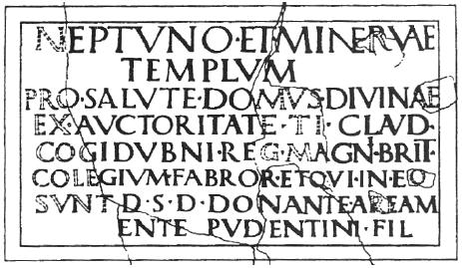
A Pudens in Britain
This inscription, found in Chichester in 1723, complicates the theory. It suggests that, contrary to the Caractacus connection, Pudens may have been involved with the client king Cogidubnus. However, that didn’t prove to be a major obstacle: the theorists simply argued that Cogidubnus no doubt had a daughter too…!

Slide 32
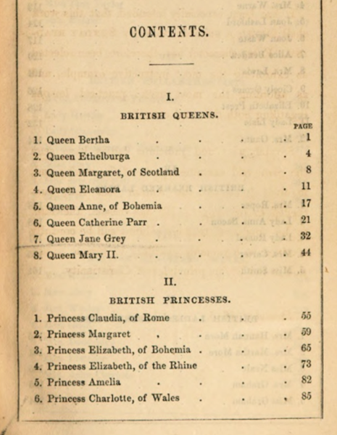
Connections
All of these connections rely upon the names ‘Claudia’ and ‘Pudens’, neither of which is particularly unusual. There are lots of other objections to the theory: historically, the whole idea is highly implausible.
Nevertheless, in the nineteenth century ‘Princess Claudia’ became so well accepted that she topped lists of inspirational women in history.
The connection was sanctioned by the church, as bishops for over three hundred years had promoted the idea of a British Claudia in St. Paul’s Rome.

Slide 33

Claudia in Literature
Some painful 19th century treatments

Slide 34
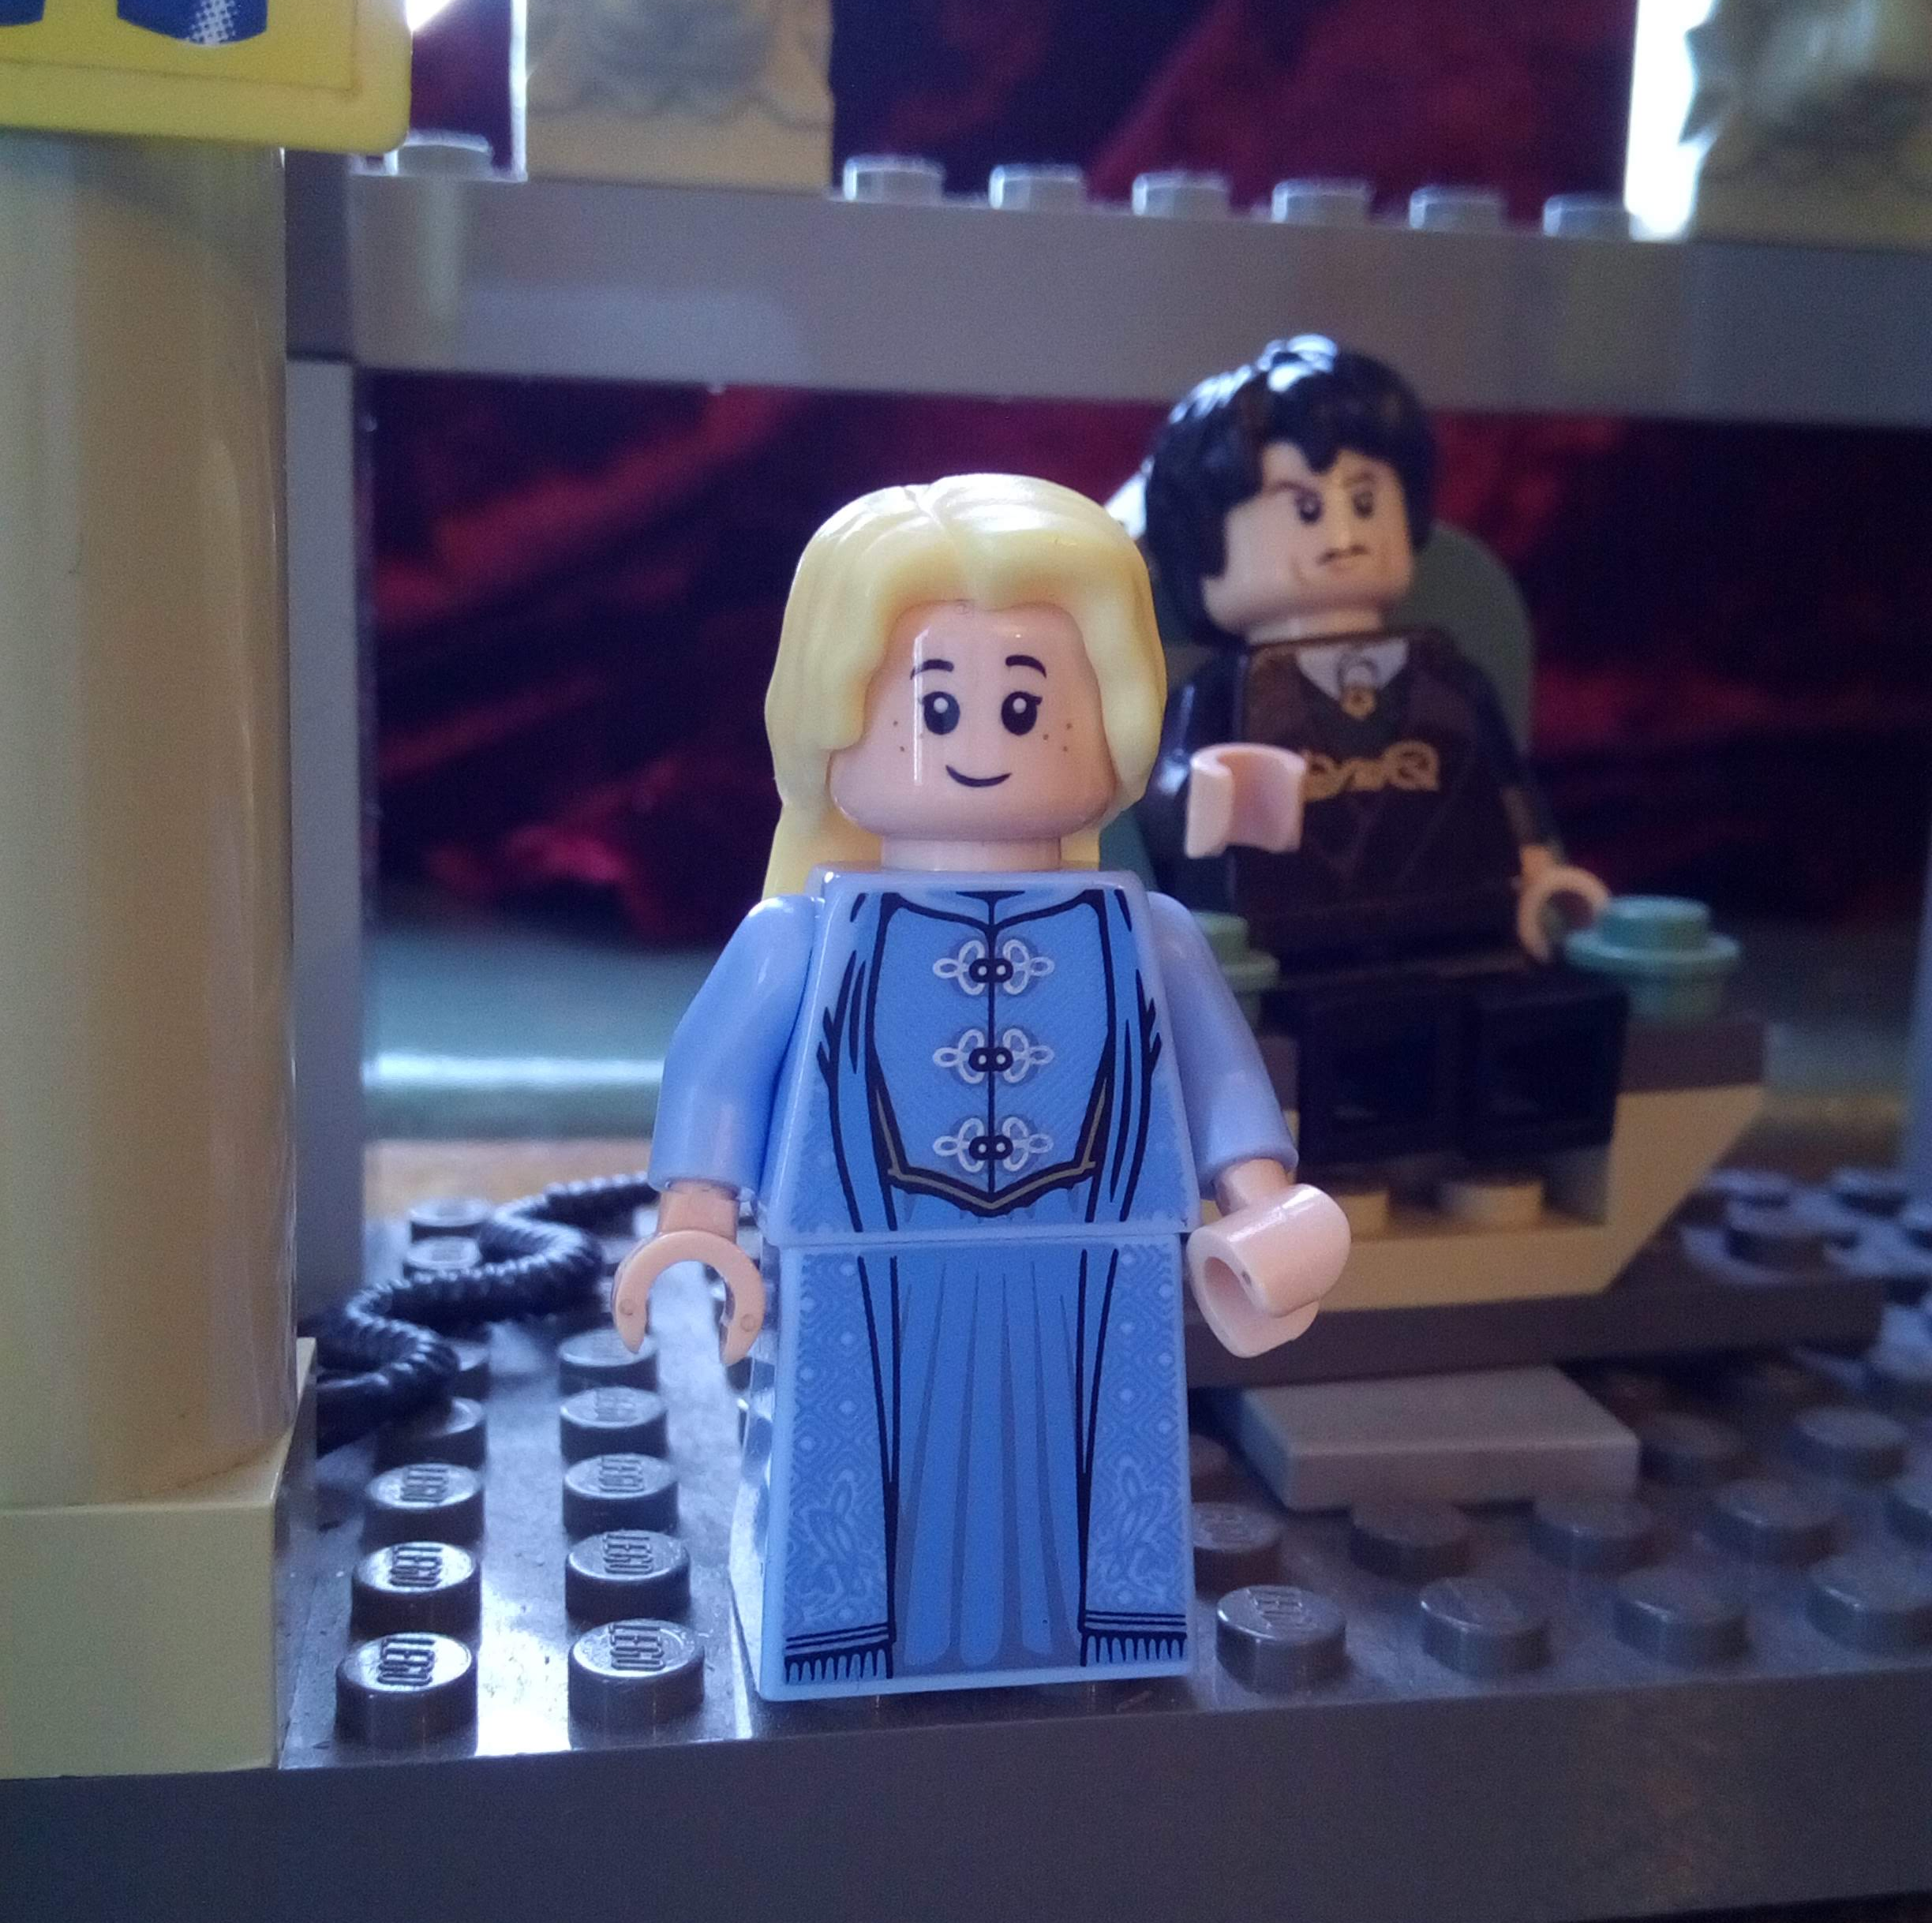
Claudia by Mrs Frederick Prideaux
‘Tis said they speak of me at Caesar’s court;
That Martialis framed an epigram
Touching the gold locks and the violet eyes,
And how the Roman and the British dames
Disputed for the honour of my birth.
Strange things have happened in these days. Perchance
I yet might be Augusta…

Slide 35
Claudia and Pudens by Samuel Lysons
Claudia's beauty on the other hand was of a totally different style; it was of that indescribable sort which attracts without our knowing how or why. Without any remarkable regularity of features, there was a grace of expression, of amiability, and of cheerfulness, mixed with a calm serenity, which bespoke her whole character at once. Her fair hair, curling gracefully, hung in ringlets over her shoulders after the fashion of her country; her soul was in her countenance, and sparkled in her light blue eye. There was no mistaking it. To see her only was to love her. And yet, with all this, she combined great strength of mind and firmness of purpose, so that her influence was unbounded. In short, she was the idol both of the Court and of the common people: and well she might be; for this great love and admiration had not spoiled her, but she used her influence with the greatest tact and benefit to all around her.

Slide 36
Uncertainties
By the 1880s, stories about ‘Princess Claudia’ were becoming unfashionable.
This mirrored a wider trend, as classical scholarship called into question the details of the Gospels and the truth of miracles.
The Anglican church was fighting a battle against the uncertainties opened up by the growing field of critical analysis.
The Claudia story was a step too far: the church could not defend it, and so it was dropped. Not officially: but it was allowed to vanish.

Slide 37
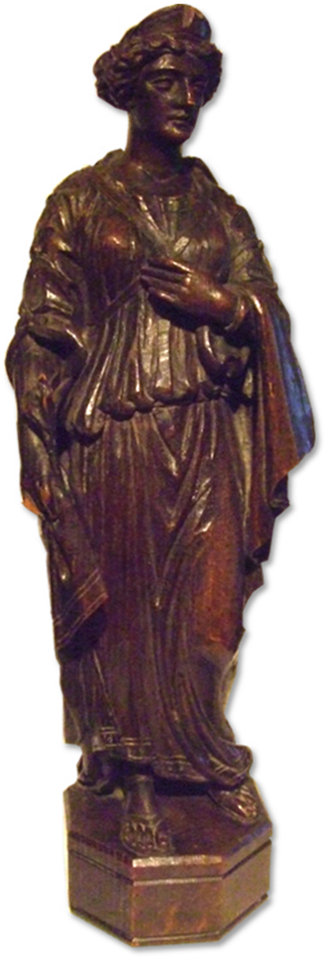
Despite the problems...
In the 1882 remodelling of Newcastle Cathedral, ‘Princess Claudia’ was a natural choice.
  Stories of Princess Claudia would have been known to the congregation from childhood.
  Claudia was an excellent match to Queen Margaret, as a married woman who united two cultures through Christianity.
  The combination of St Margaret (uniting Scotland and England) and Claudia (uniting Rome and Britain) gives a potted history of the region of Hadrian’s Wall.
  It seems that the importance of local history and heritage won out over theological and scholarly insecurities.

Slide 38
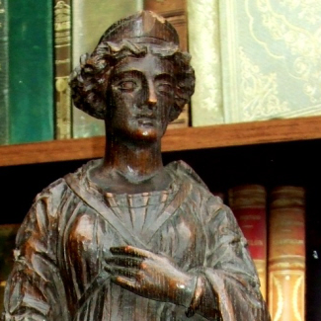
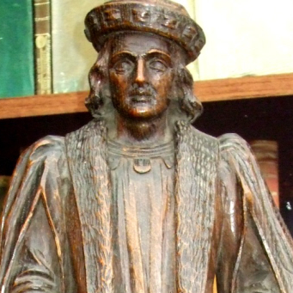
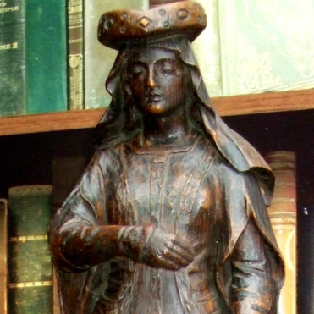

Slide 39
Further Reading
Goldhill, S. (2015) The Buried Life of Things: How Objects Made History in Nineteenth-Century Britain, CUP
Knowles, C.B. (2016), ‘A Nineteenth Century Claudia in St. Nicholas’ Cathedral’, New Voices in Classical Reception: http://www2.open.ac.uk/ClassicalStudies/GreekPlays/newvoices/Issue11/issue11index.htm
Claudia: an epic in Lego: https://classicalstudies.support/2020/02/20/international-lego-classicism-day-2020/

Slide 40



