Slide 1
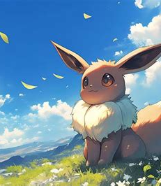
How to Name your Monster:
Neurodivergence and Mythical Hybrids
Cora Beth Fraser
The Open University
CoraBeth.Fraser@open.ac.uk

Slide 2
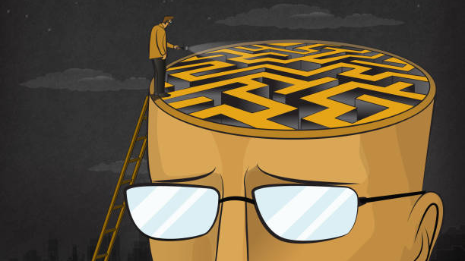

Slide 3
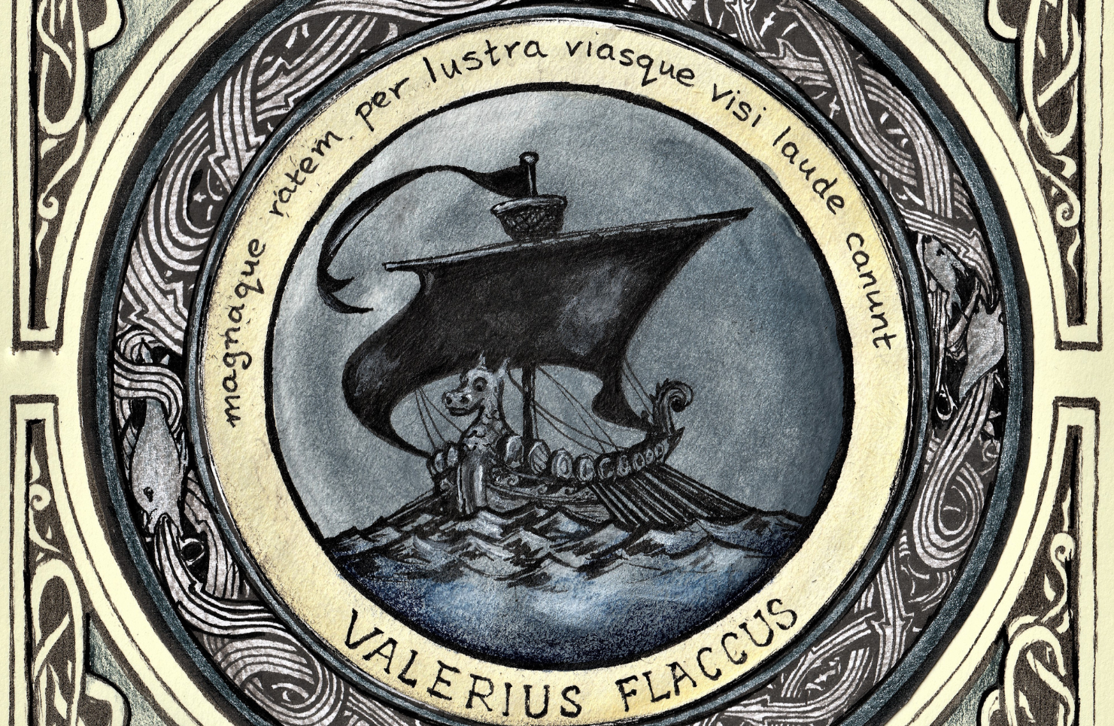
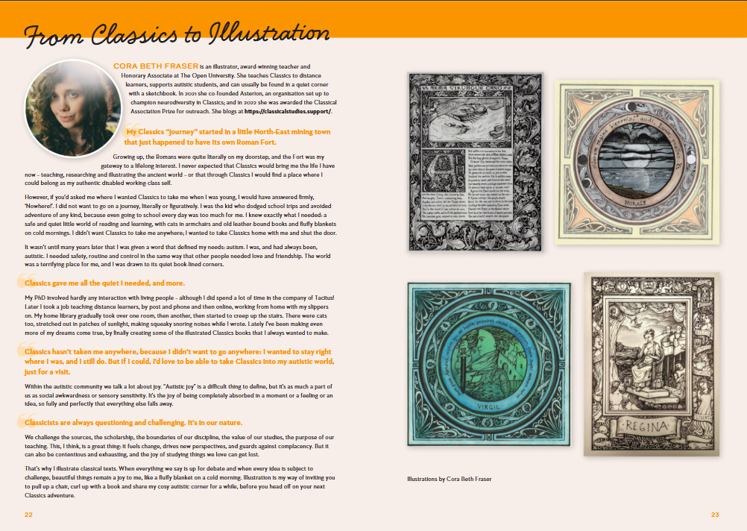
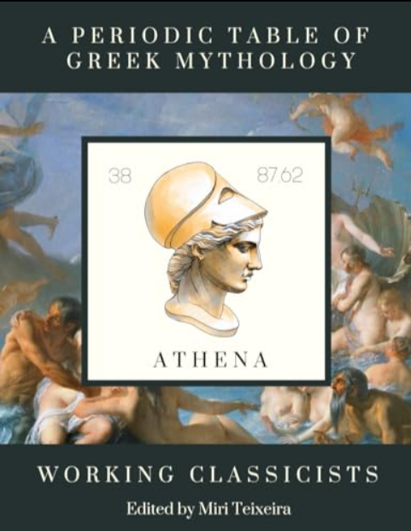
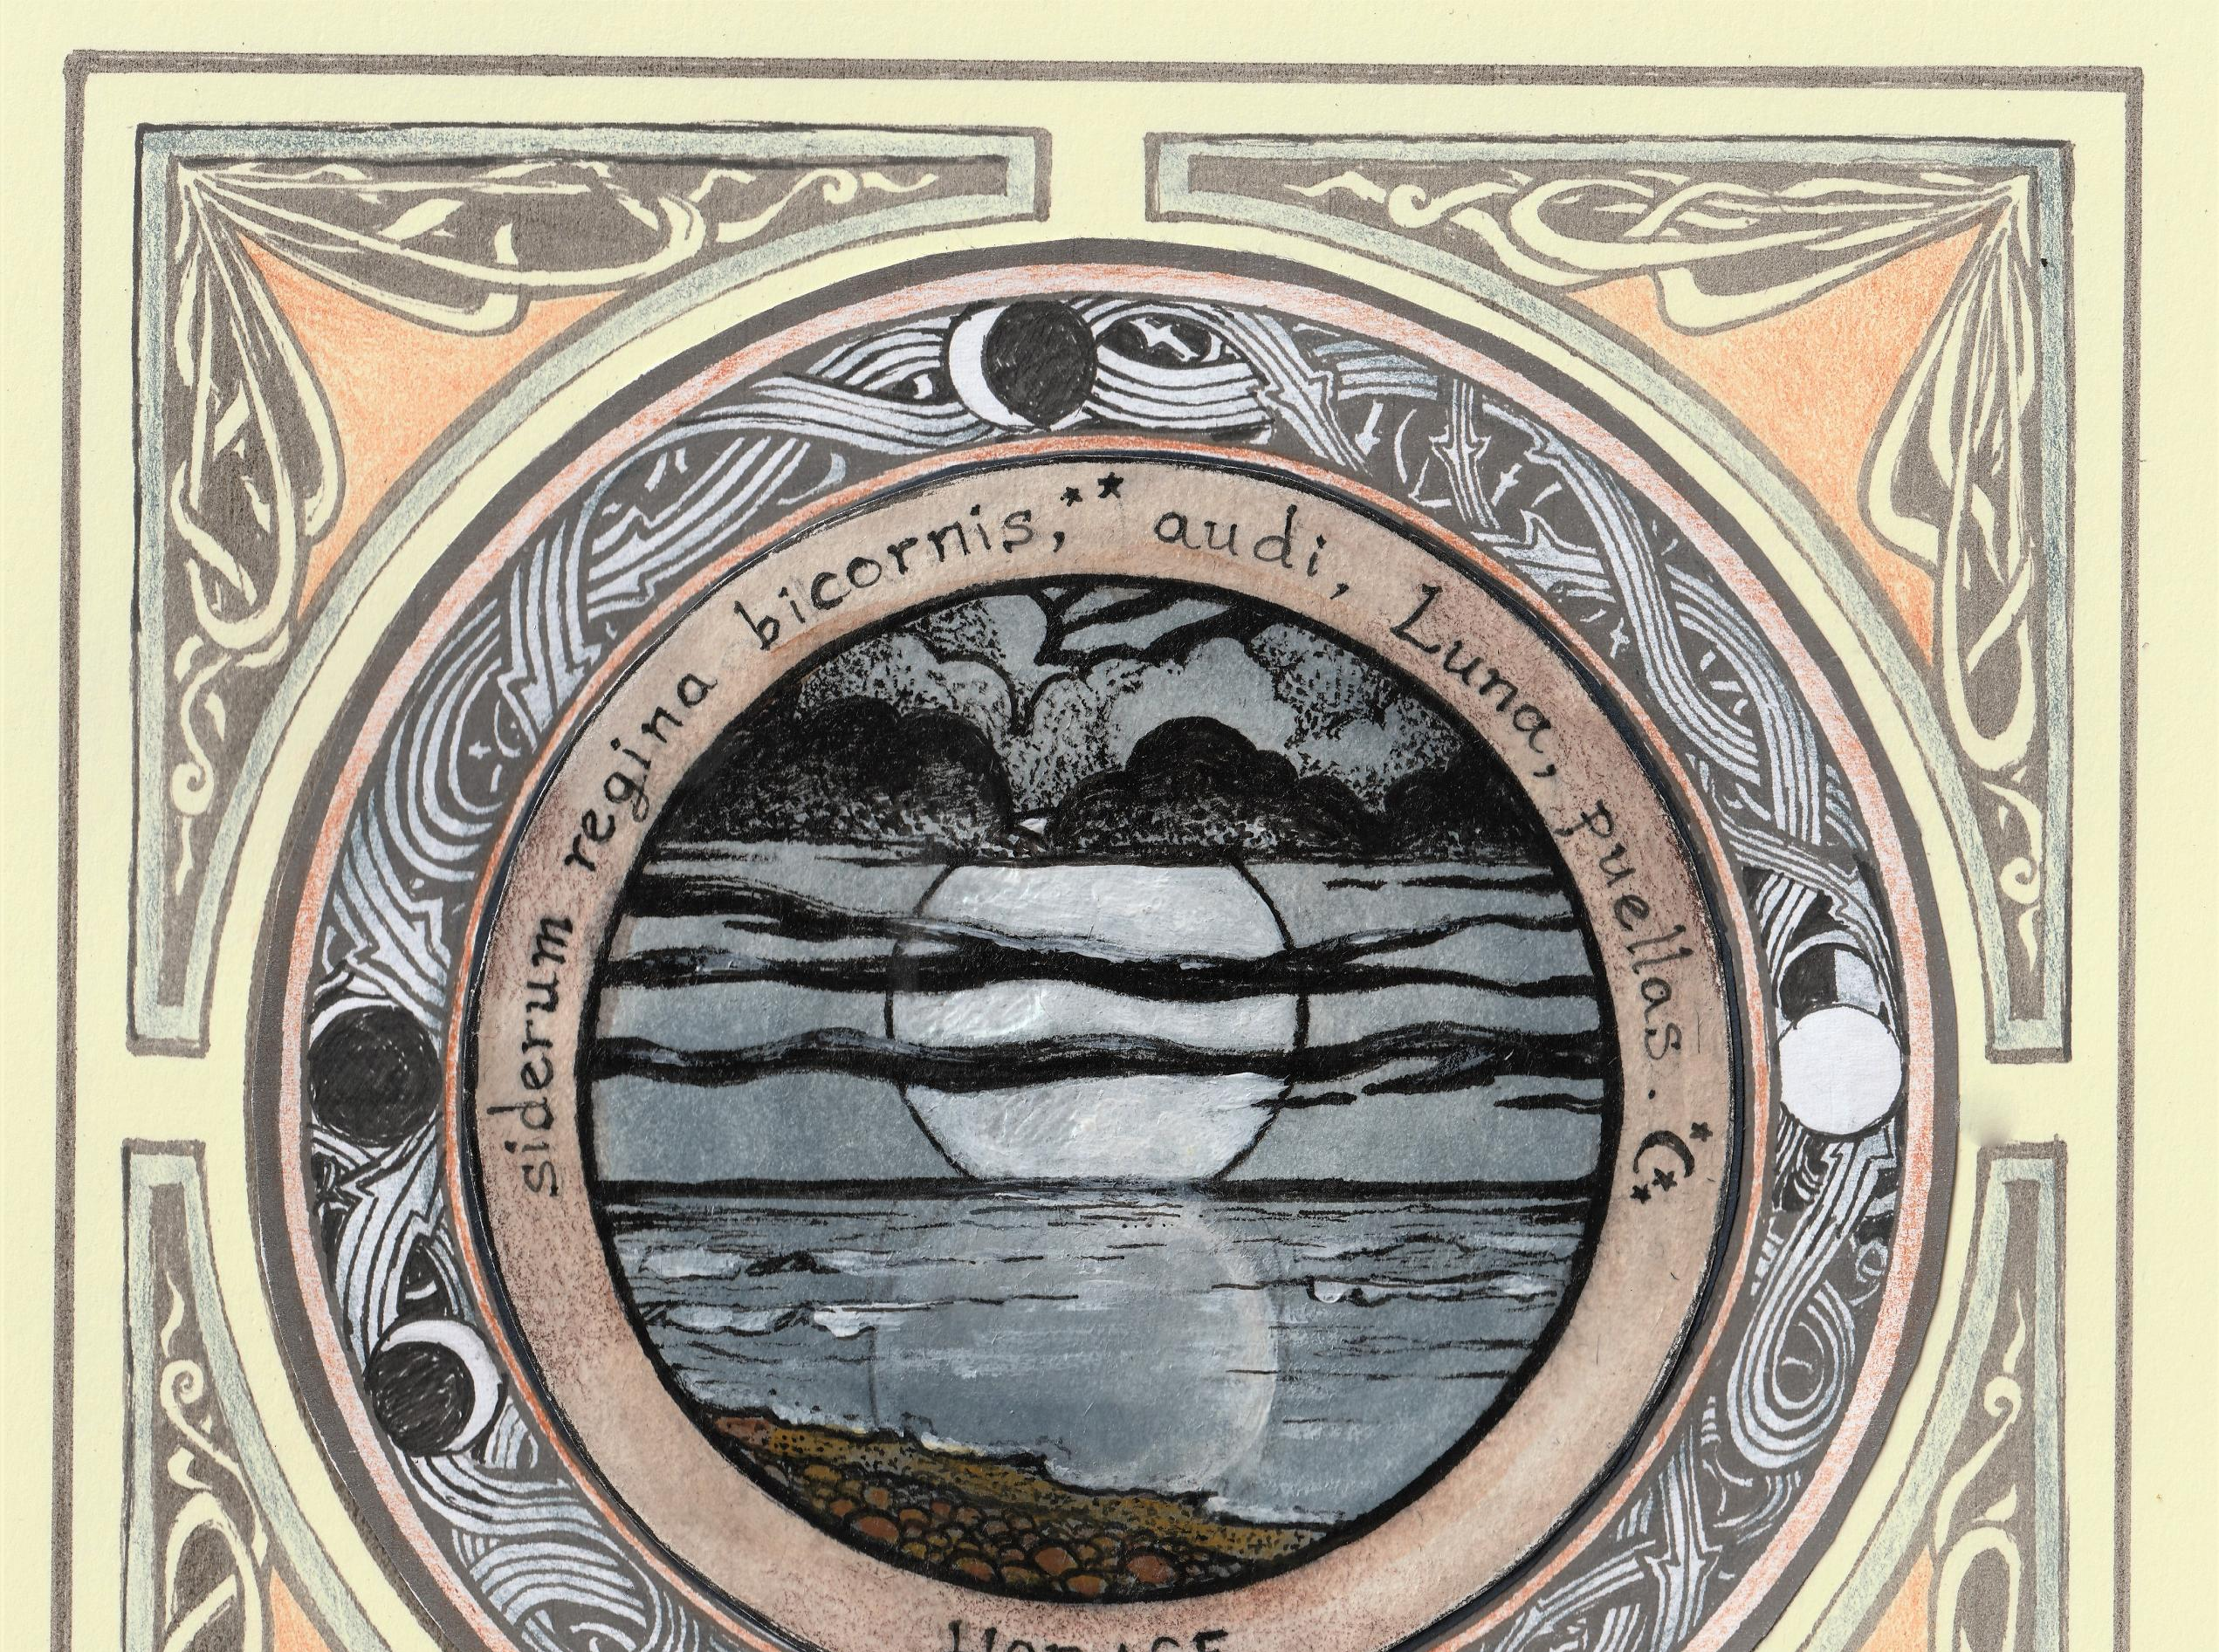
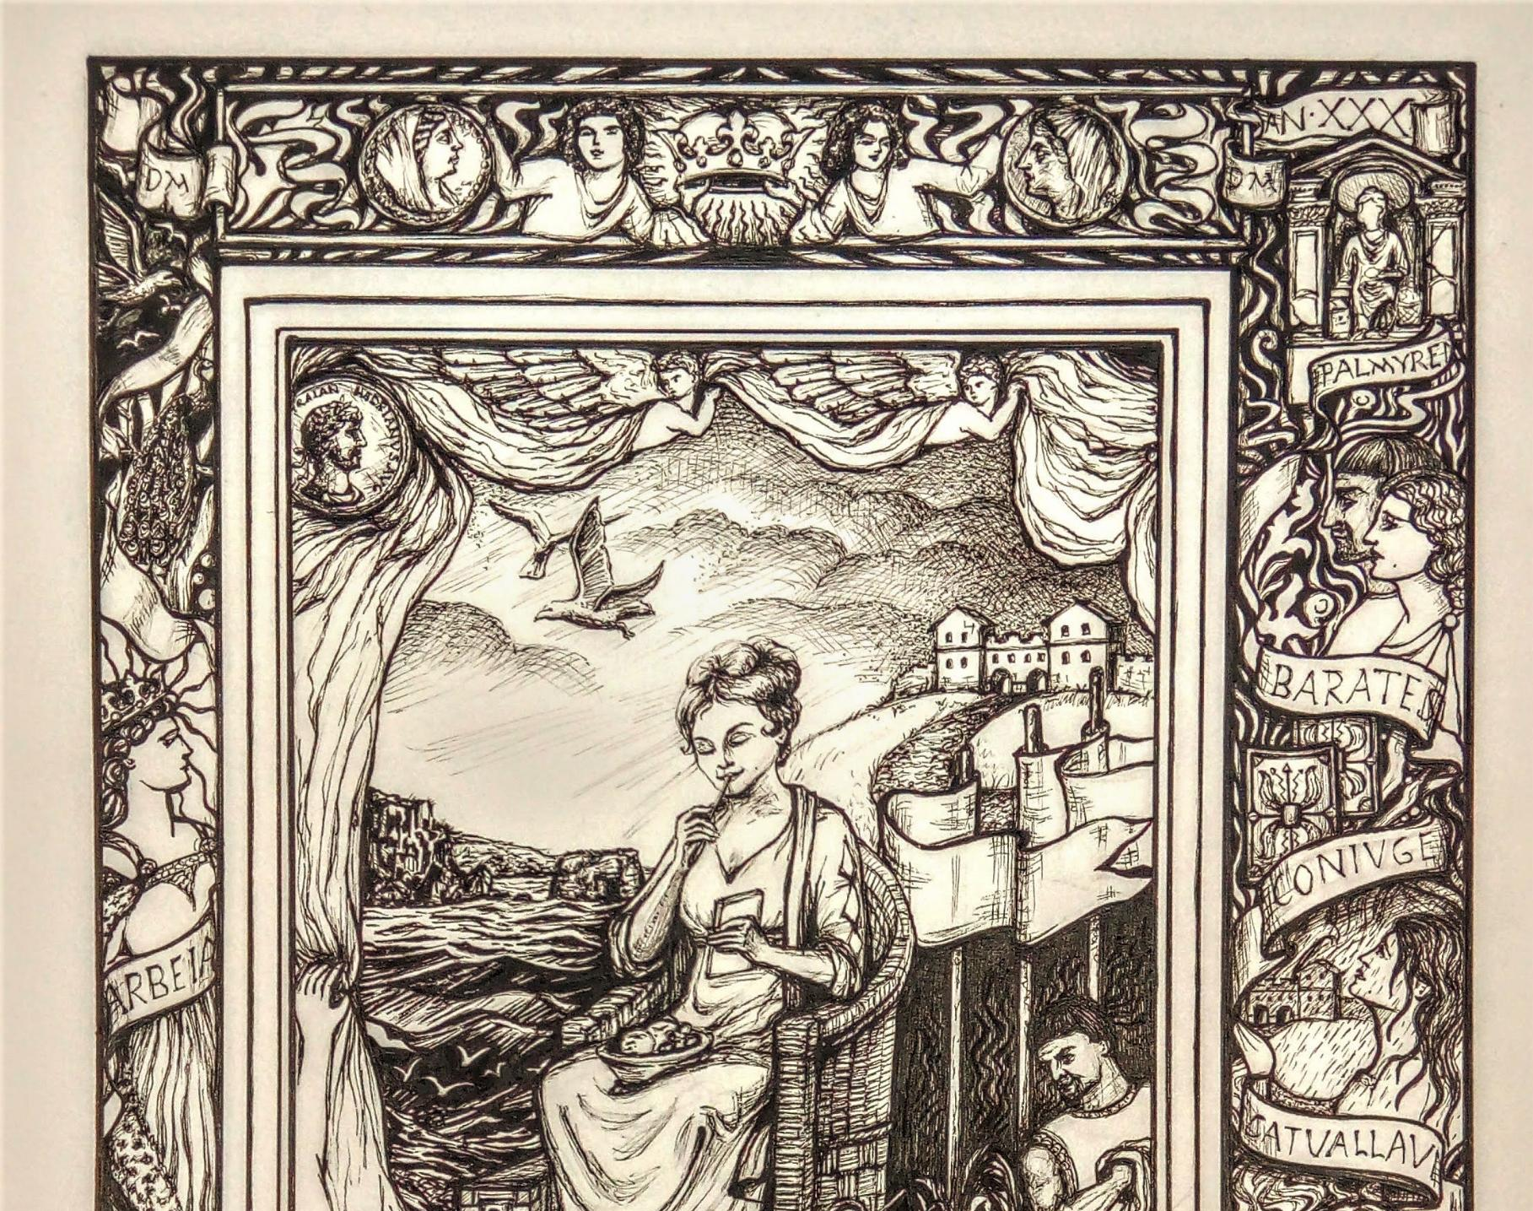
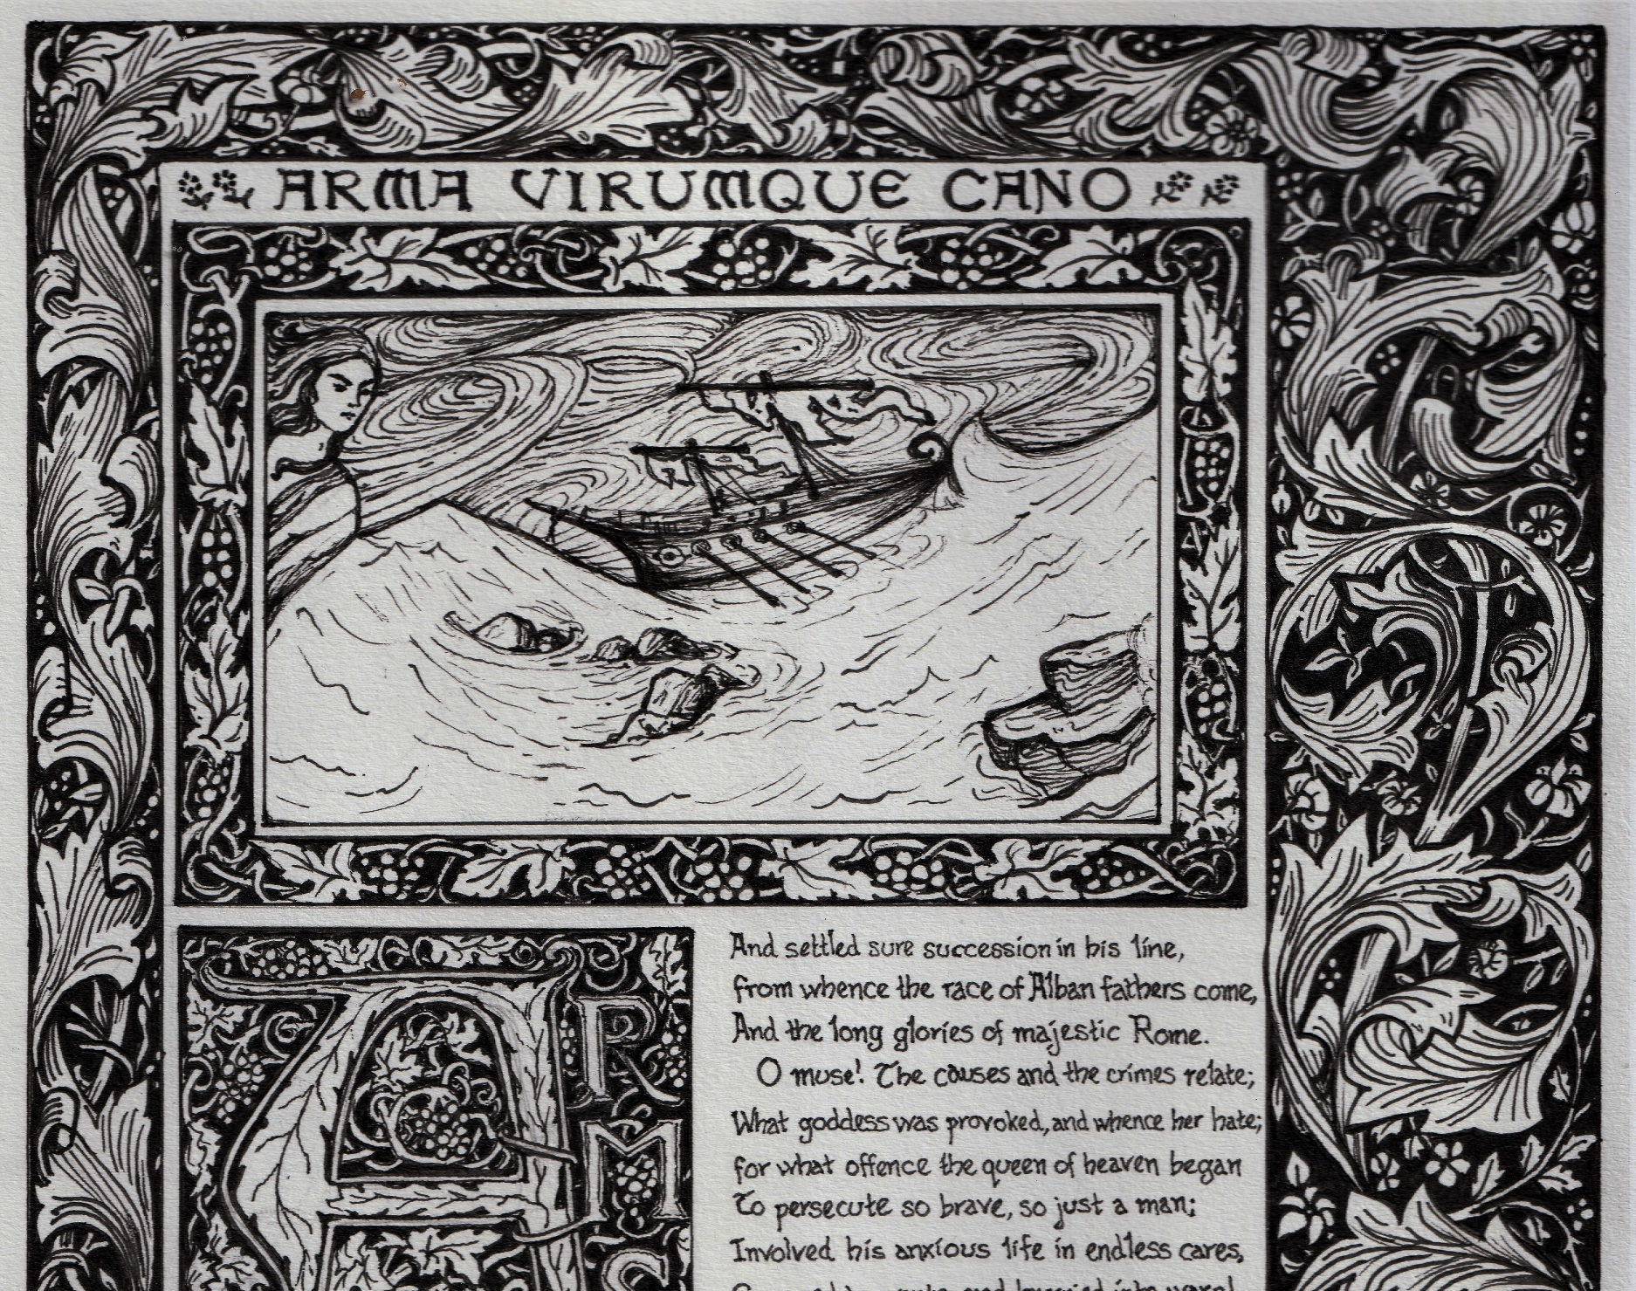

Slide 4
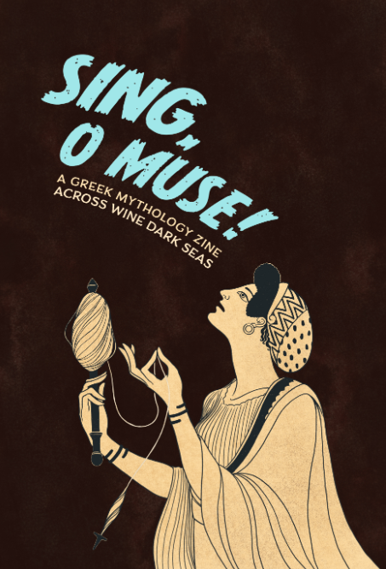
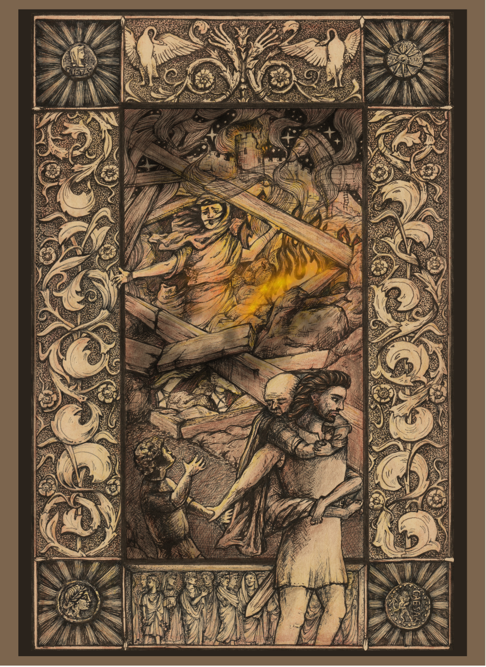
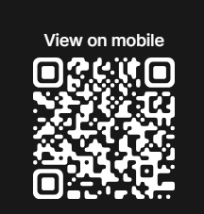

Slide 5
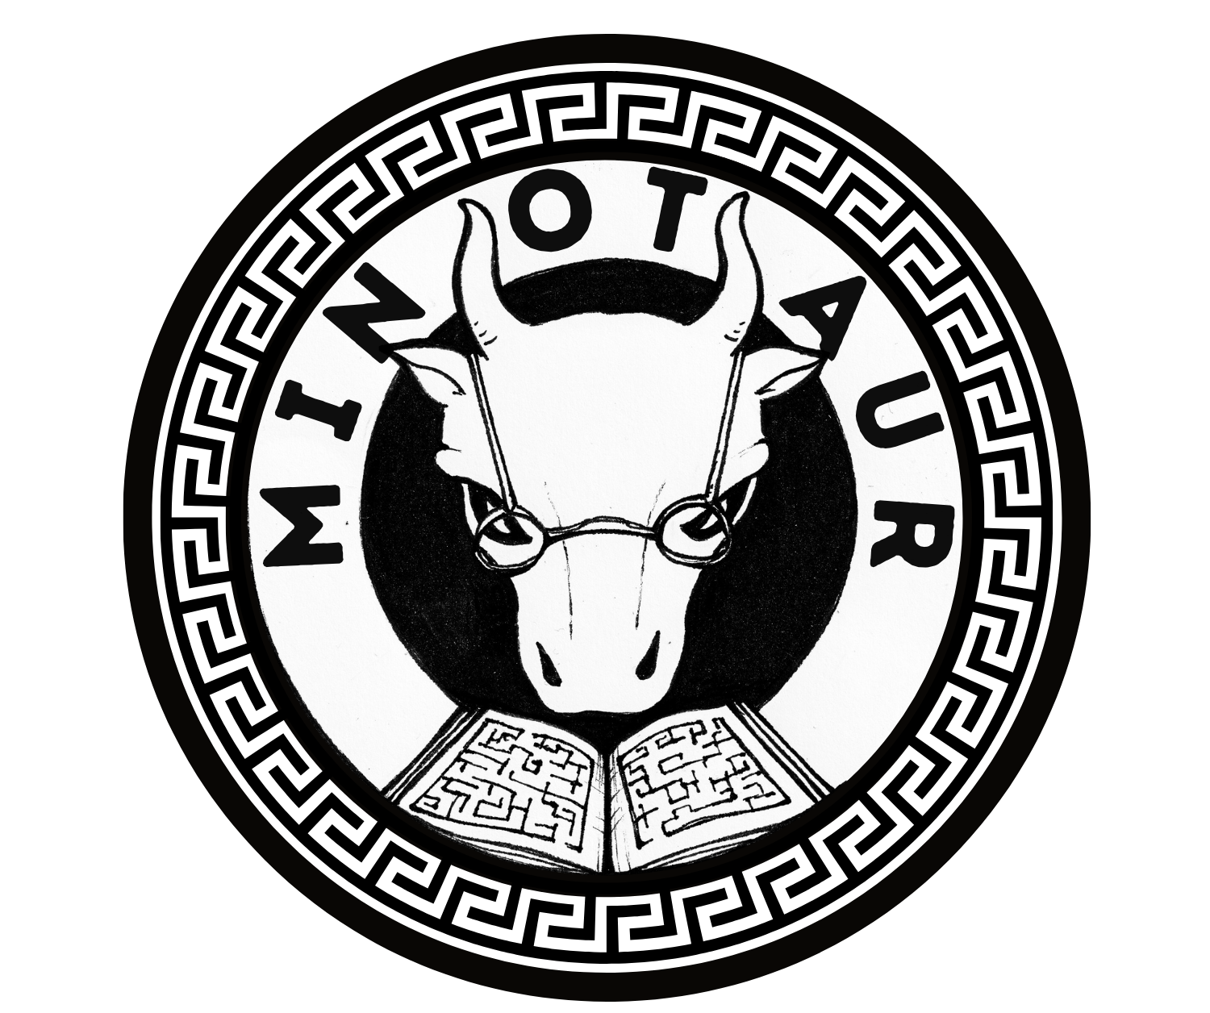


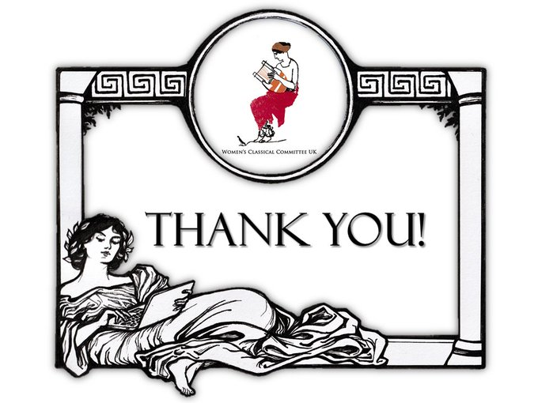
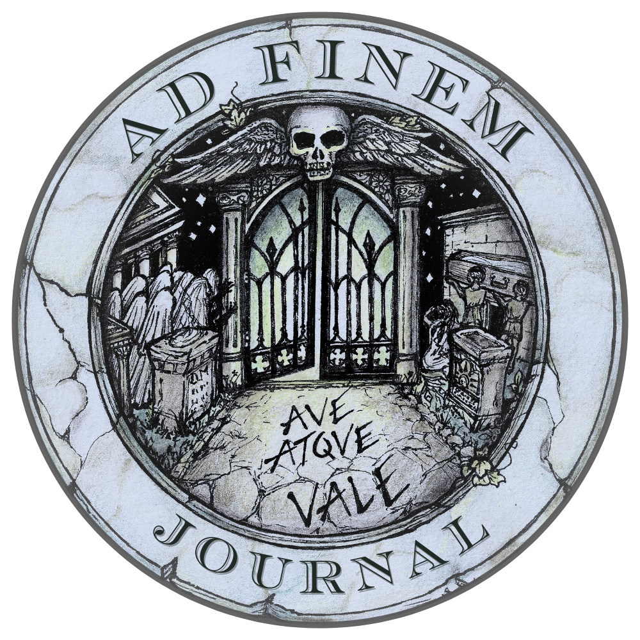
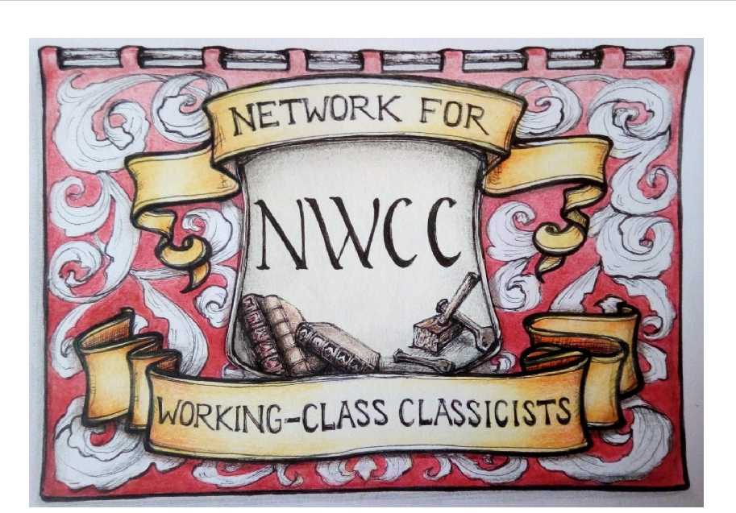

Slide 6

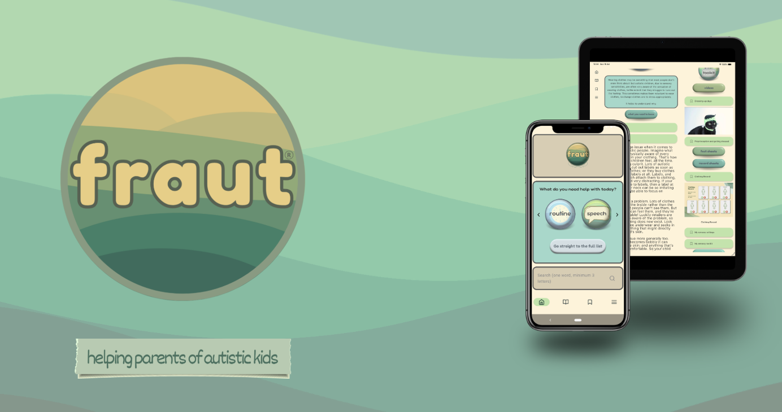

Slide 7
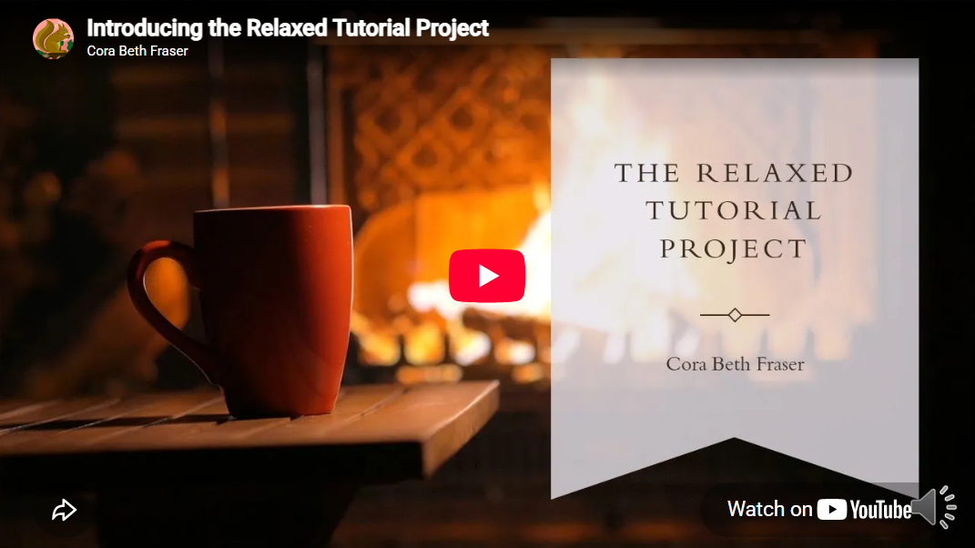
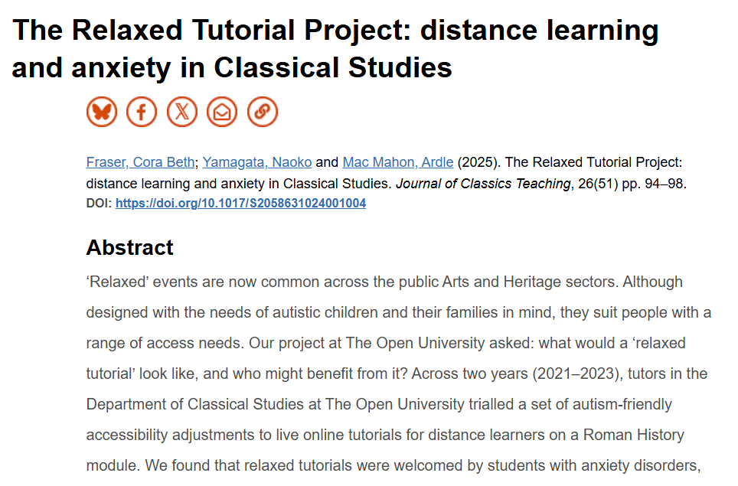
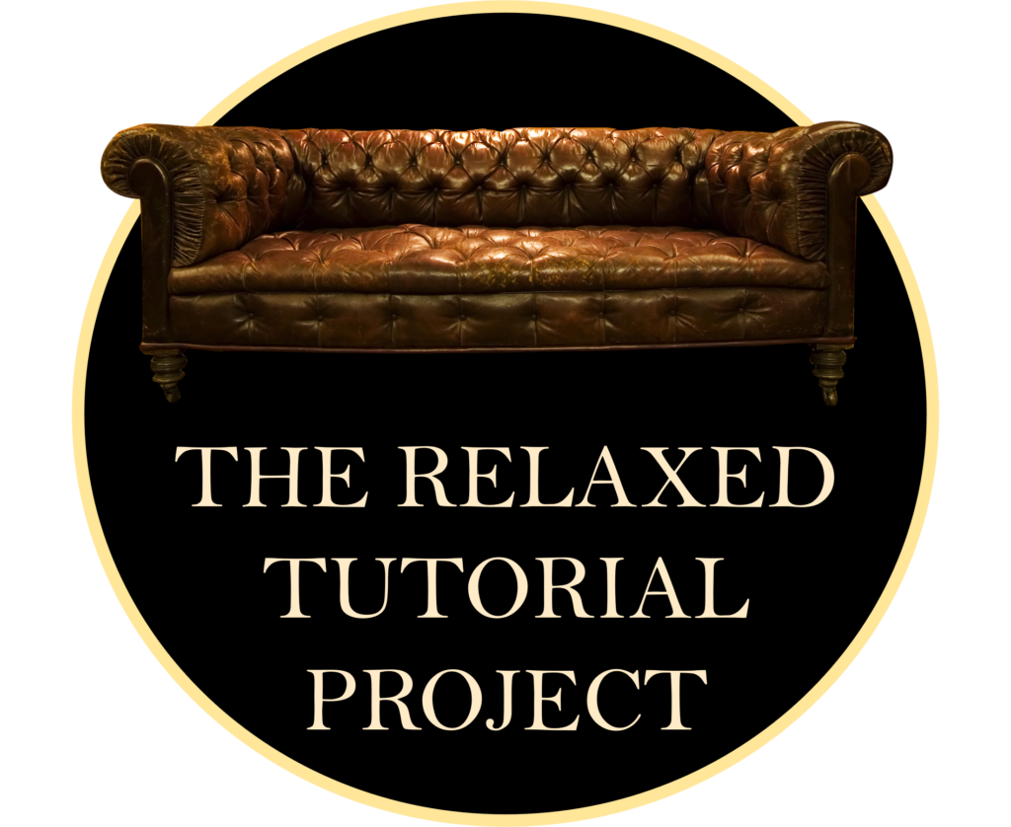
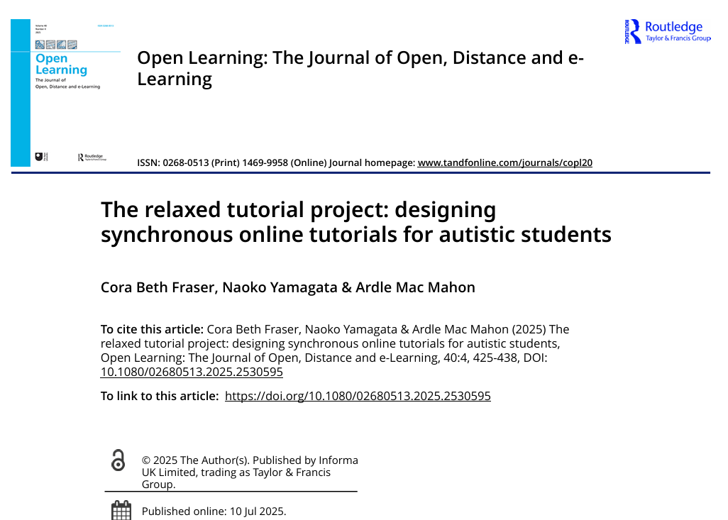
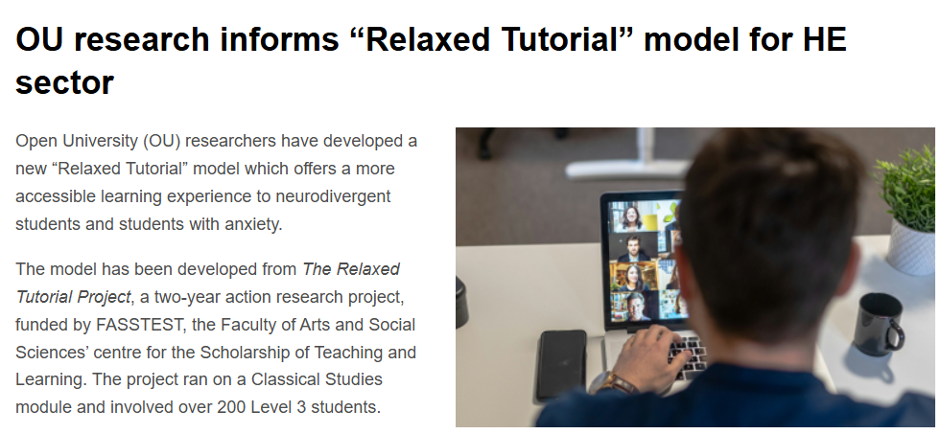

Slide 8
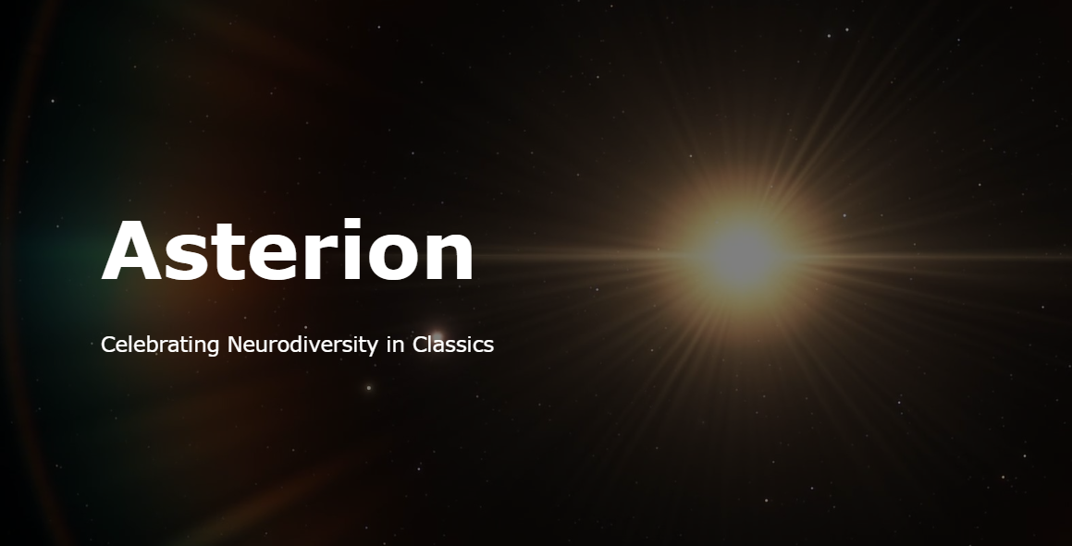
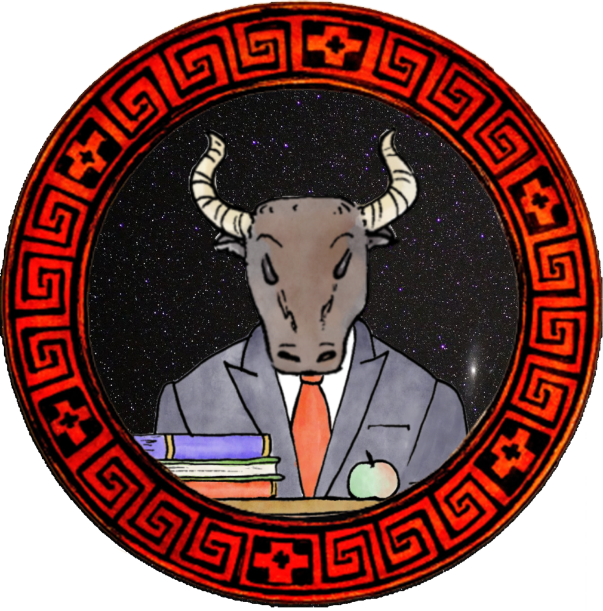

Slide 9

Three names
Monster
Minotaur
Autism
What is their function, and how dangerous are they?

Slide 10
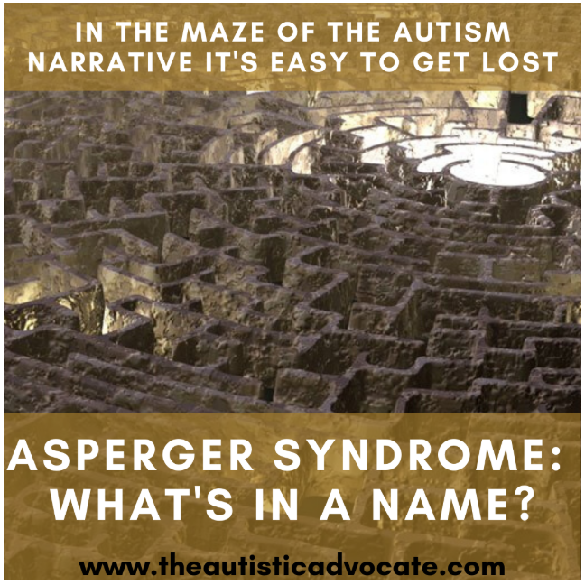
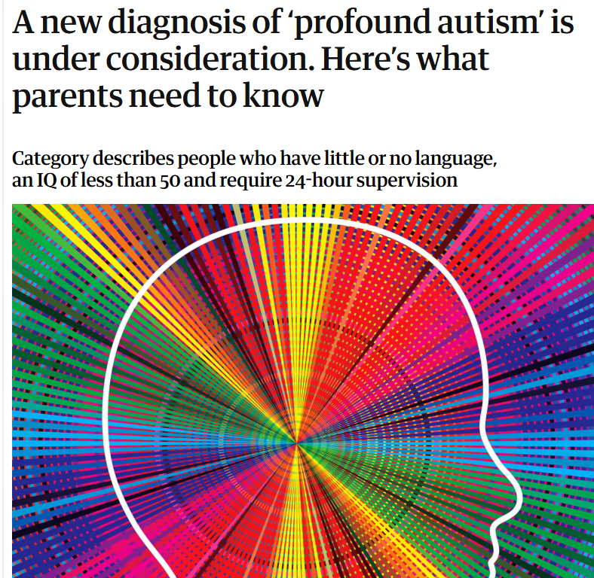
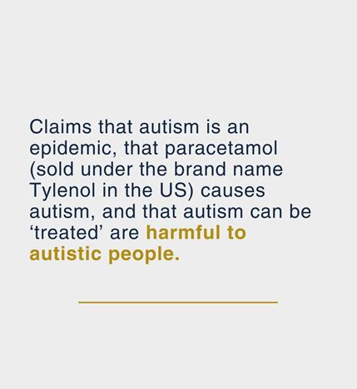

The Danger of Names

Slide 11
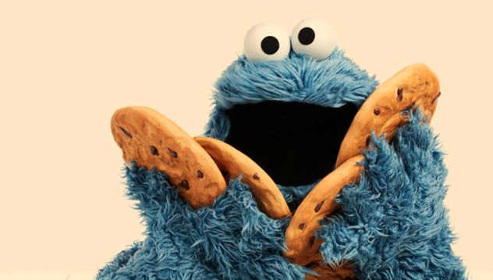
Monsters and Monster-names

Slide 12

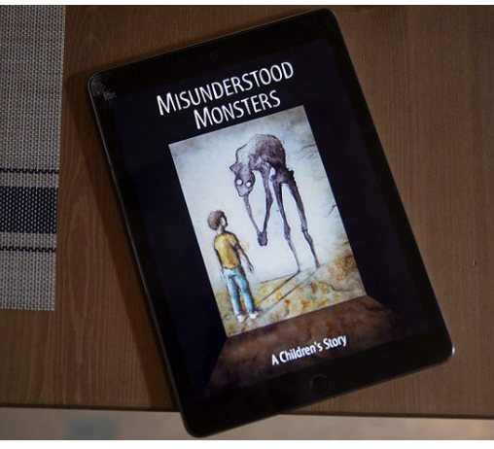
Monsters exist in stories,
and monsters are created by stories.

Slide 13
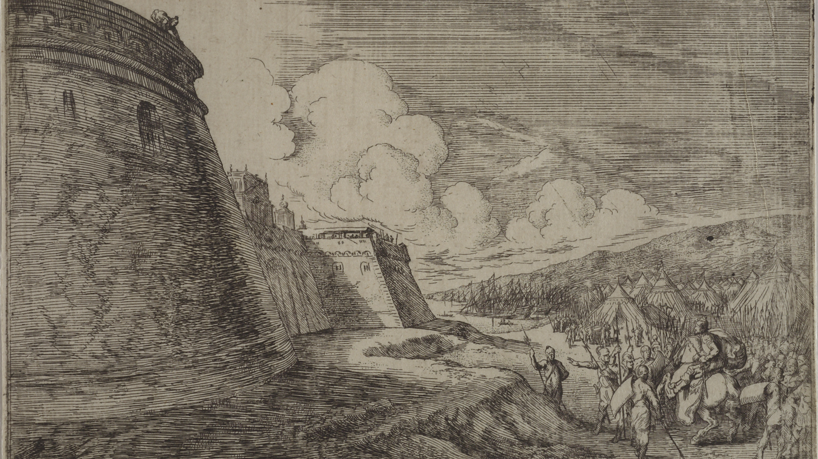
Ovid, Metamorphoses Book 8 lines 97-100
Minos Makes a Monster
“Di te summoveant, o nostri infamia saecli,
orbe suo, tellusque tibi pontusque negetur.
Certe ego non patiar Iovis incunabula, Creten,
qui meus est orbis, tantum contingere monstrum.”
“May the gods banish you, O abomination of our time,
from their world, and may earth and sea be denied to you!
Certainly I cannot allow so great a monster to touch Crete,
The birthplace of Jove, which is my world.”

Slide 14
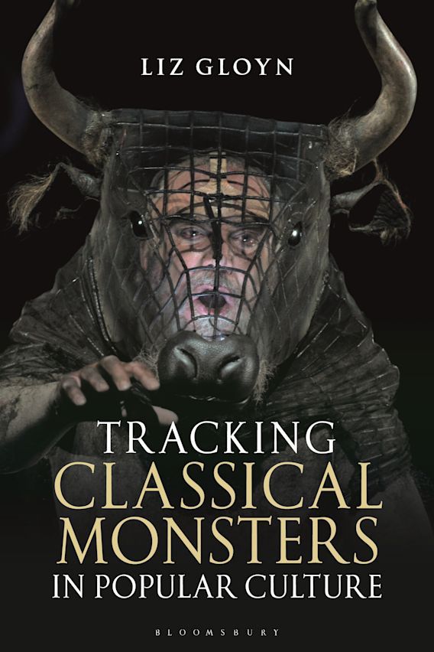
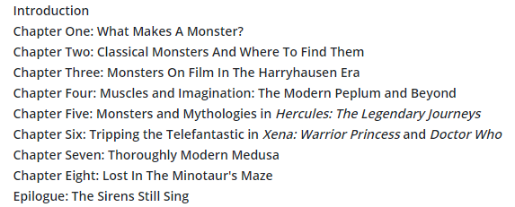

Slide 15
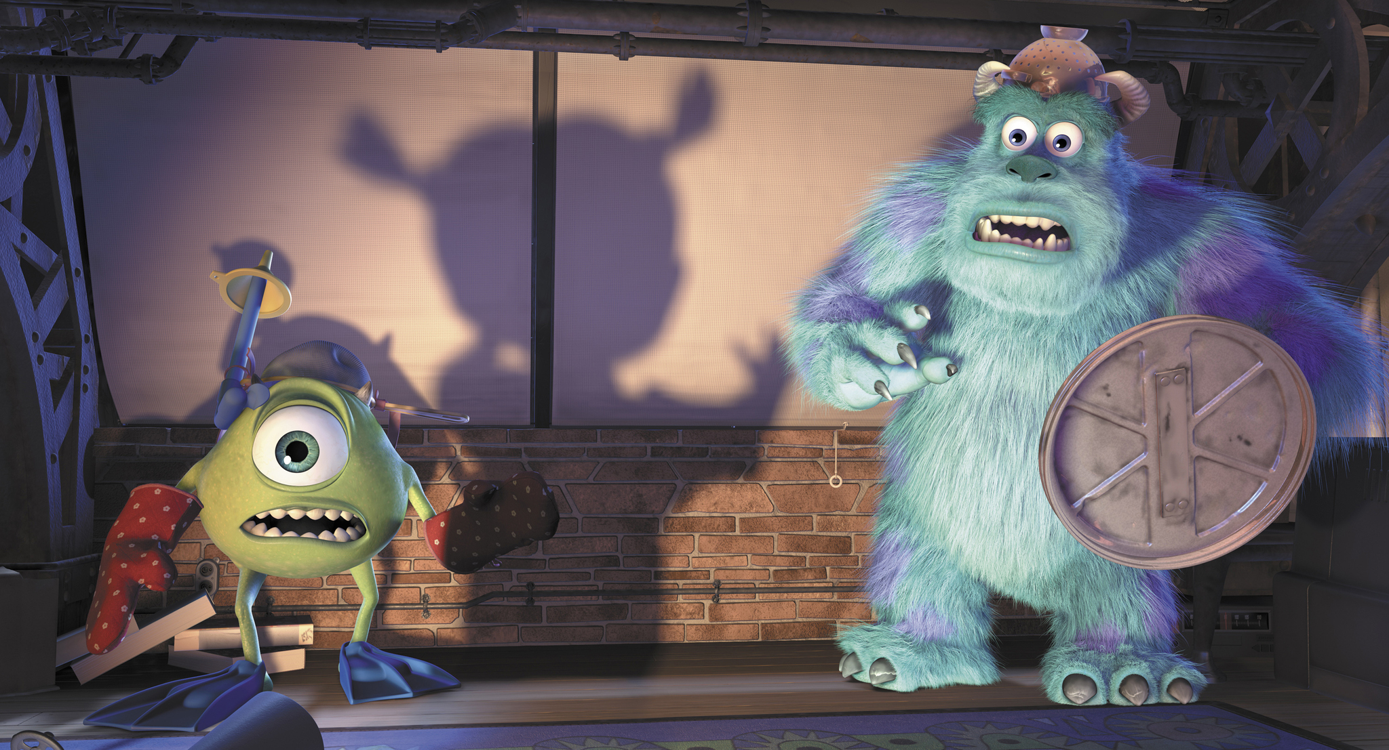
Monsters depend on your perspective

Slide 16
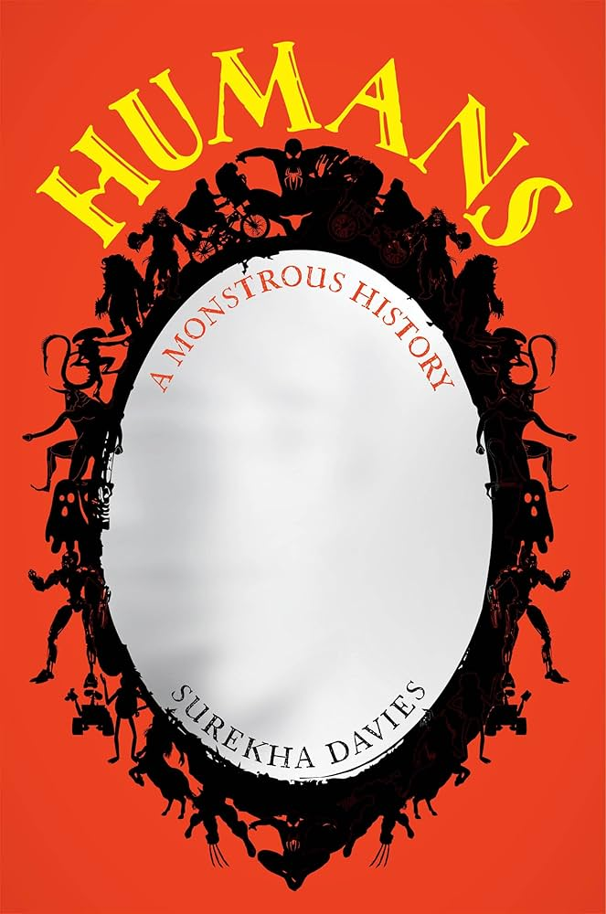
The limits of normal
“Monster” itself can be a term of classification – a brusque, dismissive shorthand for “something I don’t know what to do with”. But monster-making is also the act of making a value judgment, a form of name-calling with great power. Communities identify groups and individuals as monstrous, as transgressing the limits of normal bodies, beliefs, or behavior, to give their abstract fears and ideas a physical form and a potential solution. Assumptions about norms and monsters lie at the heart of how societies define and classify people.

Slide 17
Danny Dunn (2022), ‘Accepting the Monsters’, Autism in Adulthood 4.2
As a graduate student, I have completed 31 psychology courses thus far. I sit in a classroom, and I learn about human psychology. I learn that this practice of delineating humanity in exclusion is a foundational feature of how human minds heuristically process information. I also learn evermore lines that stand between myself and humanity.
‘‘We can all recognize these six basic facial expressions.’’
‘‘Adult humans cannot differentiate phonemes that do not exist in their native language.’’
‘‘Human beings are constantly processing huge amounts of information about the social world around them, and incorporating that into their behavior.’’
I sit in the classroom, a monster learning about human psychology. In the moments after another line is drawn, I wonder what put me on the side of monsters this time. Sometimes the cause is obvious. I do not recognize those facial expressions because I am autistic. Sometimes I wonder without resolution, as I cannot figure out why my ears can differentiate non-native phonemes. Regardless of the source, the result is the same. I am once more reminded that I am not a human being.

Slide 18
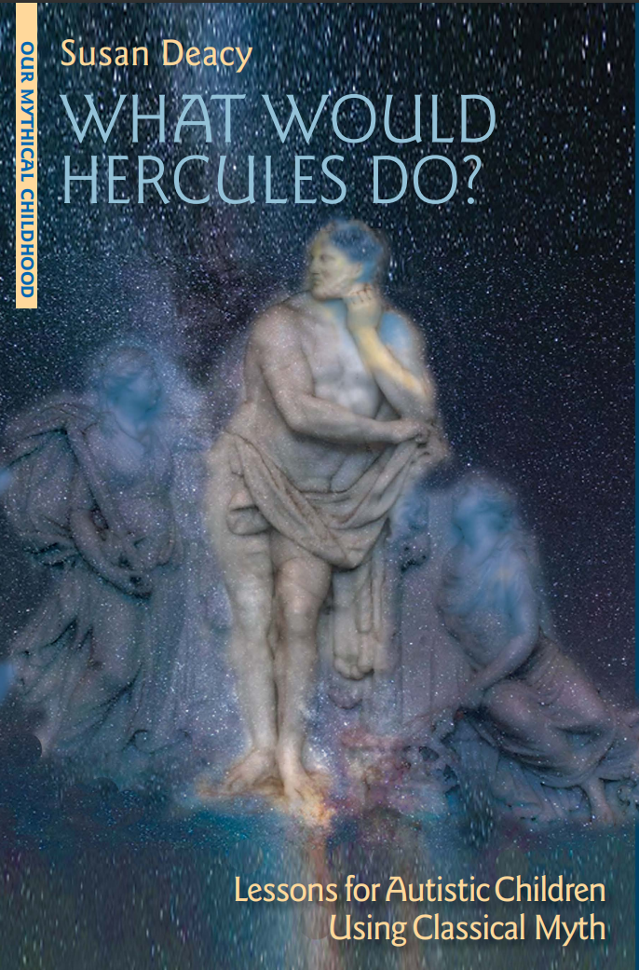
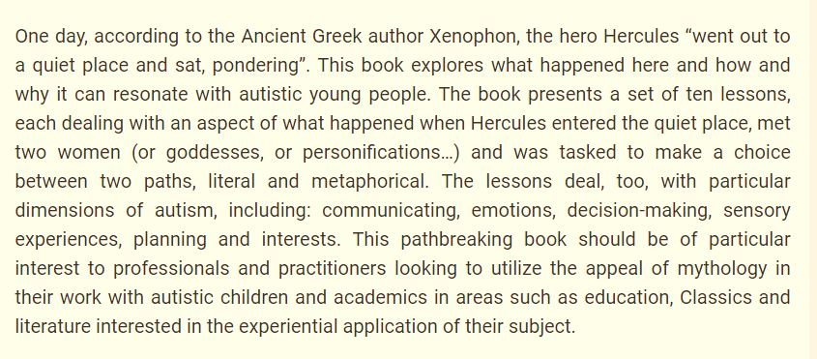
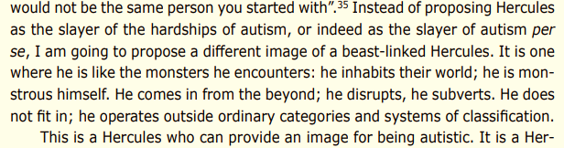

Slide 19
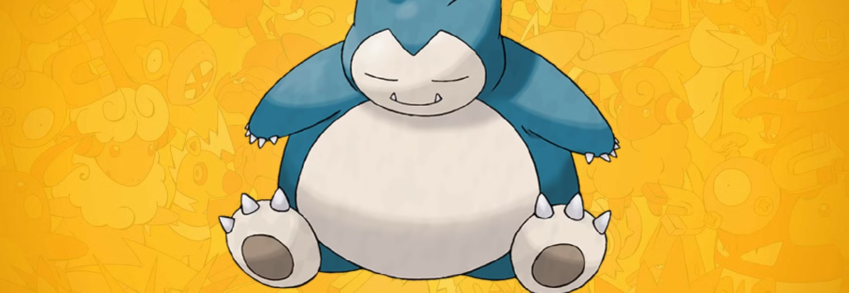
Is ‘monster’ still a social category even if we take the name away?

Slide 20
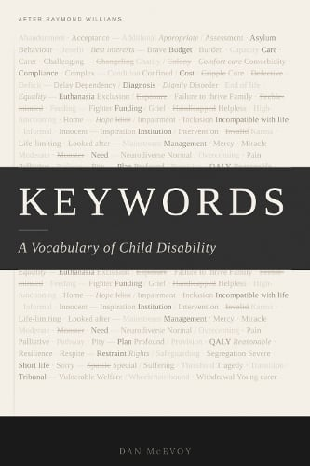
The words are not innocent. They never were.

Slide 21
“When a newspaper profiles a child as ‘inspirational’, the child’s body is being read for a meaning - courage, resilience, the power of the human spirit - that serves the reader’s needs. When a charity poster uses a photograph of a disabled child to solicit donations, the child is displayed: a monstrum shown to the public not to warn of divine anger but to demonstrate the scale of the problem and the necessity of the response.”
KEYWORD: MONSTER

Slide 22
The word monster names the oldest framework we have for looking at disabled children, and the hardest to dismantle, because it does not require anyone to use the word itself. Its structure is so deep in the culture that it operates without vocabulary. The child is shown. The child is read. The meaning is extracted. The child remains.
Dan McEvoy

Slide 23
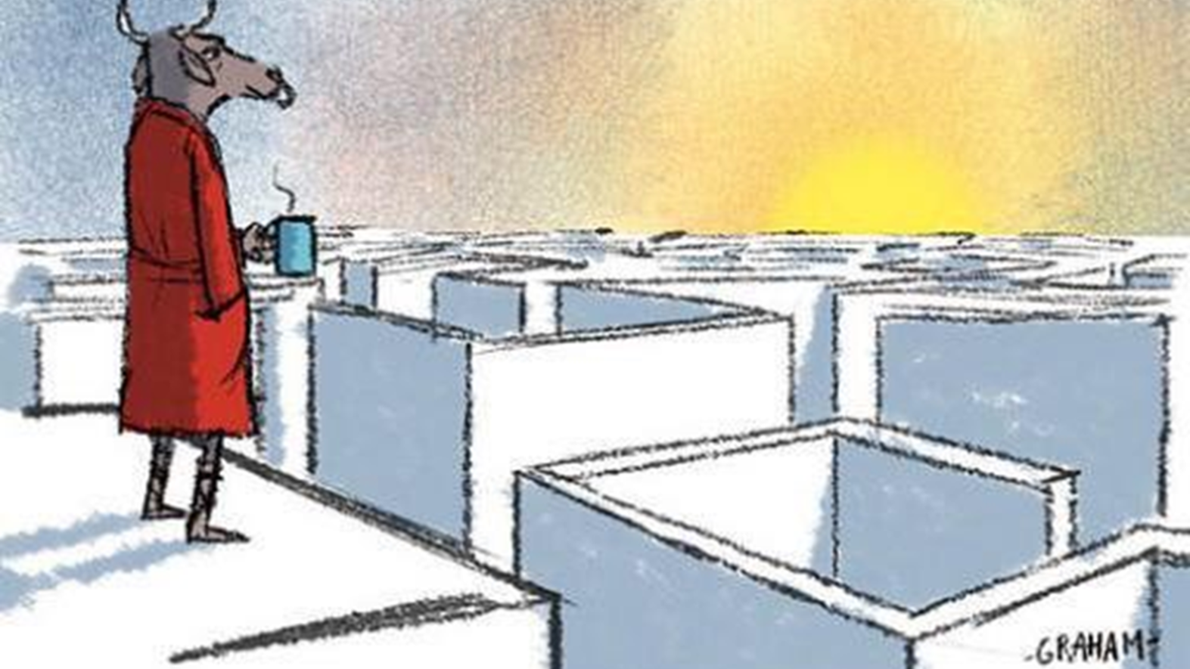
Seeing the invisible framework
Let’s look at an example…

Slide 24
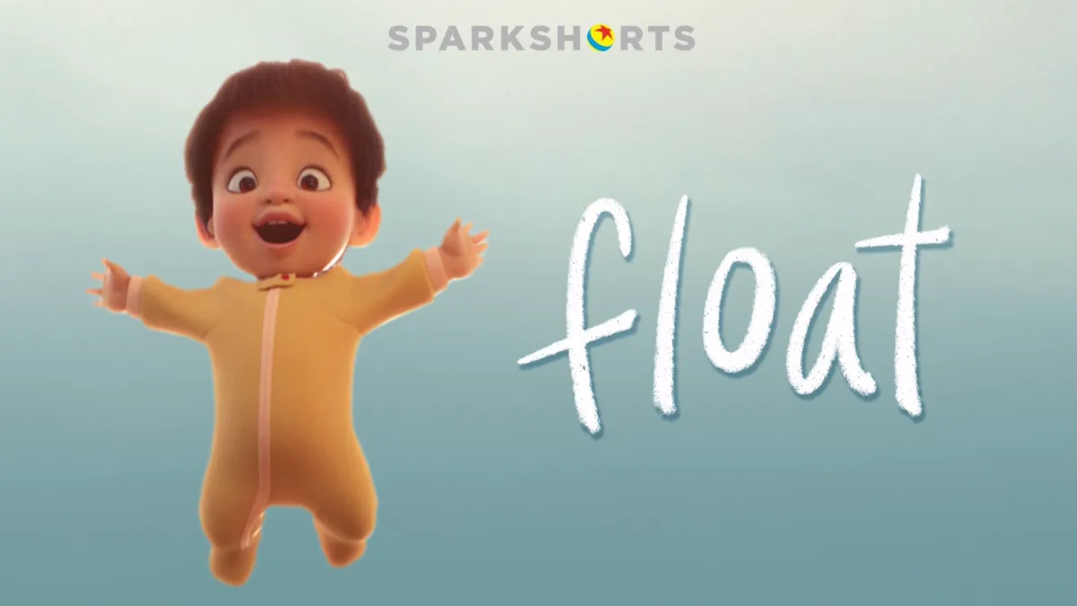

Slide 25
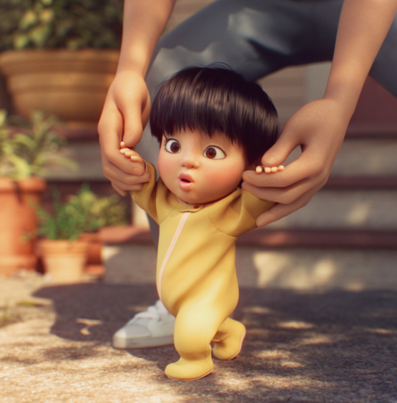
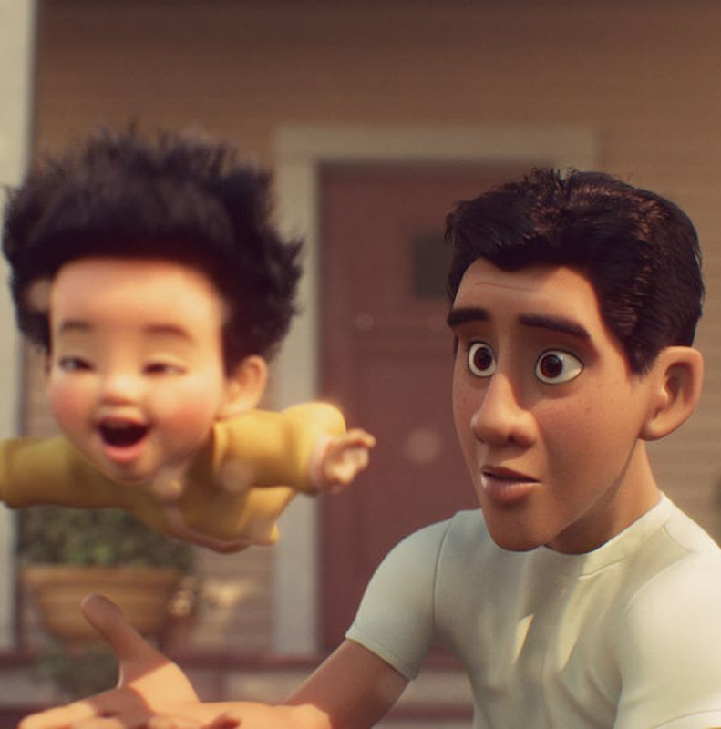

Slide 26
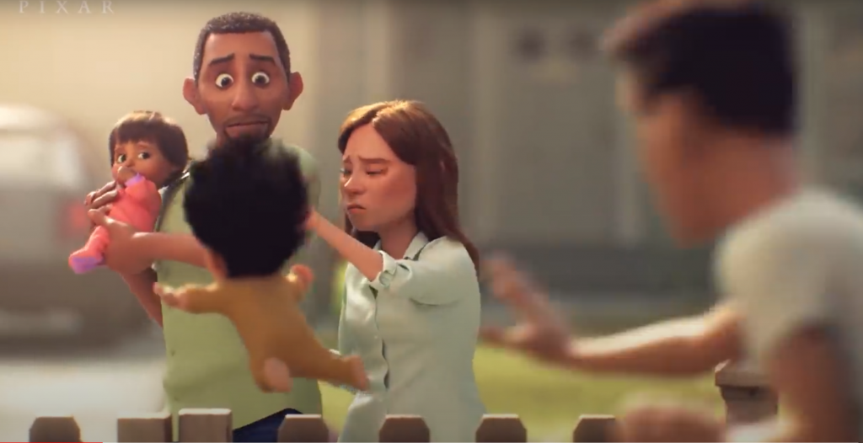

Slide 27
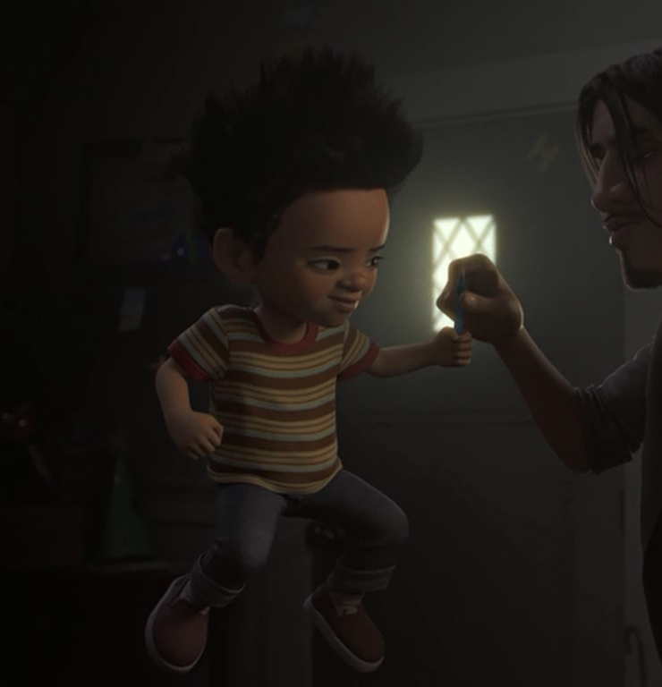
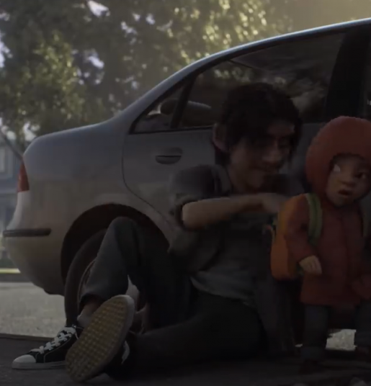

Slide 28
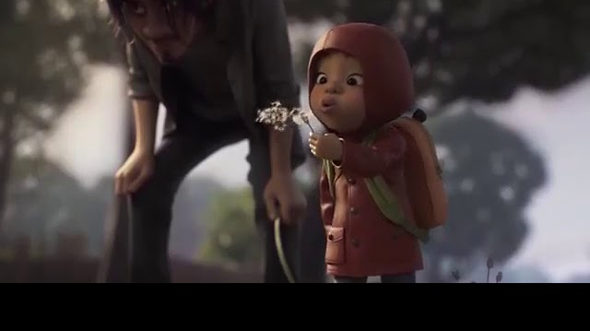

Slide 29
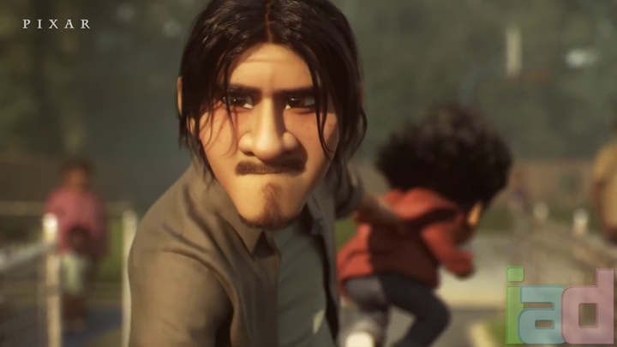

Slide 30
“Why can’t you just be normal?”

Slide 31
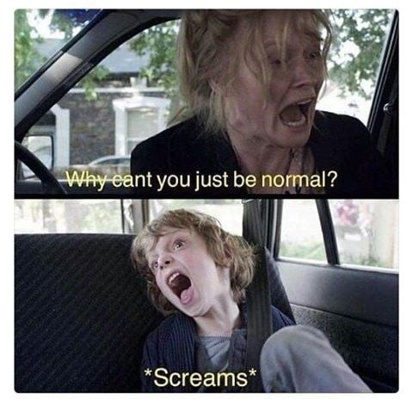
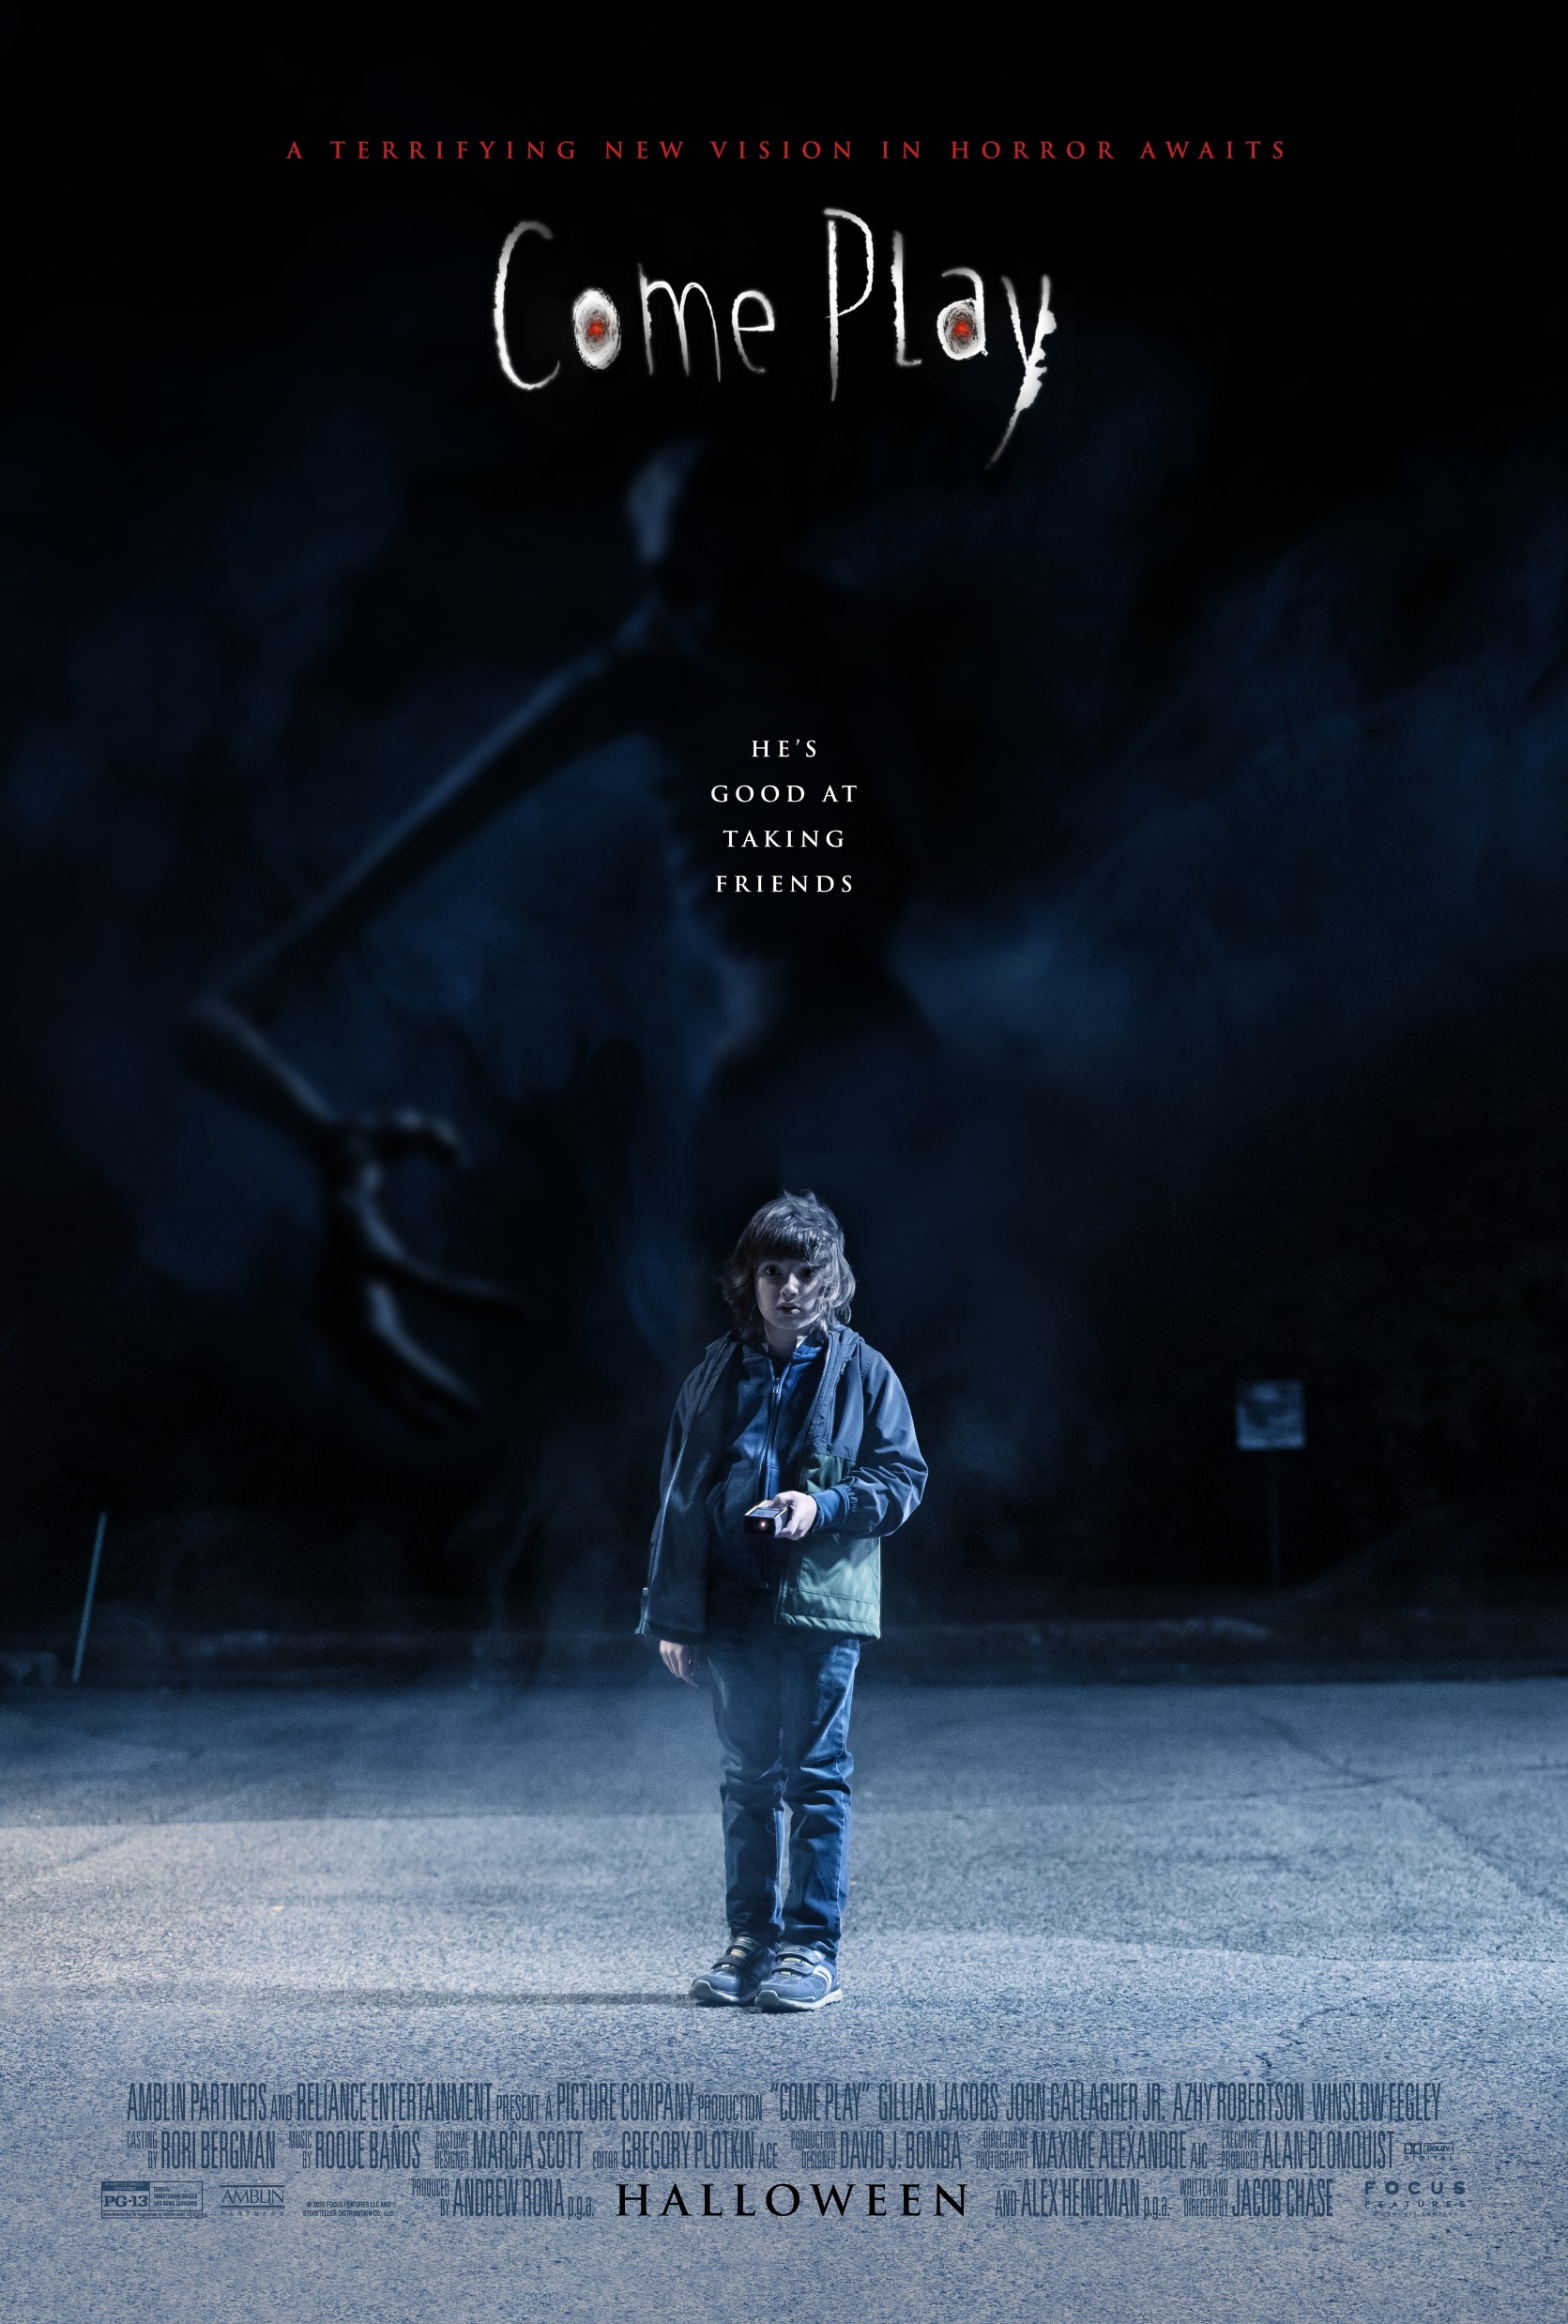

Slide 32
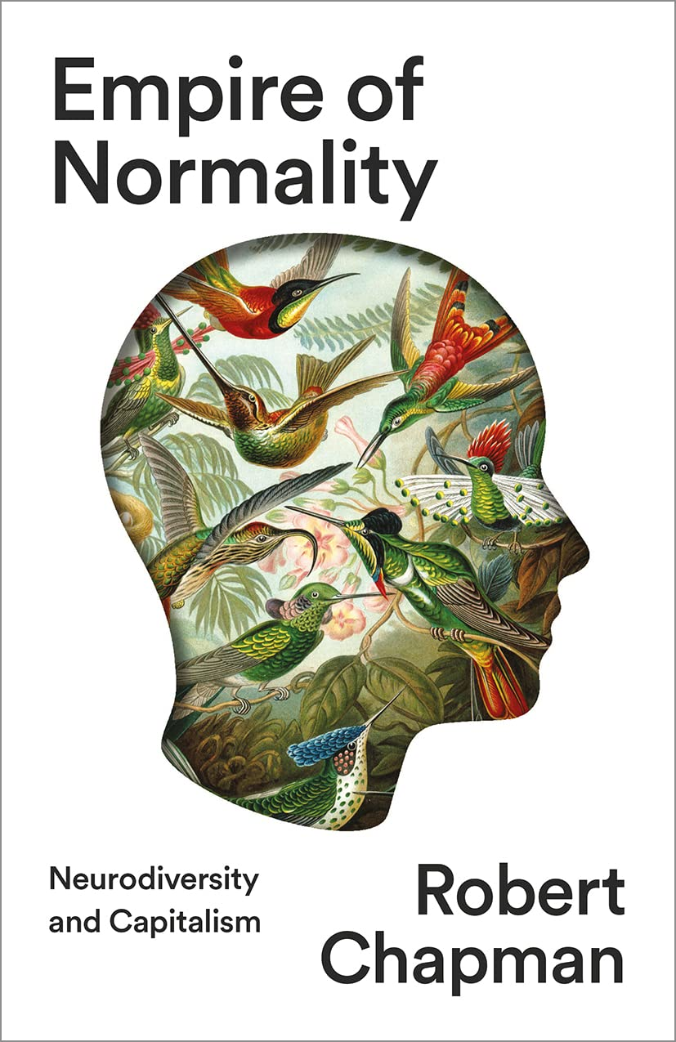



Slide 33


Slide 34


Slide 35

Lessons for a baby monster
It’s safer to be normal.
Parents will lock you away if you’re not normal.
Being unique is bad.
You are a burden to your family.
You are a danger to other children.
You will be stared at, because of your distance from ‘normal’.
People will always ask, ‘Why can’t you just be normal?’

Slide 36

Lessons FLOAT doesn’t teach
Unusual strengths will be celebrated.
People will meet you with interest and curiosity.
Your family will always put you first.
People will like you even if you’re different.

Slide 37

Monster Framework
Shown
Read
Interpreted

Slide 38





Slide 39

Minotaurs and Monster-names

Slide 40

From Legonium.com

Slide 41


Slide 42


Slide 43




Slide 45

A child who becomes a monster
A danger to other people’s children
Given a name reflecting control
Only partly human
Used for profit
Family burden
Unique
Frightening
Non-speaking
Confined in a special prison
Separated from peers
The subject of stories told about him

Slide 46




Slide 47

Minotaur Framework
Shown
Read
Interpreted
Named
Used

Slide 48



Slide 49

‘he will grow into a creature who is half-bull, half-man who sits at the centre of a fantastical underground maze and eats human flesh, and the story will spread far and wide and the people will be terrified and they will love being terrified and your husband will be in possession of a weapon which has cost him no more than two holes in the ground’

Slide 50

But what happens when the Minotaur talks back?

Slide 51

THE VOICE OF THE MINOTAUR
The defendant has the floor.
Silence.
Does the defendant have anything to say in his own defense, or does he prefer to remain silent?
The Minotaur’s voice has not been preserved anywhere in all of recorded antiquity. He doesn’t speak, others speak for him. There where everything animate and inanimate refuses to shut up, where the voices of gods and mere mortals, of wood nymphs and heroes, of crafty Odysseuses and naïve Cyclops are constantly swarming, where even the despised Centaurs have the right to speak, only one remains silent. The Minotaur. No voice, no sound, no whimper or threat, nothing anywhere.
The Physics of Sorrow, Georgi Gospodinov

Slide 52



Slide 53

The House of Asterion
Besides, one afternoon I did step into the street; if I returned before night, I did so because of the fear that the faces of the common people inspired in me, faces as discolored and flat as the palm of one's hand. The sun had already set, but the helpless crying of a child and the rude supplications of the faithful told me I had been recognized. The people prayed, fled, prostrated themselves; some climbed onto the stylobate of the Temple of the Axes, others gathered stones. One of them, I believe, hid himself beneath the sea. Not for nothing was my mother a queen; I cannot be confused with the populace, though my modesty might so desire. The fact is that that I am unique.

Slide 54
Charlotte Amelia Poe (2024), Conversations with Monsters: On mortality, creativity, and neurodivergent survival, Jessica Kingsley Publishers.
I think a lot about monsters, about how they are shaped, how they growl with sharp tooth and claw, and how they are feared rather than afraid. It is difficult to love a monster, and as I look in the mirror, my faceblindness offering me newness at every glance, I see a certain kind of monster, and I wonder who first applied the label, and when it started to fit so well. Was it the children who yelled slurs across the playground, was it the adults who misconstrued and misunderstood until I started to twist and change and my eyes flashed and became slightly more inhuman? Does the inhumane make the inhuman? Did my trauma make me into something new, and if so, does that make me evil, or does it make me a survivor? Are all monsters just trying to survive, in their way…?

Slide 55


Slide 56

The Minotaur has escaped

Slide 57



Slide 58

People used to call me a monster, and for a long time I believed them. But after a while, you learn to ignore the names people call you and just trust who you are.

