Slide 1
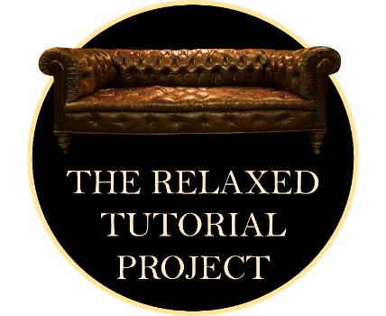
Designing for Autistic Students and the Curb-Cut Effect
Cora Beth Fraser
CoraBeth.Fraser@open.ac.uk

Slide 2

Project Team at The Open University
Cora Beth Fraser
Naoko Yamagata
Ardle Mac Mahon and Trevor Fear
Phase 1: 2021J
Phase 2: 2022J

Slide 3

What does a Relaxed event look like in the theatre or cinema?
Low noise
Moderate lighting
Casual attendance
Safe, sympathetic environment

Slide 4

What might a Relaxed Tutorial look like?
Reduced sensory input
Reduced social participation
Casual attendance
Safe, sympathetic environment

Slide 5

In a Relaxed Tutorial you will:
Not be recorded
Not be expected to use the microphone
Not be asked to switch on your webcam
Not be put on the spot, or called upon by name
Not be put into a break-out room
When you participate in the tutorial you can take part in the chat box discussion, or you can simply watch and listen, and you can leave and rejoin whenever you need to. Slides will be sent to you in advance, if you’ve booked a place, so that you can read through the material.

Slide 6
Project Findings

Slide 7

Student interest
The numbers of students attending these sessions was unusually high (between 30 and 70 students per session) across both years (usual numbers are 10-15).
A large majority of students who attended indicated that they would like to attend more relaxed tutorials.
Participation rates in the chat box were very high – around 90% of attendees contributed.
Enrolments on the module went up by 45% across the two years of the project.
Relaxed tutorials were designed with autistic students in mind, but benefitted many non-autistic students too.

Slide 8
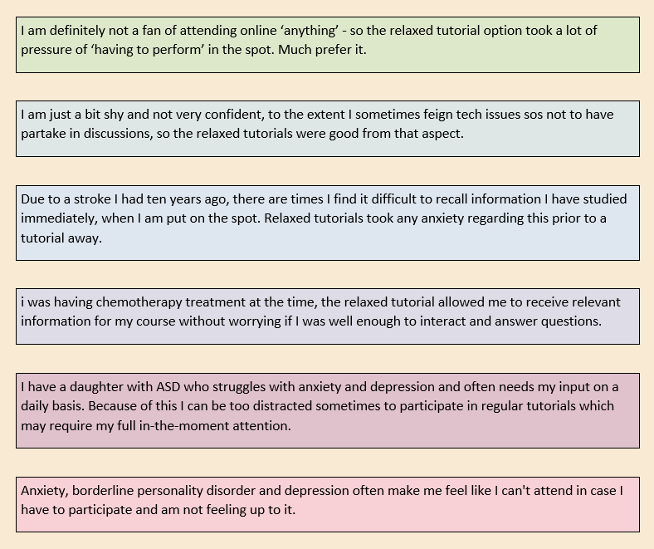
Who benefits?

Slide 9
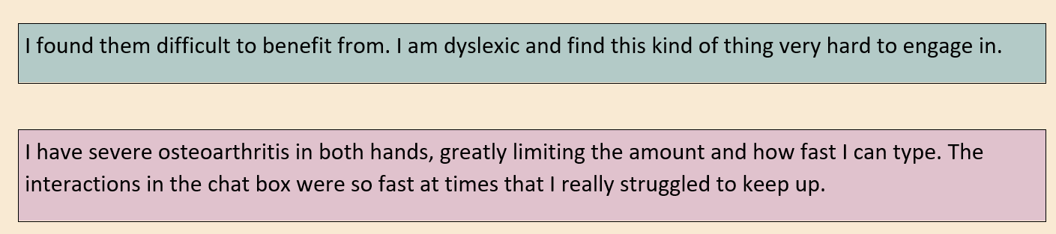
Suitable for all?

Slide 10

In summary…
Relaxed online environments can benefit a lot of students, and are easily achieved.
Advertising relaxed environments can attract students who might otherwise avoid live classes.
Relaxed environments don’t necessarily reduce participation or class discussion.
Relaxed environments which depend on text chat aren’t suitable for everyone, and should be seen as an additional option, not as a replacement for other modes of teaching.

Slide 11
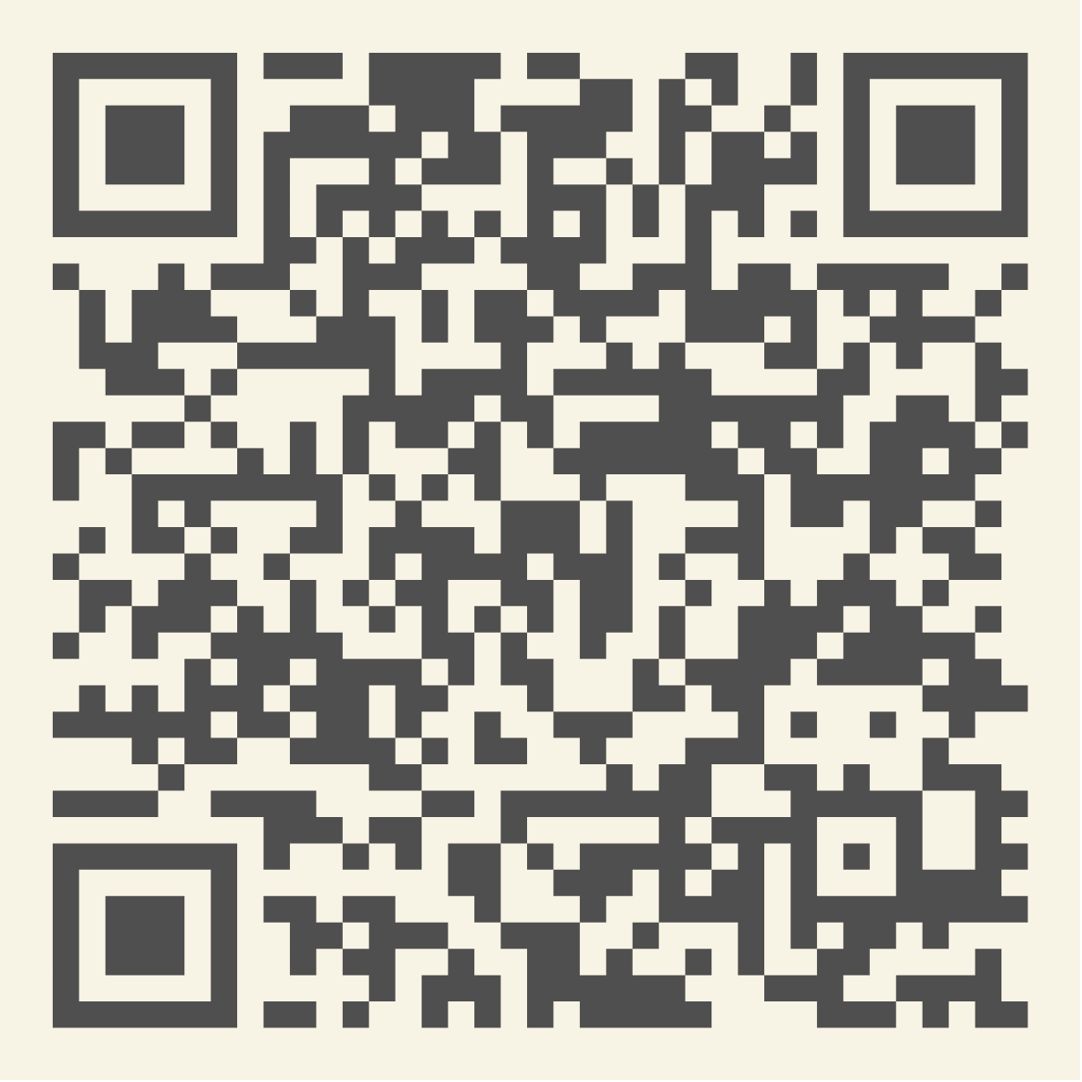
Read more about it…
Fraser, C. B., Yamagata, N., & Mac Mahon, A. (2025). The relaxed tutorial project: designing synchronous online tutorials for autistic students. Open Learning: The Journal of Open, Distance and e-Learning, 40(4), 425–438.
https://doi.org/10.1080/02680513.2025.2530595
Thank you!

