Slide 1


An Academic in the App Store: exploring a new frontier in outreach?
Cora Beth Fraser

Slide 2
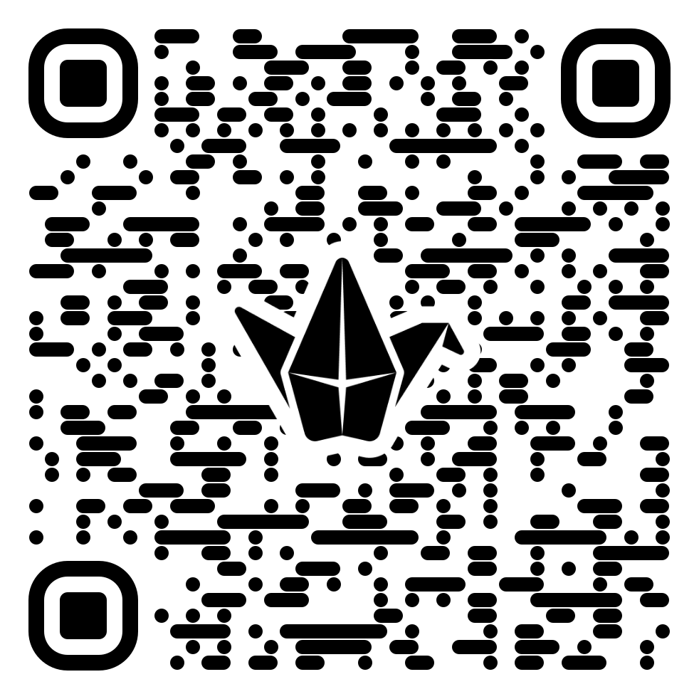


https://padlet.com/corabethknowles/feedback-board-aavbjyiul6cxnavf

Slide 3

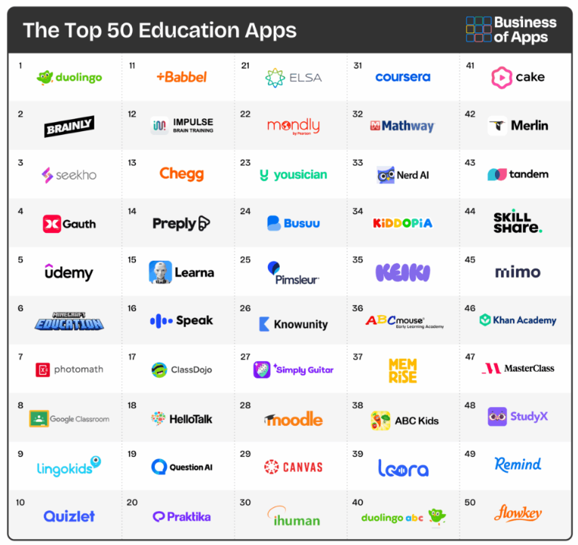
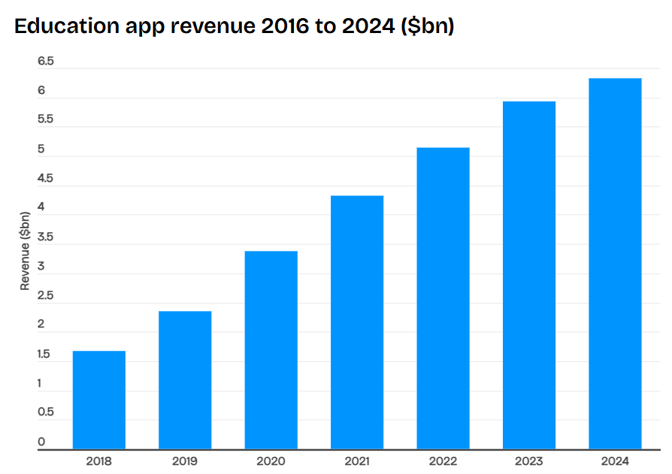
Why aren’t there more academics in the app stores?

Slide 4
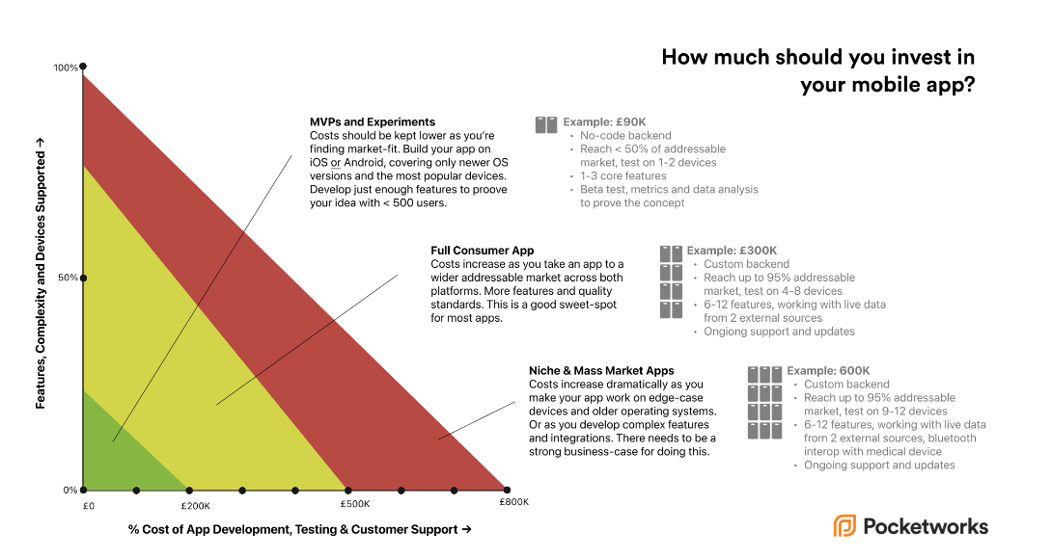

Slide 5
But can it be done in-house?

Slide 6
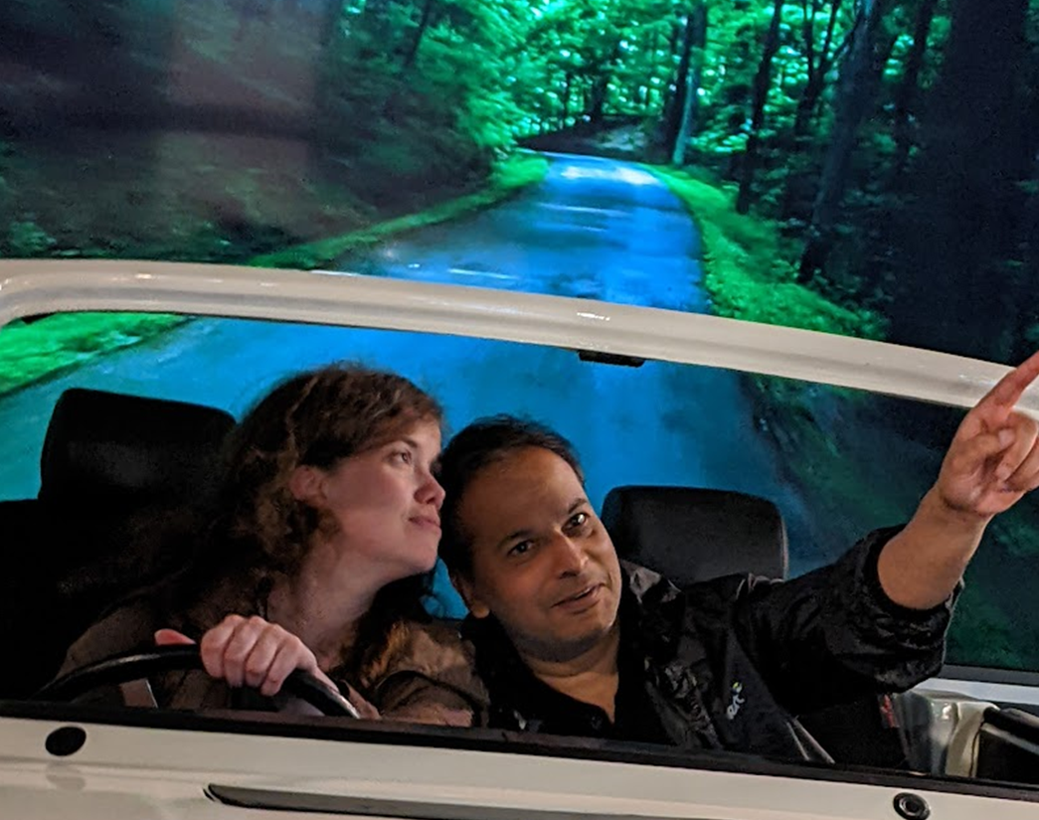


No team.
No funding.
No experience.
December 2024
me
Tony
What could go wrong?

Slide 7
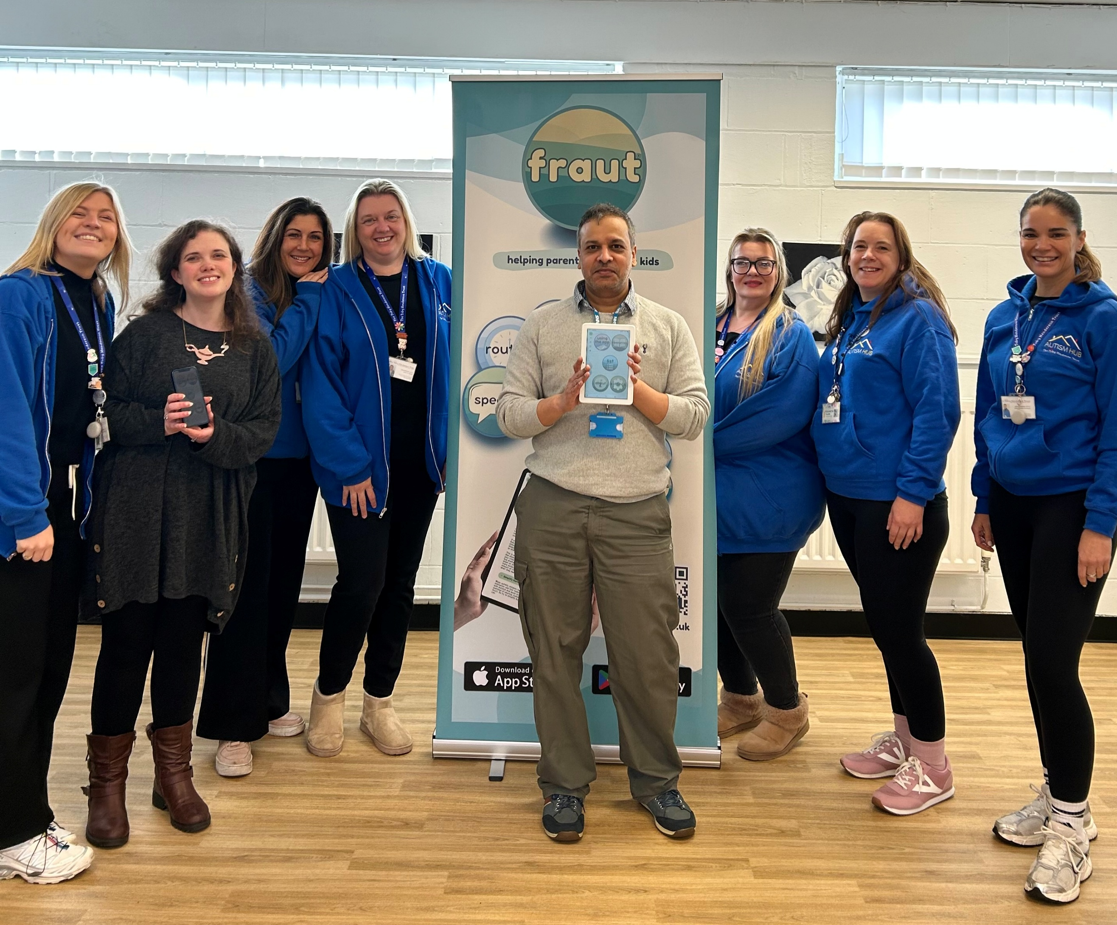


March 2026
Two commercial products released by Google and Apple;
Five-star feedback;
Community support;
Award nominations…
AND our own banner!

Slide 8
So what did we build?

Slide 9
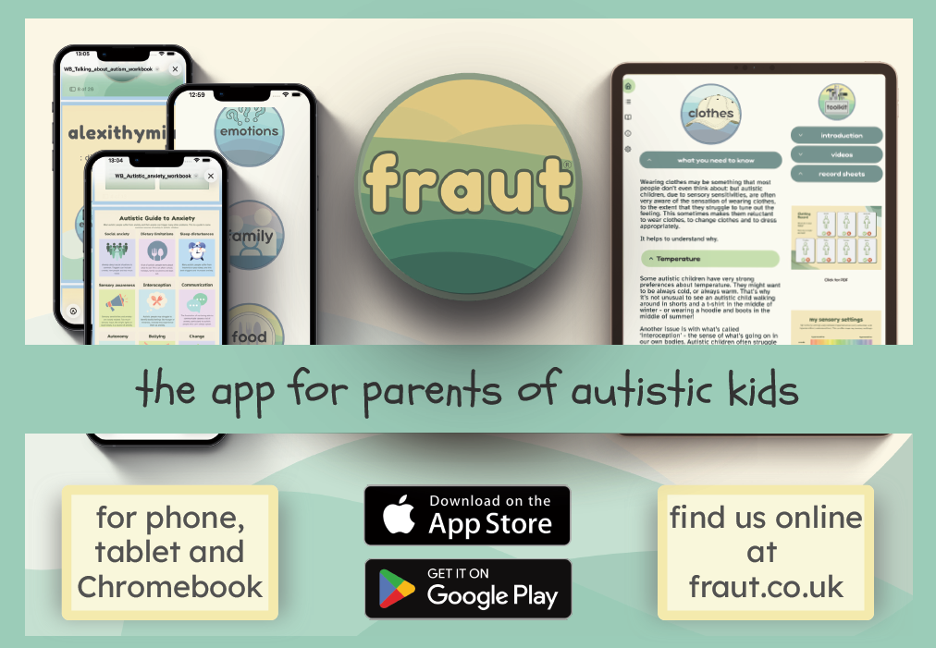

Slide 10
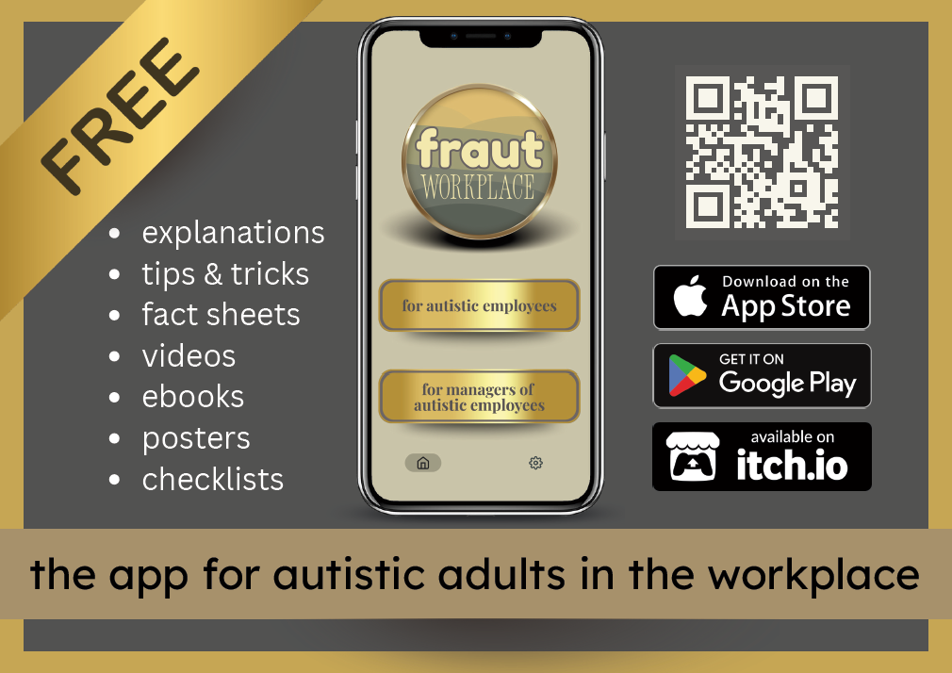

Slide 11
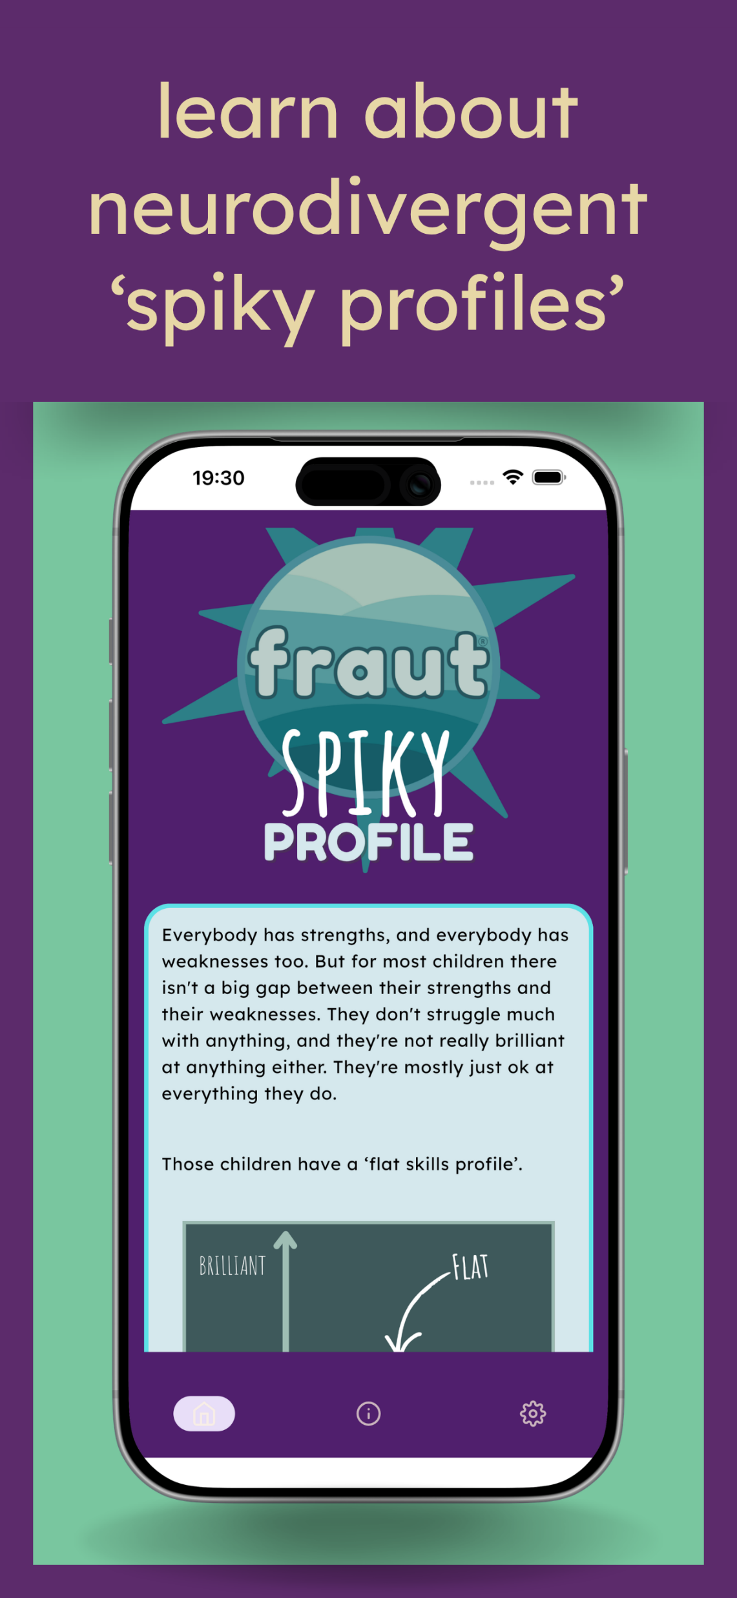
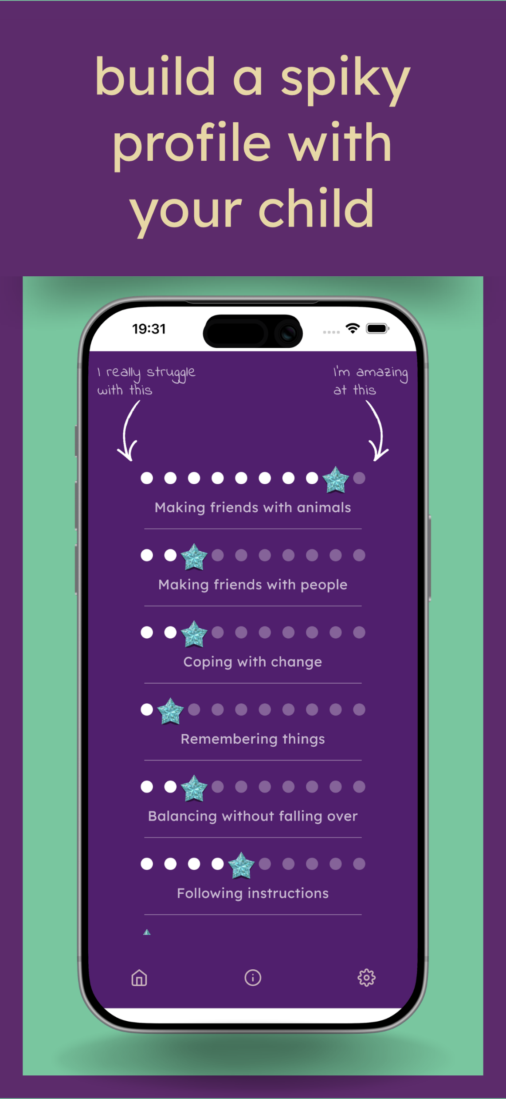
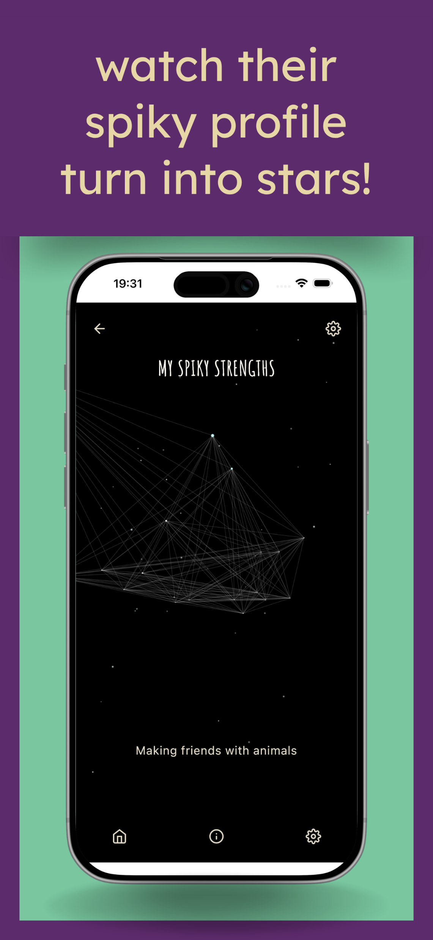

Slide 12
What did we learn?
LOADS!

Slide 13
The tech process
Coding
Testing
The writing process
Text
The design process
Logo and branding
The business process
Hosting
Updates
Resources
Video
Accessibility options
UX
Accessible design
Testing and feedback
IP
Developer accounts
Website
Company registration

Slide 14
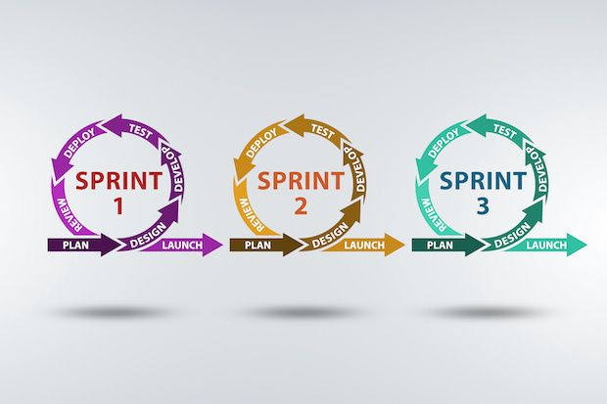
1. The tech process
Coding: Kotlin multiplatform.
Project management: Scrum.
Testing: plan + results.
Upload to platform: Google, Apple.
Ongoing updates.
Variety of hardware needed, but not all of it needs to be up-to-date.

Slide 15
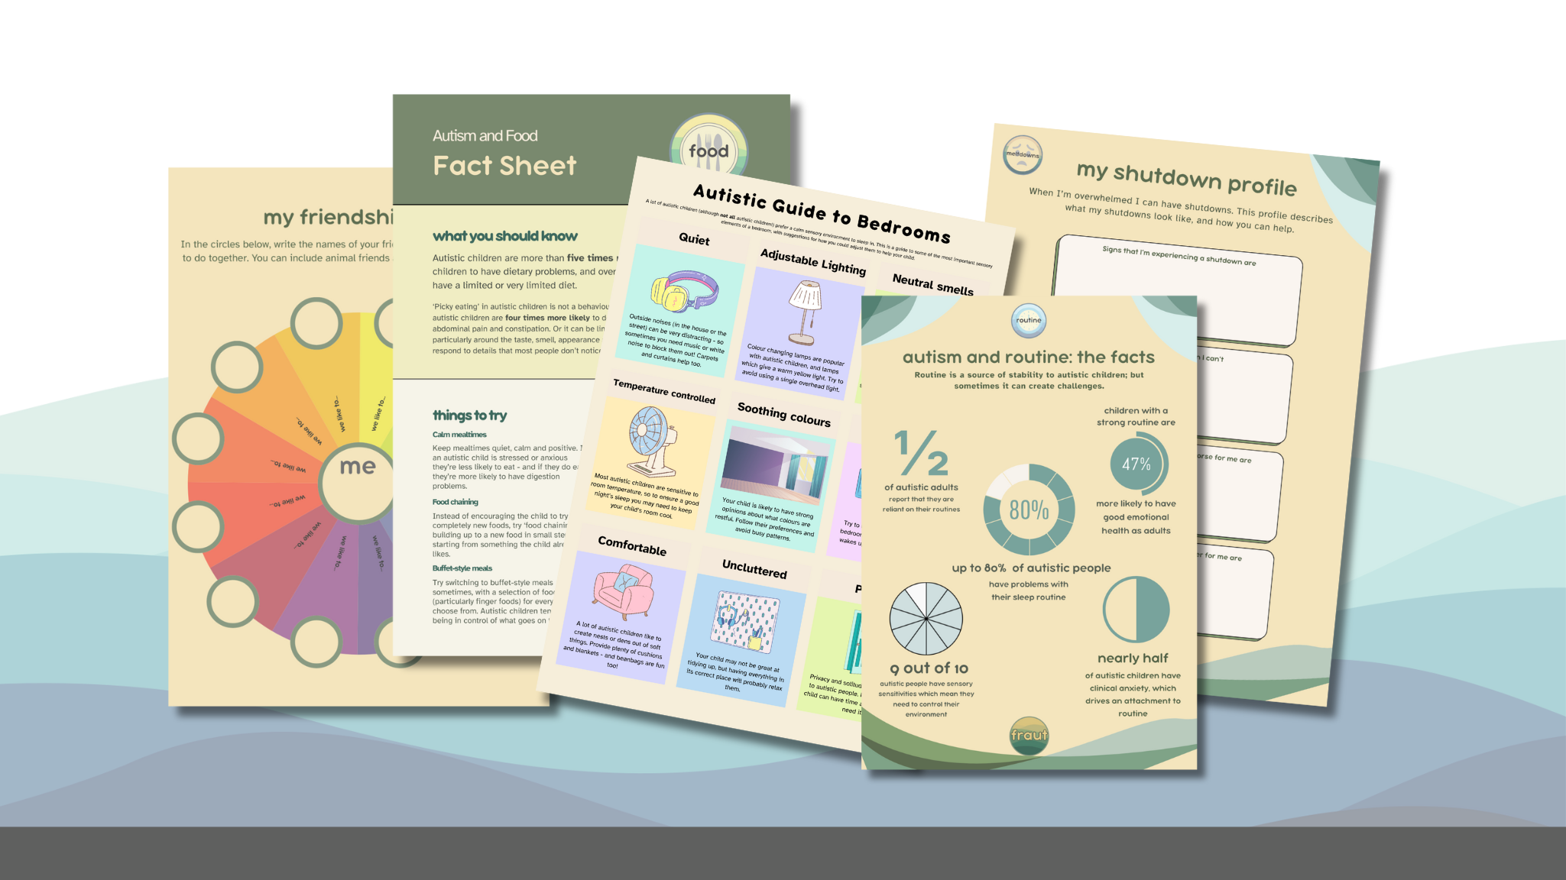
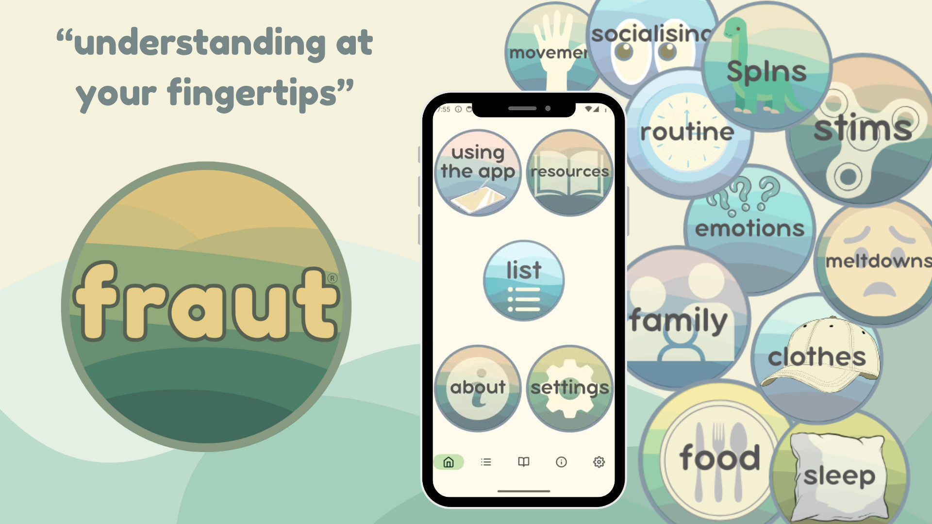
2. The writing process
Three elements: text, resources and videos.
Text: approx. 80k words of unique content.
Resources: workbooks, record sheets, fact sheets, posters, ebooks.
Videos: 40 videos of 3-4 mins each, voiceover, transcript.

Slide 16
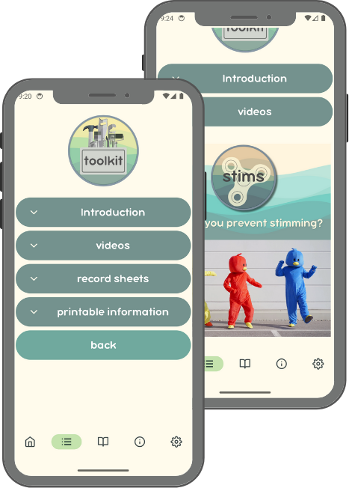
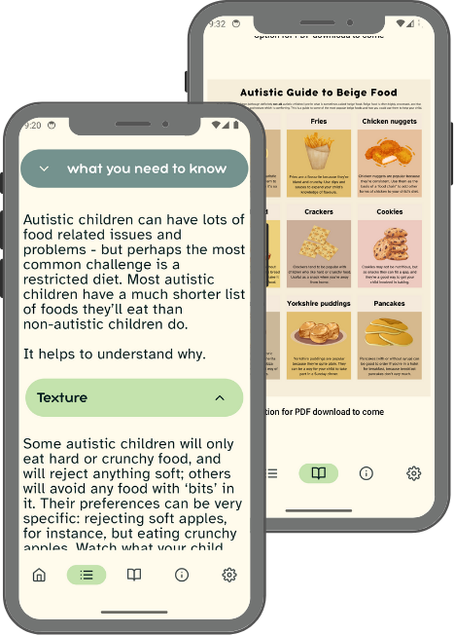
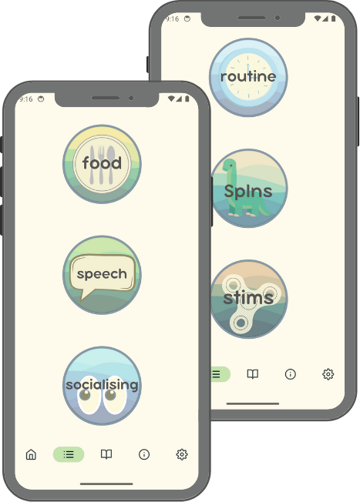
3. The design process
Logo and branding; colours.
UX and the user journey.
Design for accessibility.
Testing and feedback.

Slide 17
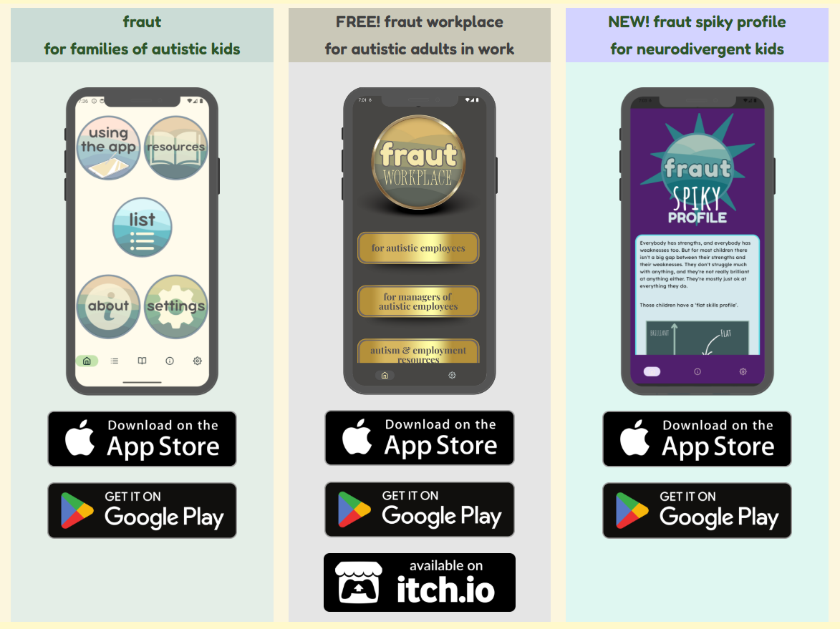
4. The business process
Protecting idea: IP, trademark.
Local business team support.
Personal vs company considerations.
Website, domain and privacy policy.

Slide 18
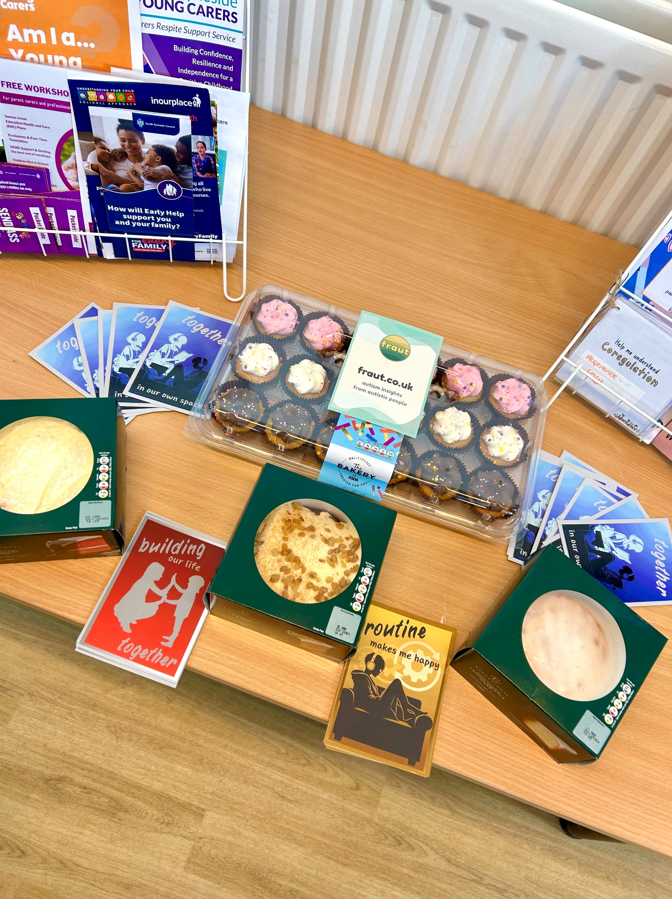
What next?
More from fraut: primary and secondary SEN, universities, adult.
More collaboration with support services.
More cake.
Different apps.
World domination?

Slide 19
