Slide 1
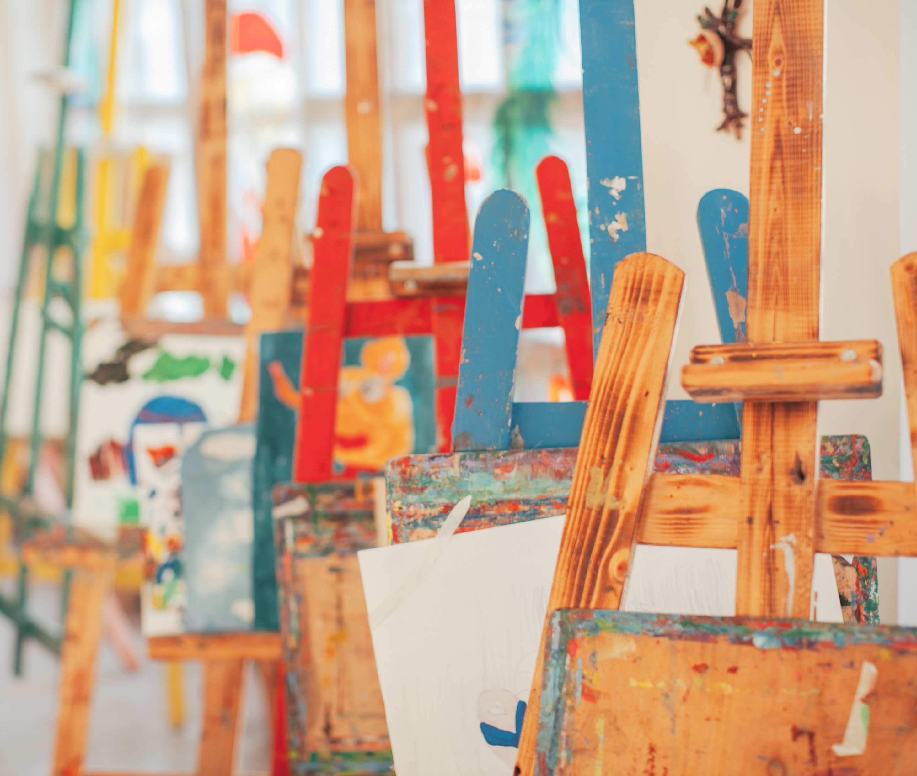
If you were planning a ‘Medea’ painting, what would you include?

Slide 2

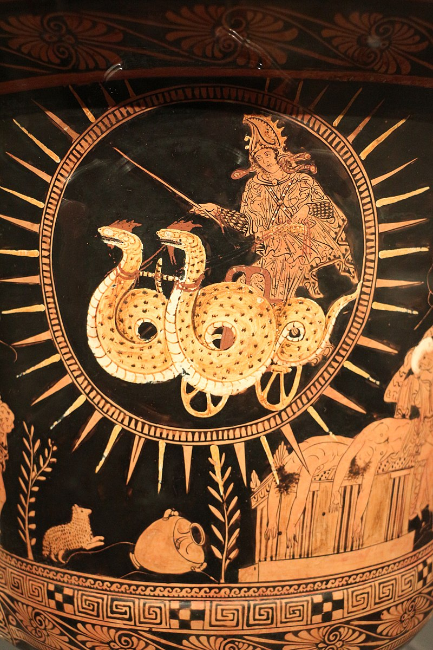
Picturing Medea
Working with Sources

Slide 3
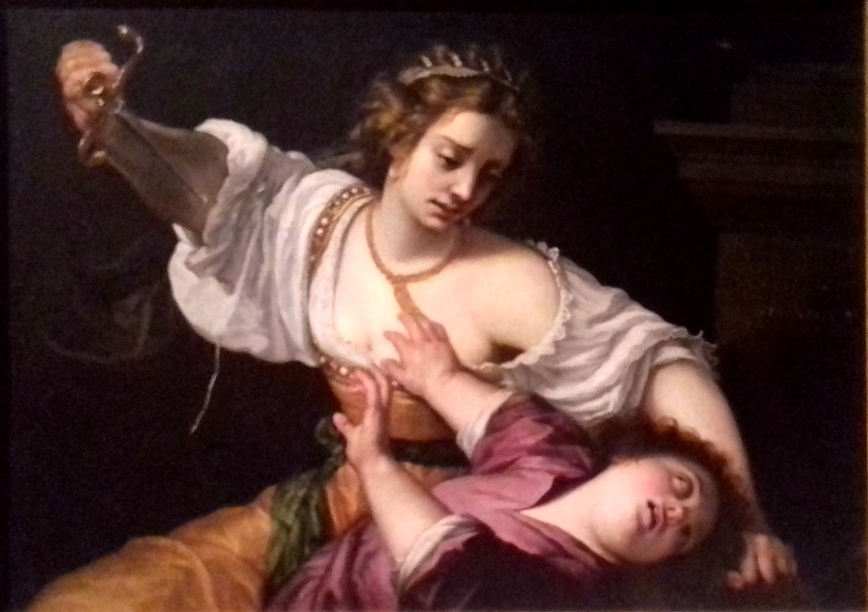
Gentileschi, A. (1620) Medea [Oil]. Private Collection, Rome.

Slide 4
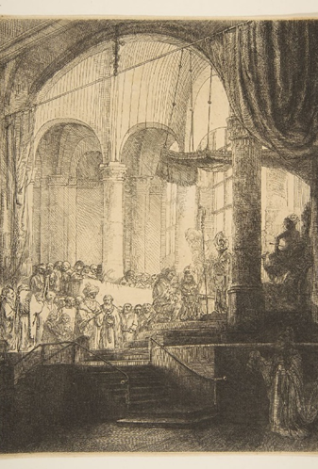
Rembrandt (1648) Medea: or The Marriage of Jason and Creusa [Etching with touches of drypoint] The Metropolitan Museum of Art, New York
‘Rembrandt chooses to present Jason and Creusa as central figures within the image with a crowd of onlookers watching them. Perhaps Rembrandt wants the viewer to sympathise with the pair and be in favour of their relationship due to his own difficulties in remarrying after the death of his first wife. Despite living with Hendrickje Stoffels as his common law wife for decades, he was unable to legally marry her, Becker explains that “Rembrandt would certainly have married her were it not for a clause in the will of Saskia, his first wife, which read that if he should marry again he should lose the income from the money left to Titus” (1910, p.324). To have limitations on a new marriage placed upon him by his previous wife, Rembrandt may have felt empathy for Jason’s position and viewed him as the victim to Medea’s scheming, choosing to portray Medea as the villain. ‘
Batty, unpublished Dissertation, 2022

Slide 5
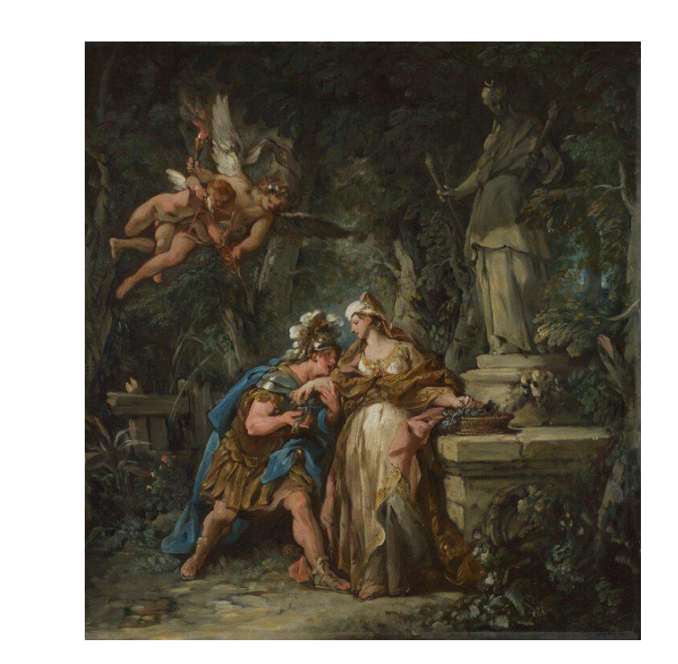
Jason swearing Eternal Affection to Medea
Jean-François de Troy, 1742-3
56.5 × 52.1 cm
‘Sketches’ for a series of seven Jason-themed tapestries.

Slide 6
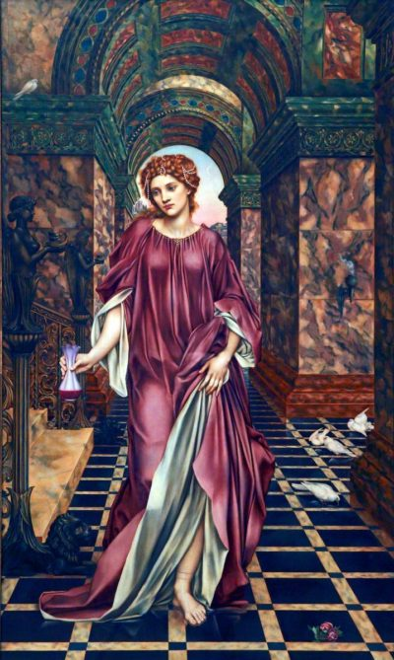
Medea
Evelyn de Morgan
1889
148cm X 88cm
Accompanied by a quotation from William Morris’ poem ‘The Life and Death of Jason’…
“Day by day,
she saw the happy time fade fast away,
And as she fell from out that happiness,
Again she grew to be the sorceress,
Worker of fearful things, as once she was.”

Slide 7
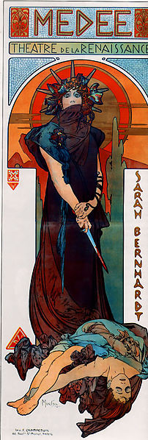
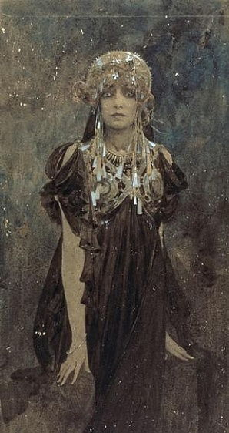
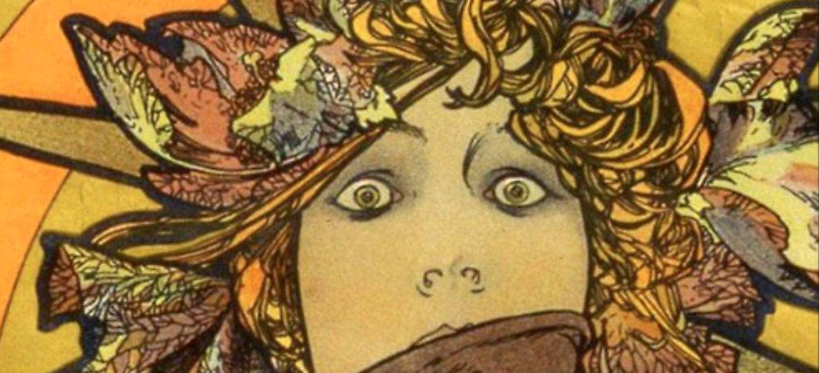
Médée
Alphonse Mucha
1898
206 x 76cm
Lithograph

Slide 8
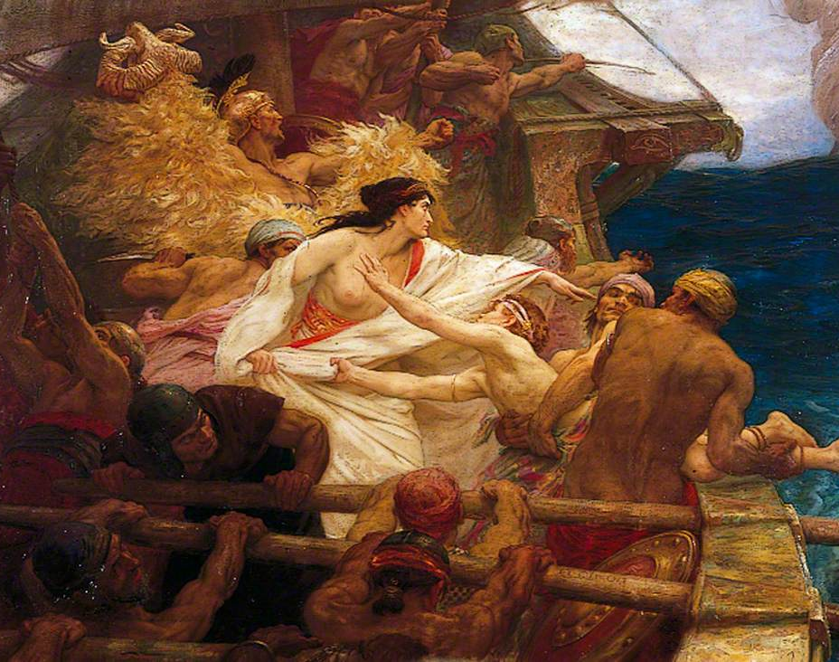
The Golden Fleece
By Herbert James Draper, 1904
155 x 272.5 cm
Medea throws her brother into the sea to drown so that her father will slacken his pursuit long enough for her to escape with the golden fleece.

Slide 9
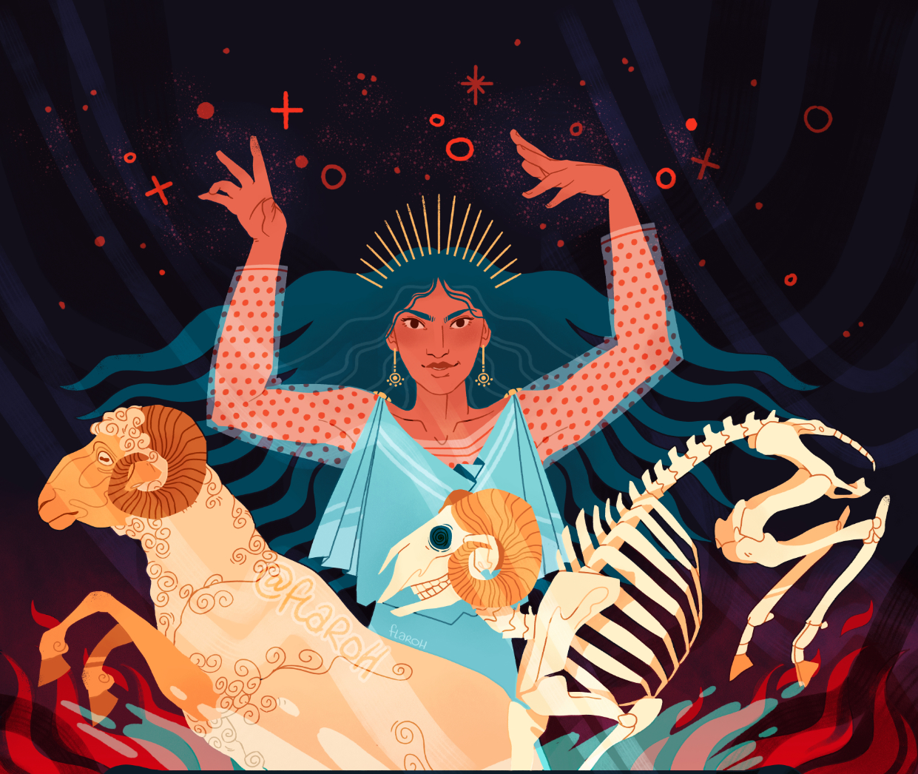
Flaroh’s Medea
Medea and her ‘cauldron of rejuvenation’, where she rejuvenated an old sheep by cutting it up, putting it into a cauldron, and applying herbs. While impressive, this was an elaborate trick to fool her enemy Pelias’ daughters, who attempted the same ritual with their own father with much less success…
Created by Flora Kirk of Flaroh Illustration as part of the Drawtober 2020 art challenge.
You can buy this, and other similar pieces, as a print.
https://greekmythcomix.com/comic/guest-illustration-flaroh-medea/

Slide 10
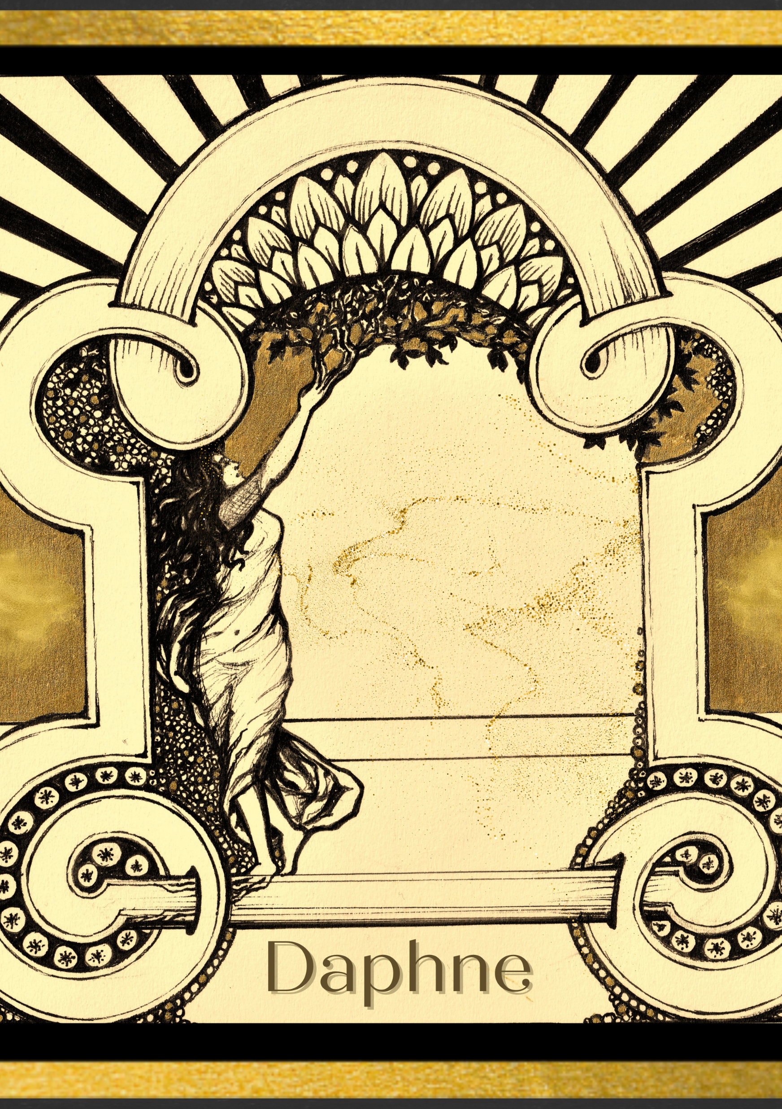
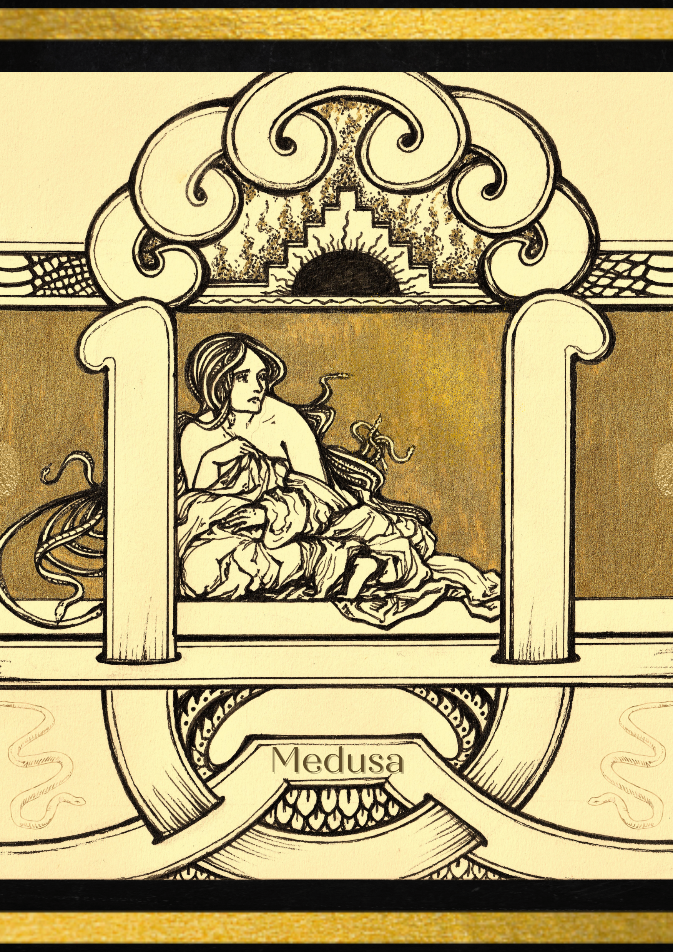
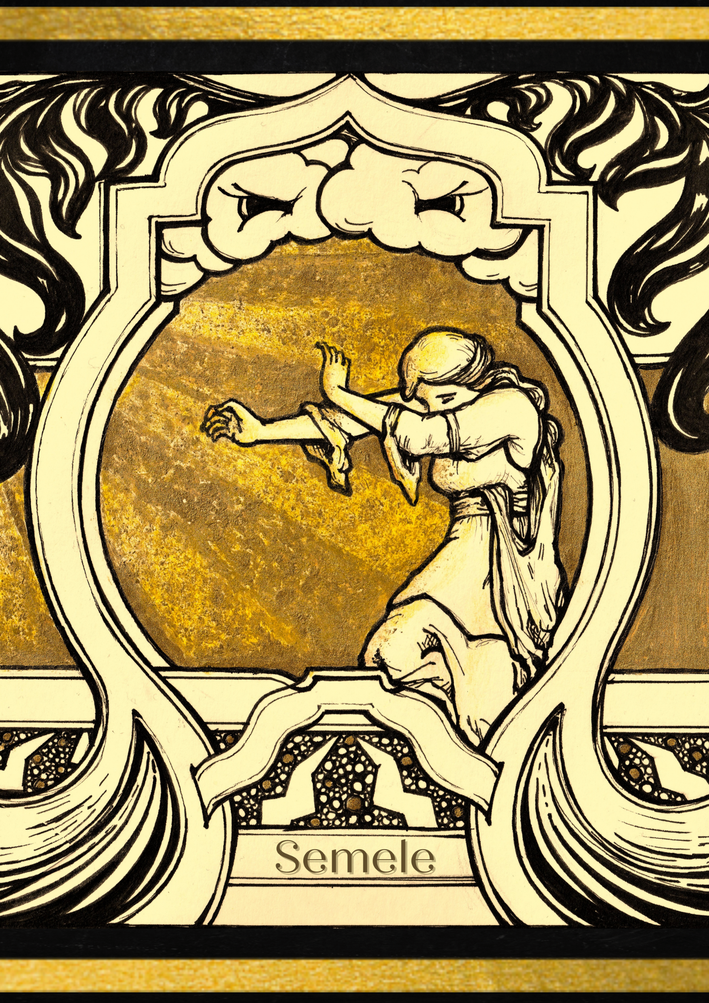
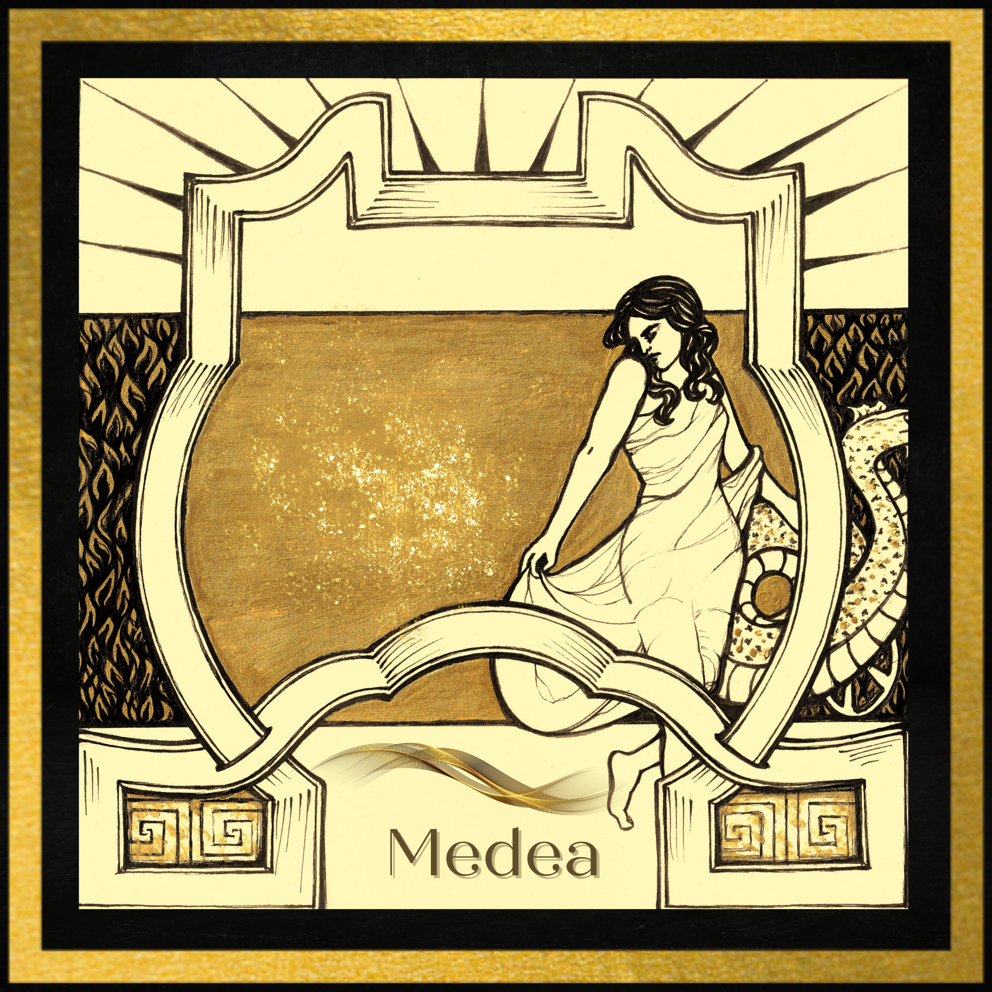
Medea by Cora Beth Fraser
Part of a series of four Art Deco-inspired designs; the others feature Medusa, Semele and Daphne.
Based on the Cleveland krater…

Slide 11
