Slide 1
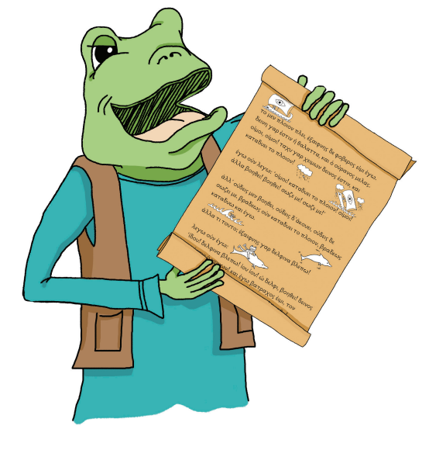
The Ancient Greek Alphabet
with Dr Knowles

Slide 2
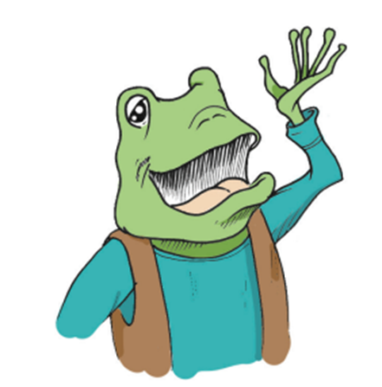
What do you know about Ancient Greek literature?

Slide 3
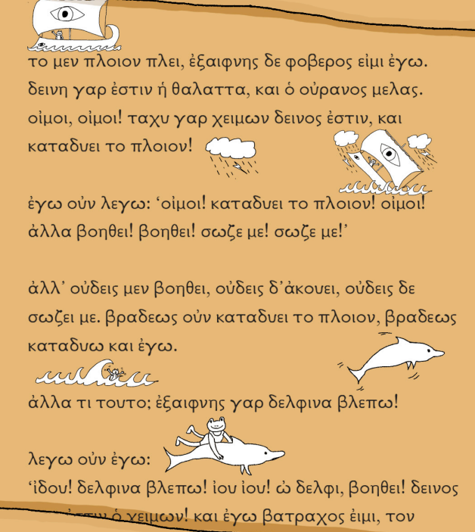
What did Ancient Greek writing look like?

Slide 4
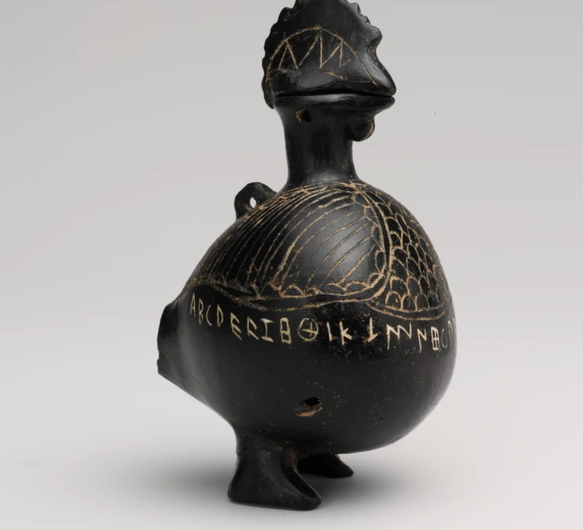
Introducing…
…The Alphabet Chicken!

Slide 5
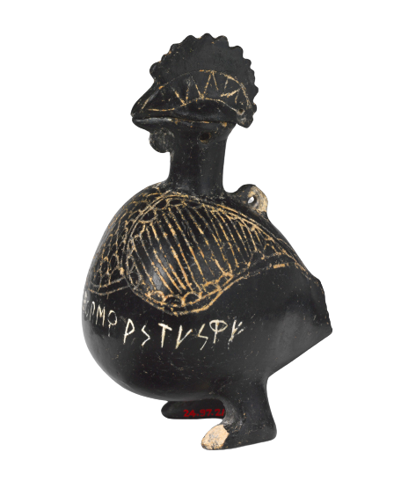
Did the Ancient Greeks invent the alphabet?

Slide 6


Vowels!!! α ε η ι ο υ ω

Slide 7
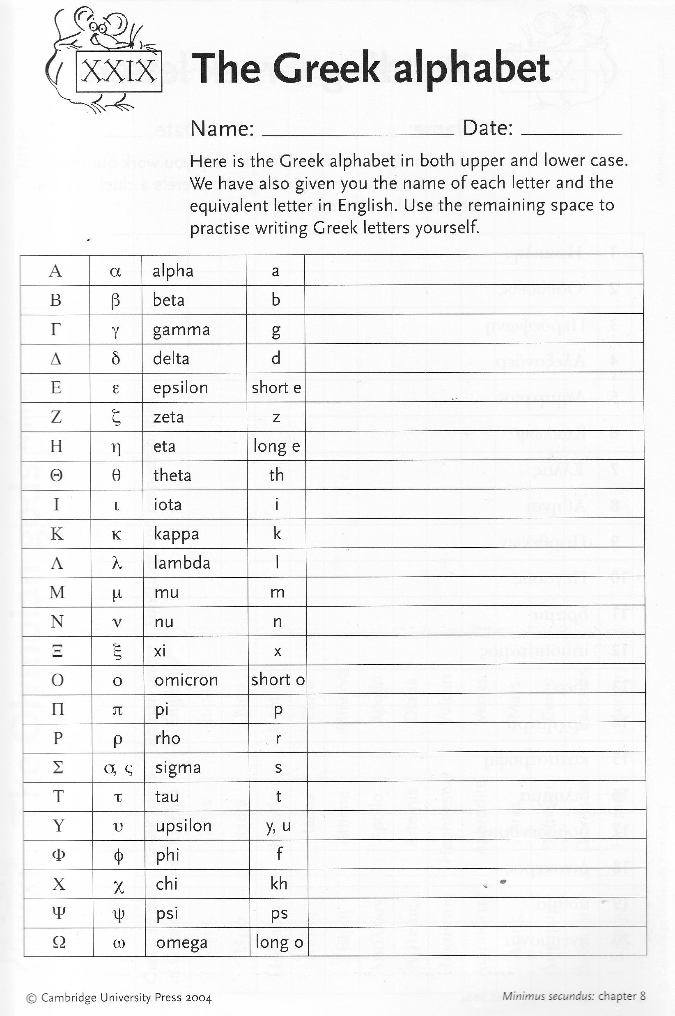
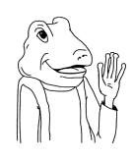
Which letters have you heard of?

Slide 8
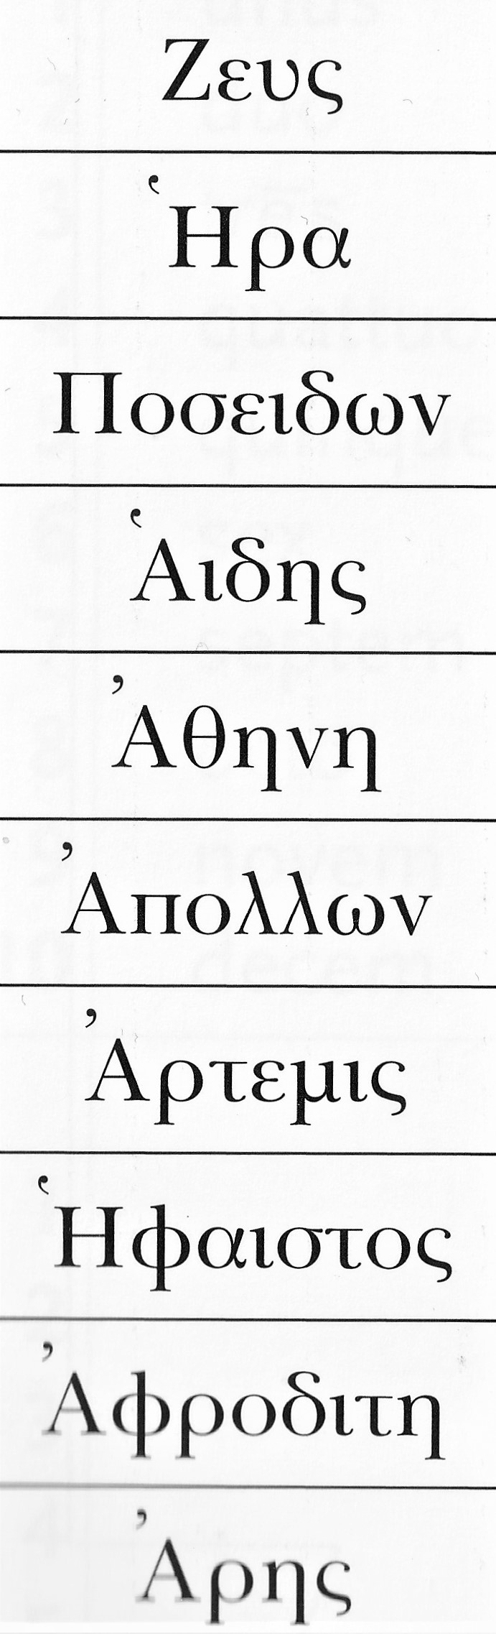
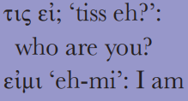
Can you figure out who these are?

Slide 9

Name Practice!
Use the Alphabet Sheet to figure out how to write your name.
Look for the right sounds, not the right letters.
Some sounds don’t exist in Greek – so you’ll have to find something similar!

