Slide 1
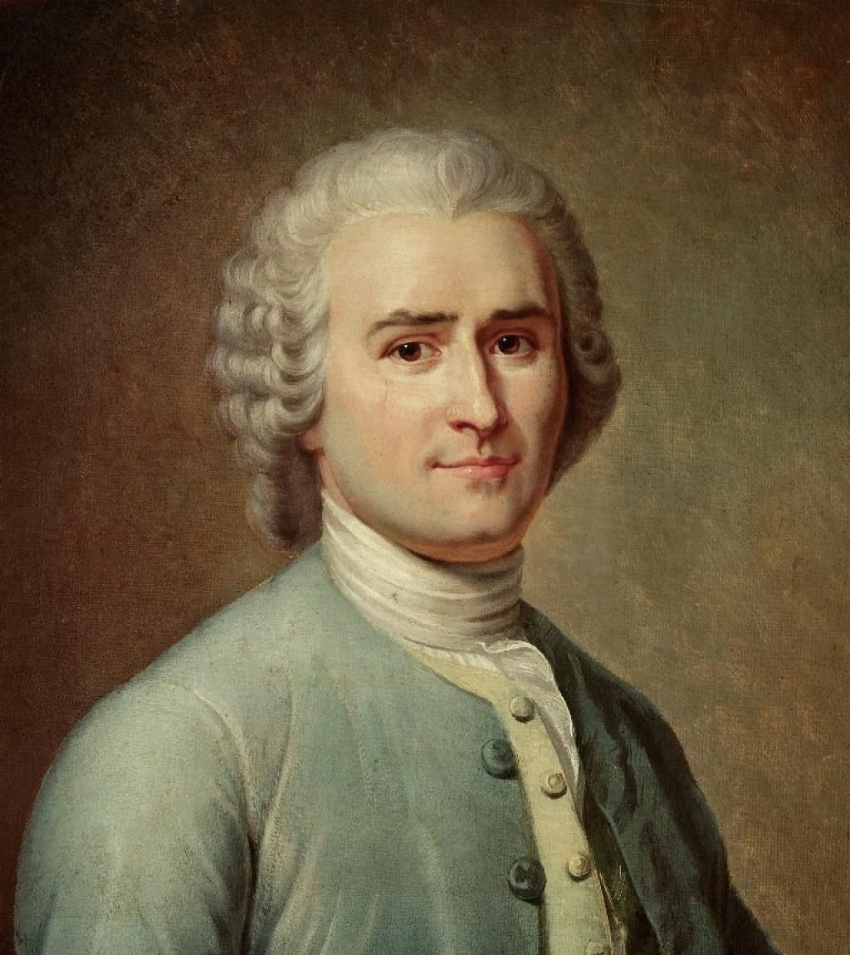
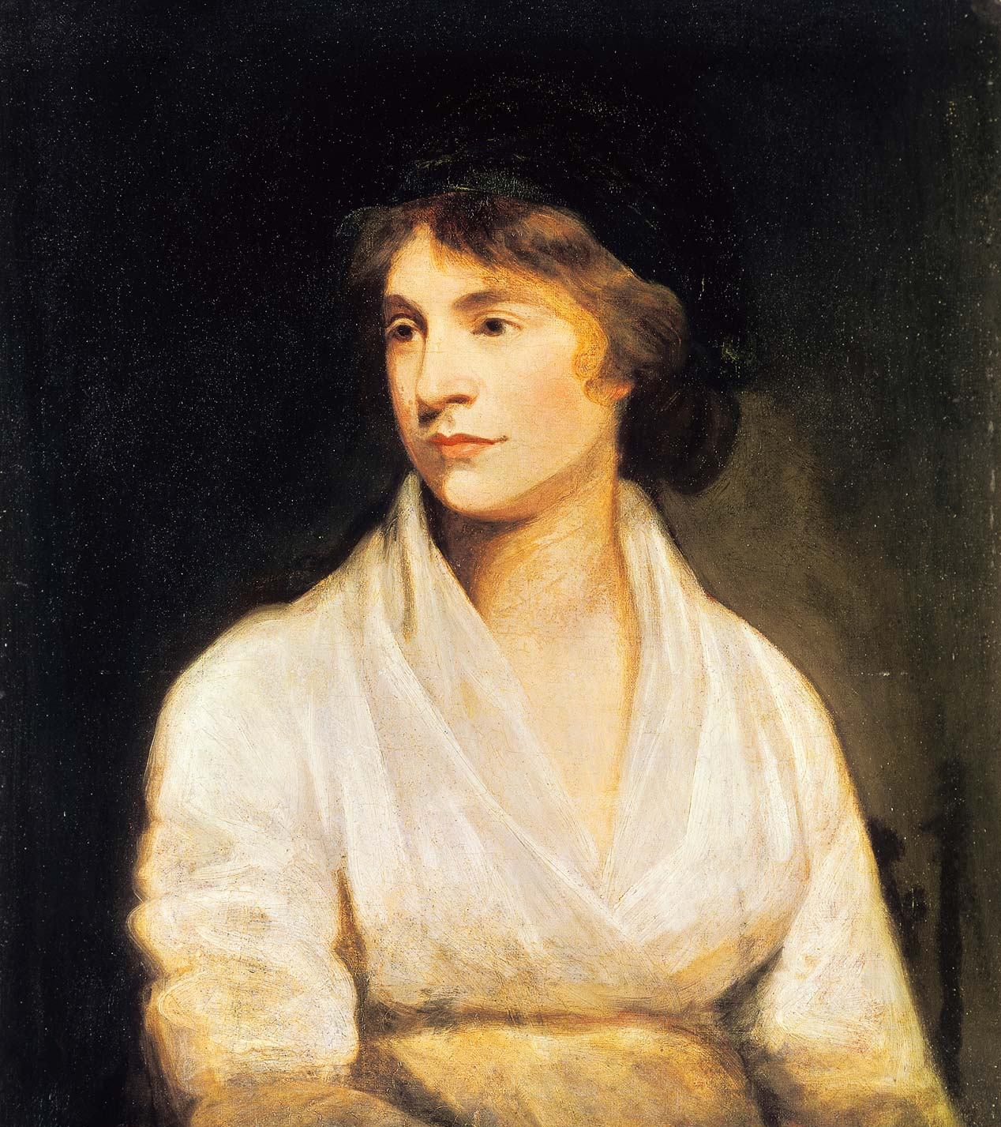
Nature or Nurture
Or… Rousseau or Wollstonecraft?

Slide 2
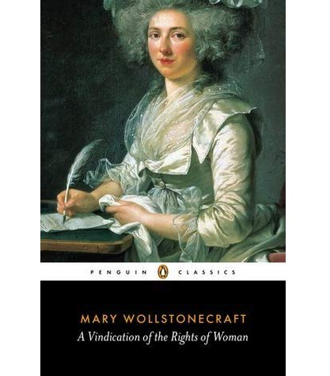
The ‘Nature’ argument

Slide 3
Rousseau on educating girls
[At this point, Wollstonecraft quotes from Rousseau’s Émile in a footnote:] ‘I once knew a young person who learned to write before she learned to read, and began to write with her needle before she could use a pen. At first, indeed, she took it into her head to make no other letter than the O; this letter she was constantly making of all sizes, and always the wrong way. Unluckily, one day, as she was intent on this employment, she happened to see herself in the looking glass; when, taking a dislike to the constrained attitude in which she sat while writing, she threw away her pen […] and determined against making the O any more. Her brother was also equally averse to writing: it was the confinement, however, and not the constrained attitude, that most disgusted him.’

Slide 4
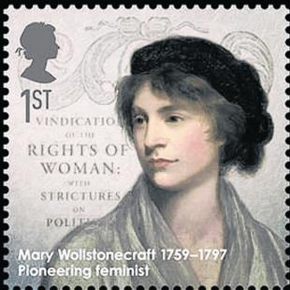
The ‘Nurture’ argument

Slide 5
Wollstonecraft on Rousseau
I have, probably, had an opportunity of observing more girls in their infancy than J. J. Rousseau – I can recollect my own feelings, and I have looked steadily around me; yet, so far from coinciding with him in opinion respecting the first dawn of the female character, I will venture to affirm, that a girl, whose spirits have not been damped by inactivity, or innocence tainted by false shame, will always be a romp, and the doll will never excite attention unless confinement allows her no alternative. Girls and boys, in short, would play harmlessly together, if the distinction of sex was not inculcated long before nature makes any difference

Slide 6
So… what are little girls made of?

Slide 7
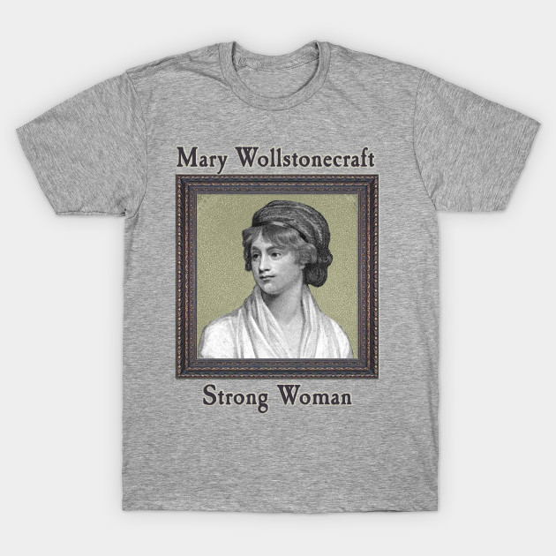
What do our T-shirts say?

Slide 8
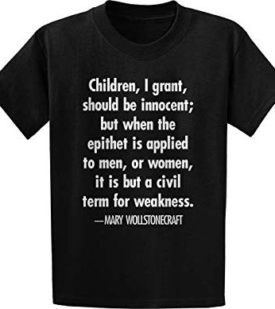


Slide 9
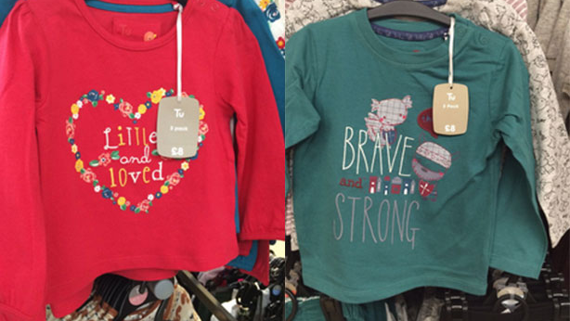

Slide 10
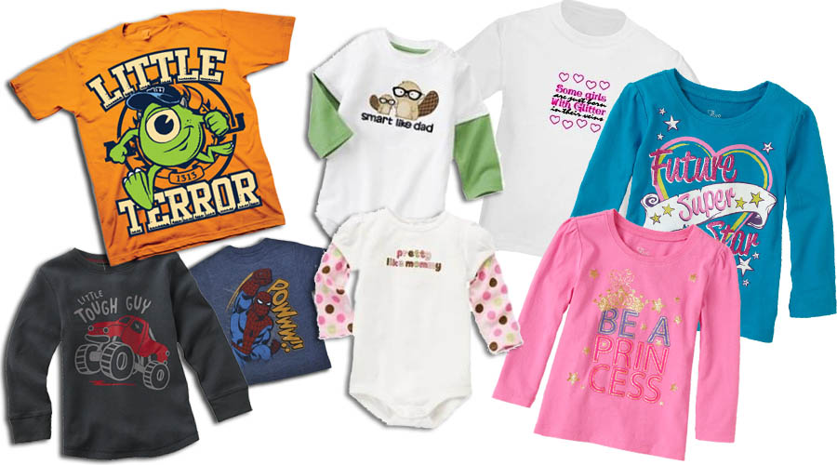

Slide 11
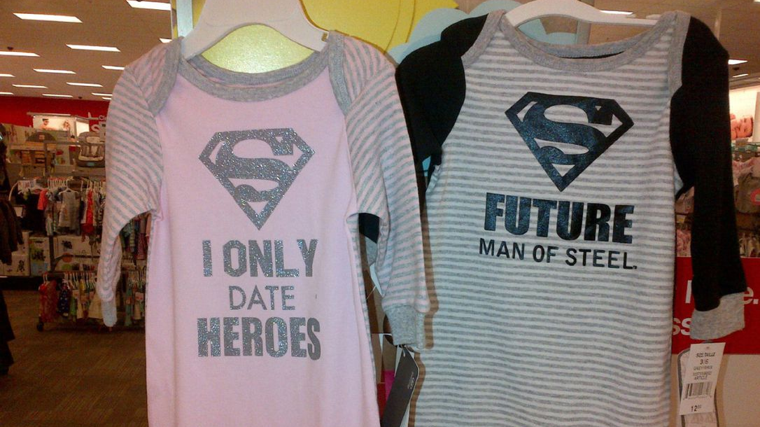

Slide 12
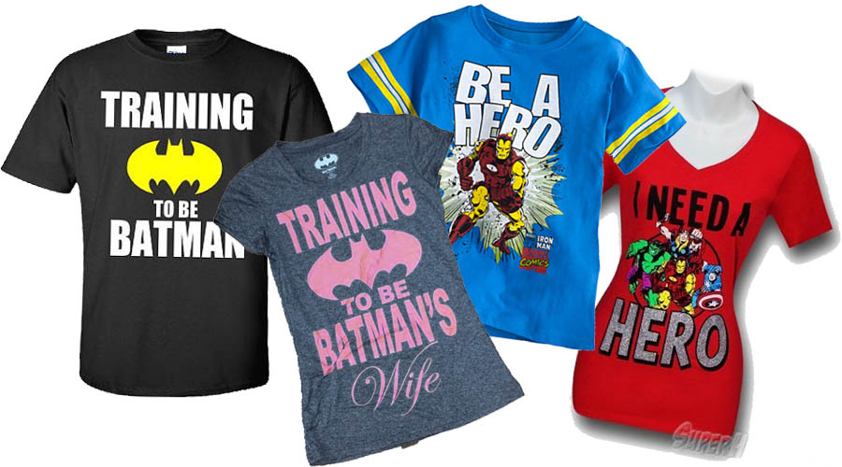

Slide 13
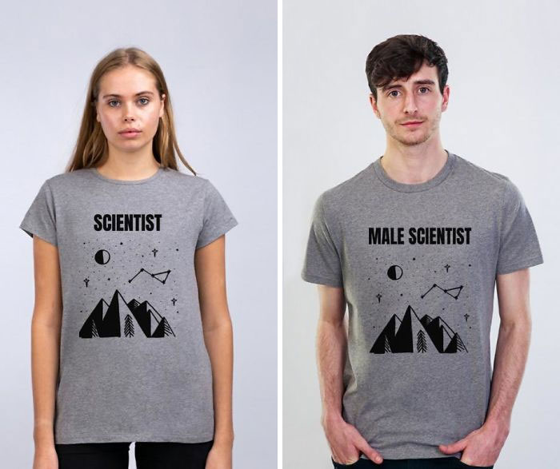
A satirical response…

Slide 14
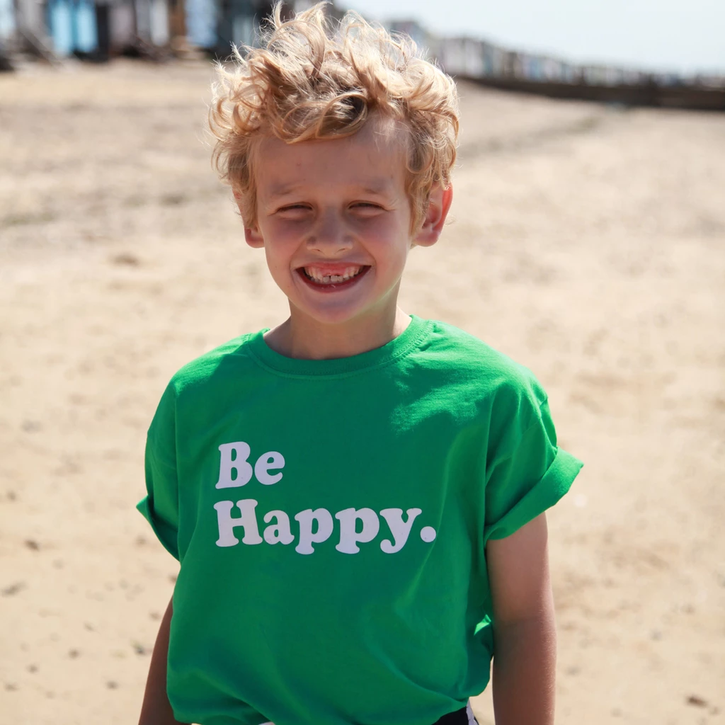
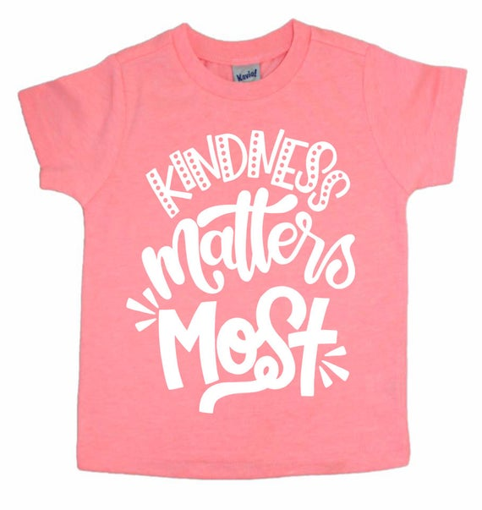
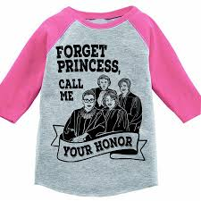
How do we challenge the tradition?

