Slide 1
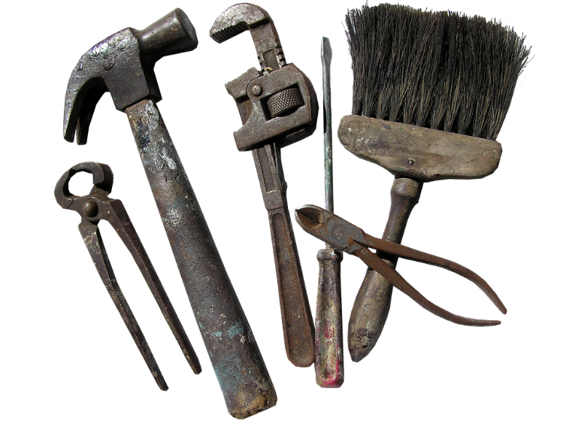
Storytelling
…and the importance of a Toolkit

Slide 2

To begin…
I’d like you to write a short description of a wizard. Don’t worry too much about technique at this stage: you can keep it simple!

Slide 3
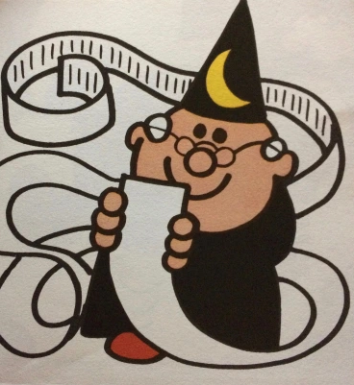
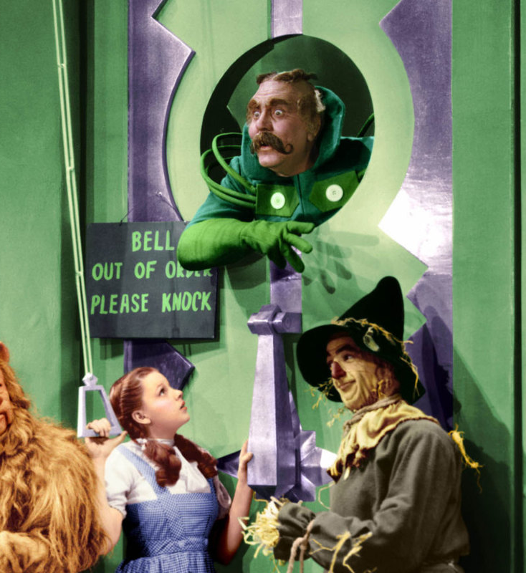

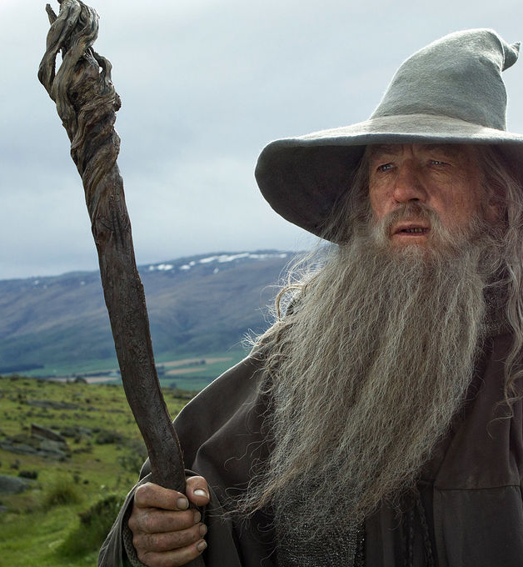
What traditions does your wizard draw on – or react against?

Slide 4
Storytelling Tools
Character
Imagery
Setting
Point of view
Time
Showing and telling

Slide 5
Toolkits for Writing

Slide 6
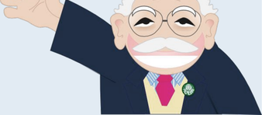
Sentence openings: Dadwavers!
https://www.literacyshedblog.com/dadwavers

Slide 7
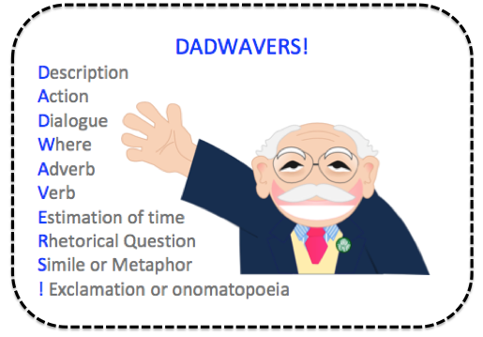

Slide 8
Let’s try it!
Rewrite your wizard description – and this time, start with one of the Dadwavers and see where it takes you.
Whenever you start a new sentence, choose a new Dadwaver.

Slide 9
Toolkits help you to play with traditions. They…
…open up new ways of thinking about a story;
…can take your ideas in surprising directions;
…help you to add variation and personality to your writing.
They’re also very useful when you get stuck!

