Slide 1
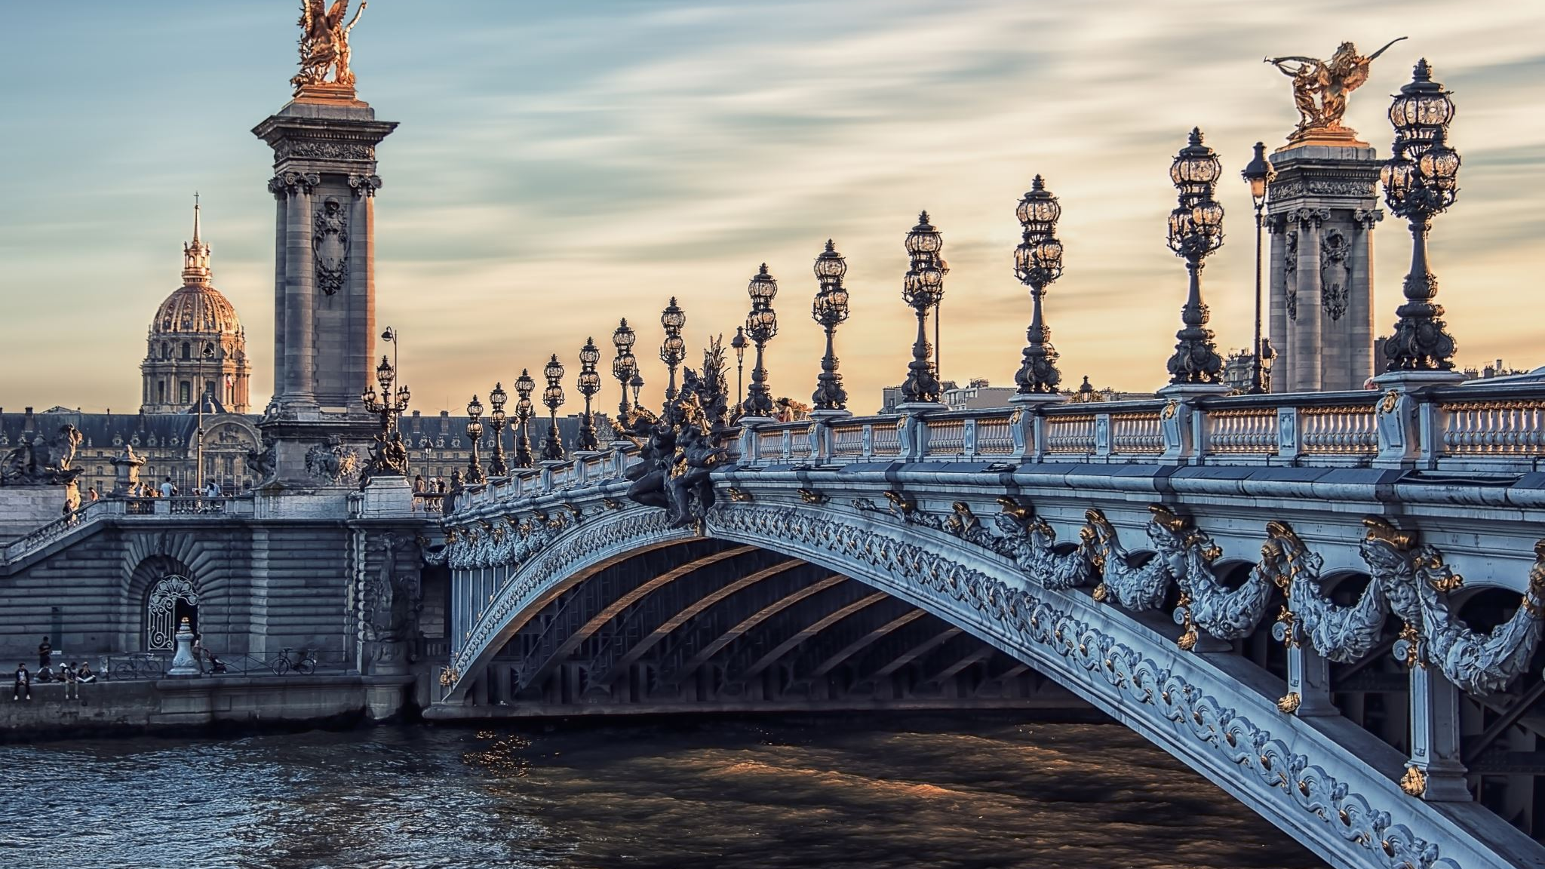
Statues of the Ancient World
The Prima Porta Augustus

Slide 2

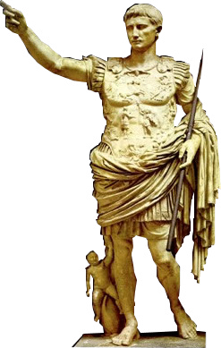
Who was Augustus?
First Roman Emperor
Previously known as Octavian
Adopted son of Julius Caesar
Enemy of Antony and Cleopatra

Slide 3
Augustus supposedly said…
…that he found Rome a city of brick, and left it a city of marble.
There are a lot of ways we can look at the Prima Porta statue through this statement – and in this session we’ll examine just a few.

Slide 4
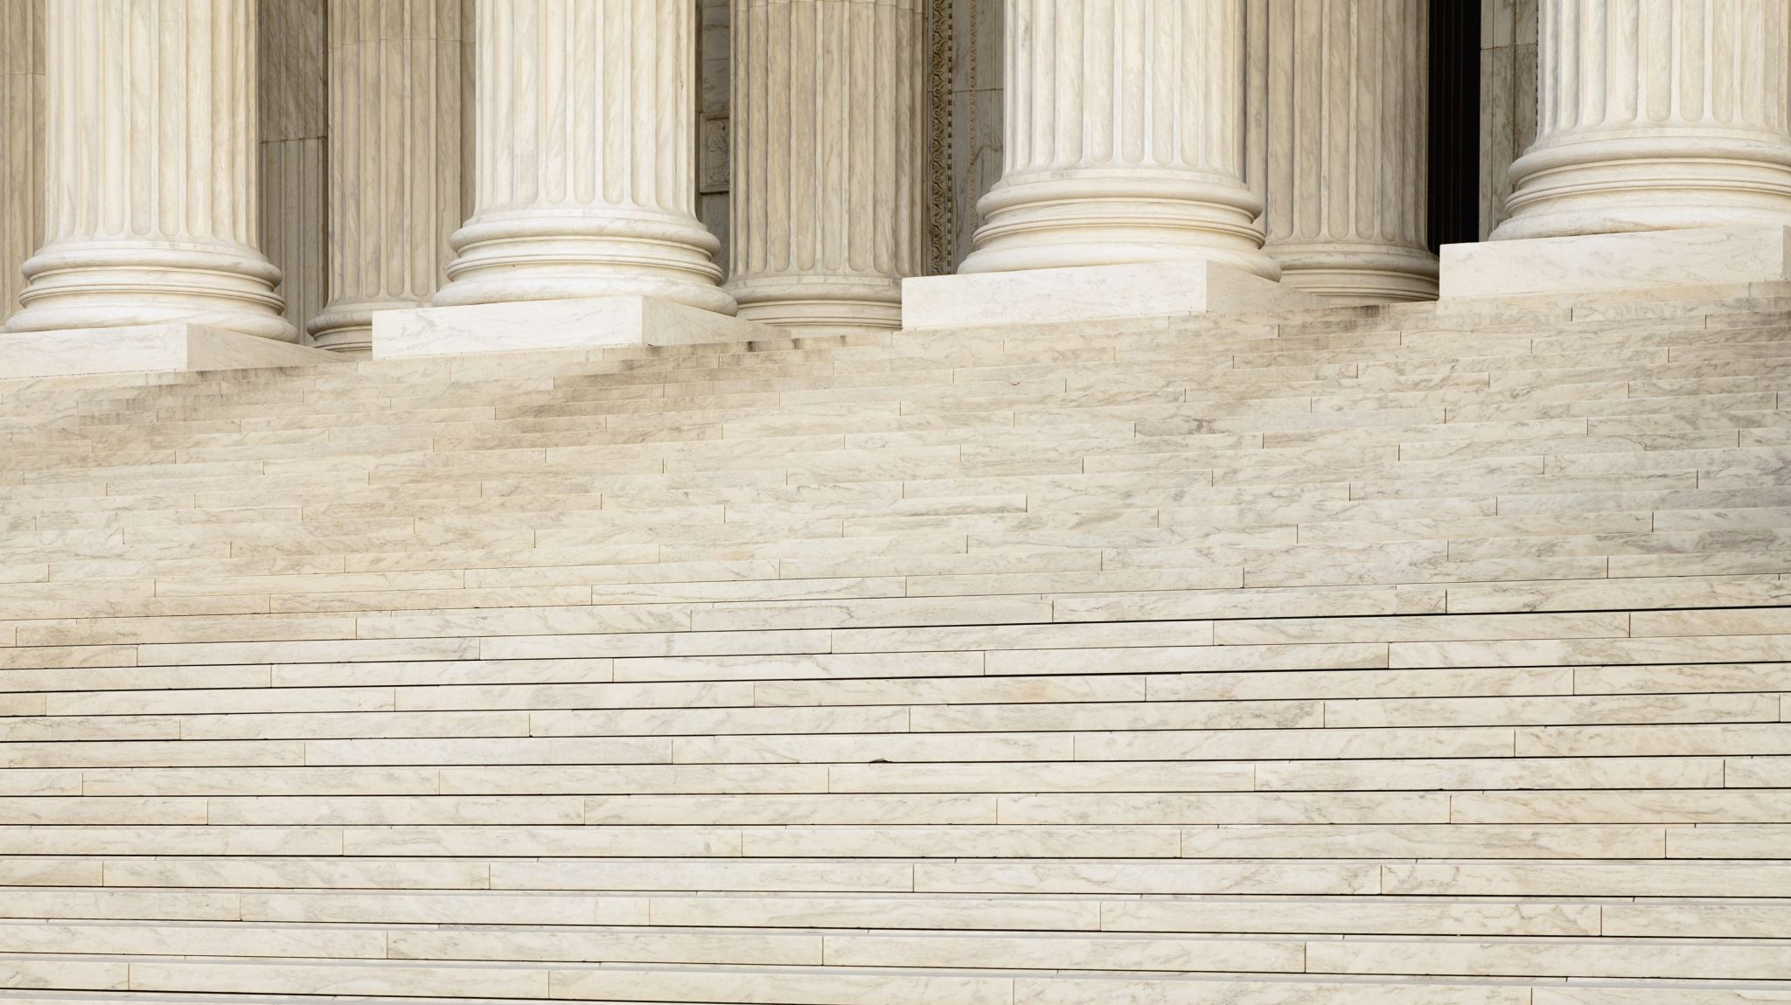
First: why did Augustus want to leave Rome built of marble?
…and what does this have to do with the Prima Porta statue?

Slide 5
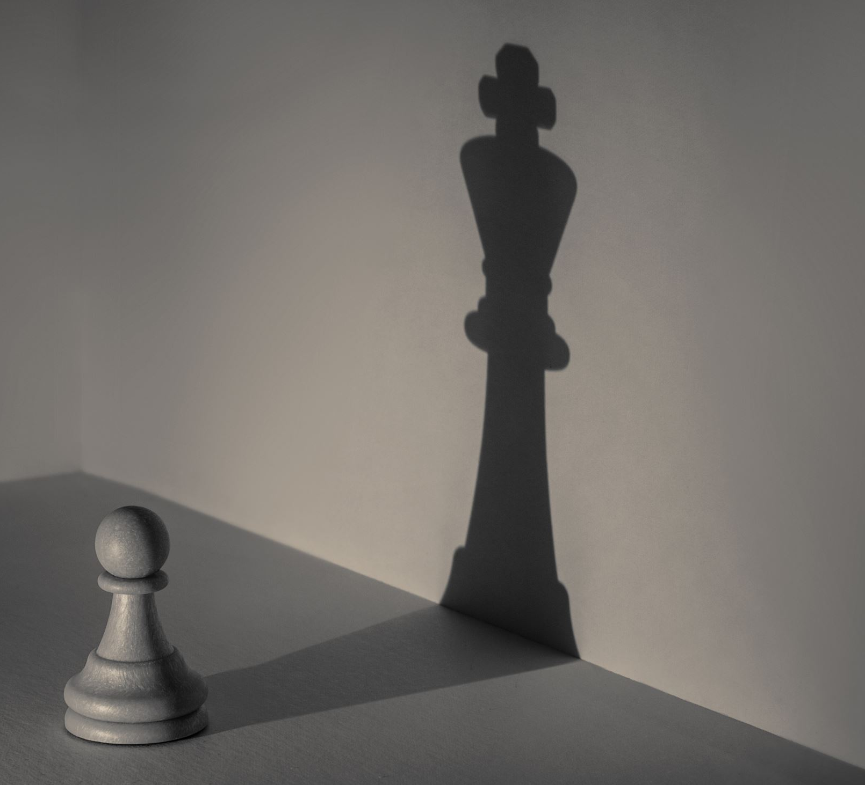
Public Image
Augustus had a public relations nightmare on his hands.
The Romans had kicked out their kings hundreds of years before, and Julius Caesar had only recently been assassinated for acting like a king.
Kings were BAD. So how could Augustus be a king without being stabbed in the back or chased out of Rome by an angry mob?

Slide 6
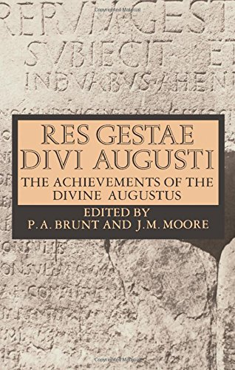
The answer was simple: Control The Media
There were no newspapers, no TV, no internet.
But people would see public buildings, statues and monuments.
They would read poetry and see plays.
They would use coins.
By controlling all of these media, Augustus could put his own spin on his rule, as a rule that reclaimed traditional values.

Slide 7

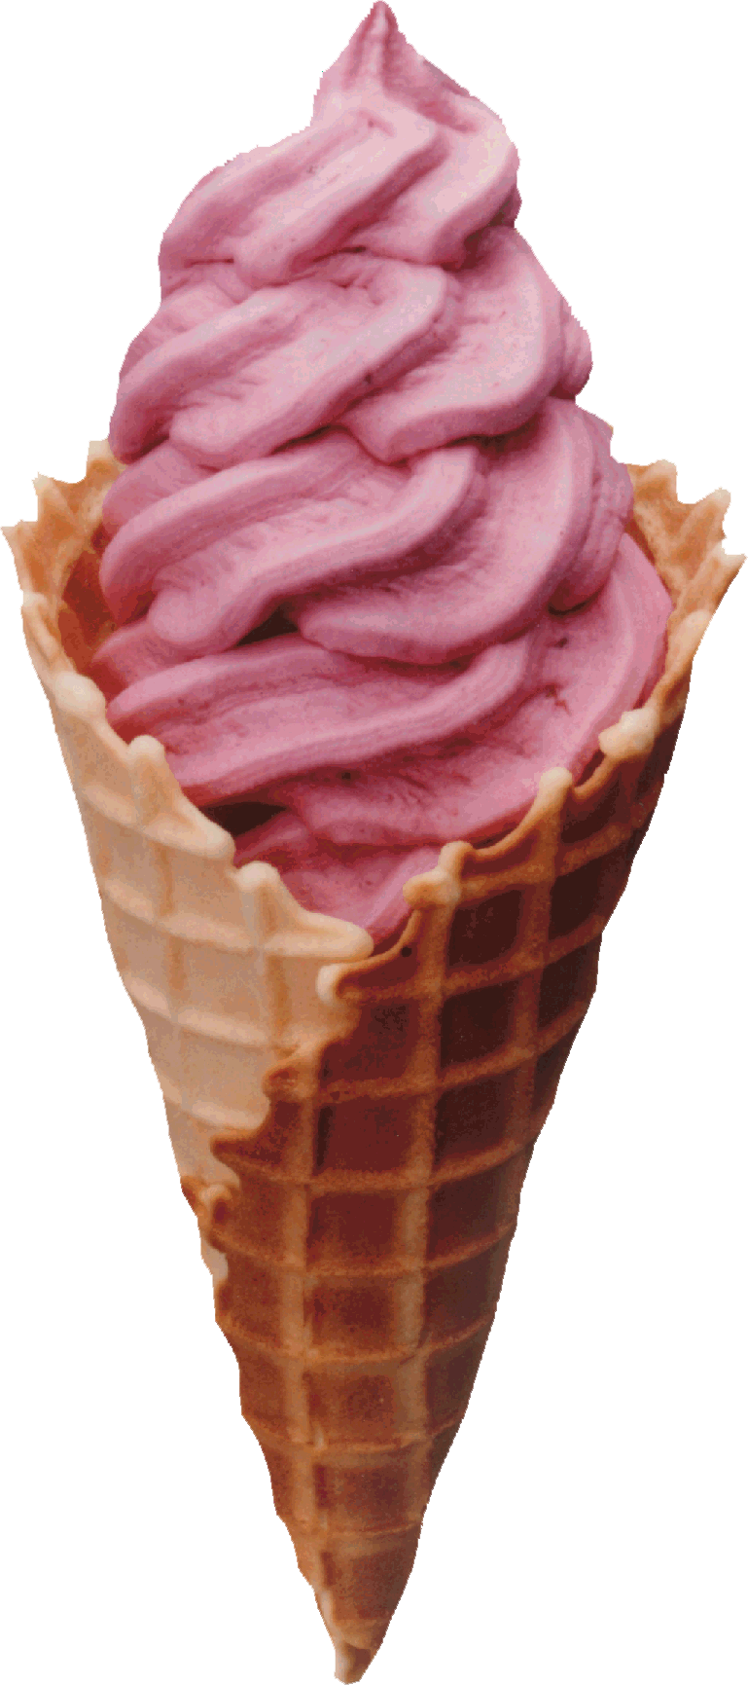

Which elements of his image is he controlling with the Prima Porta statue?
Let’s take a look at some of the details…

Slide 8
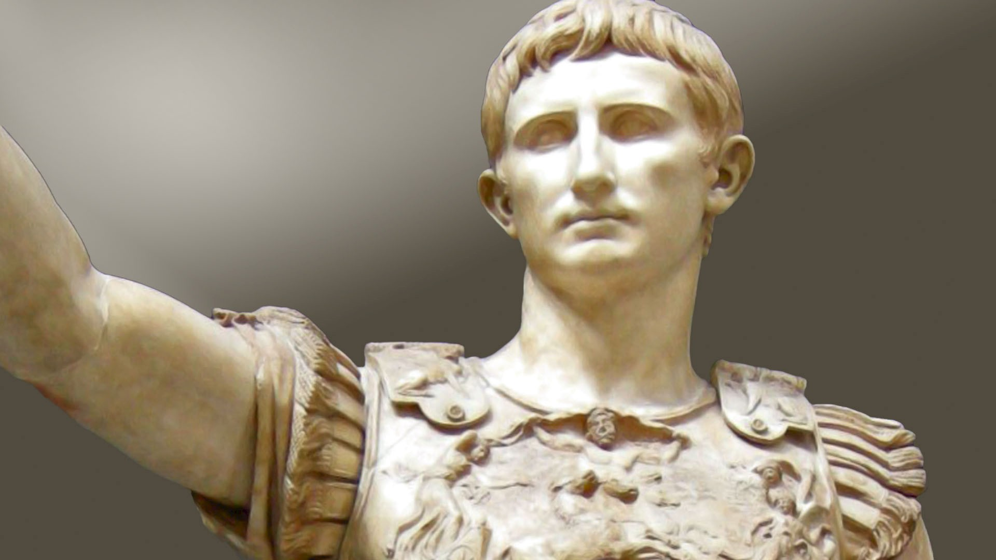

Slide 9
For comparison – this is what Roman statues looked like before Augustus…

Slide 10
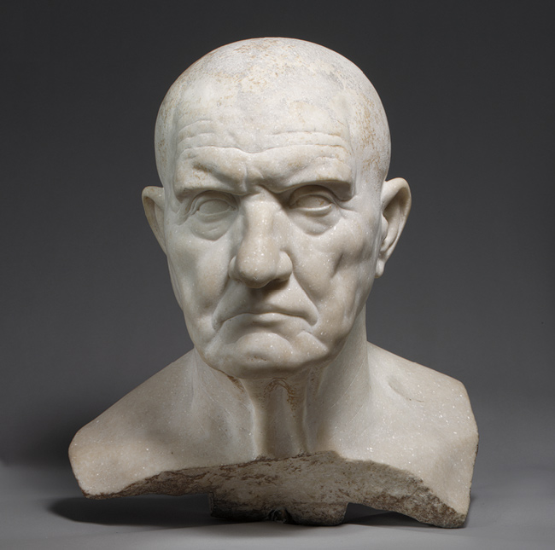
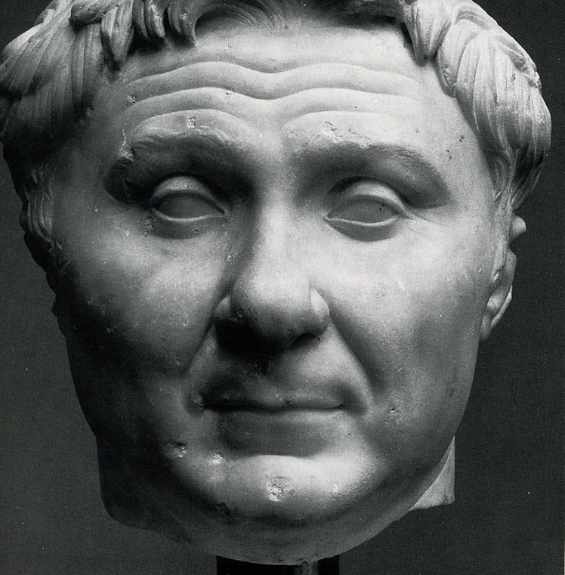

Slide 11
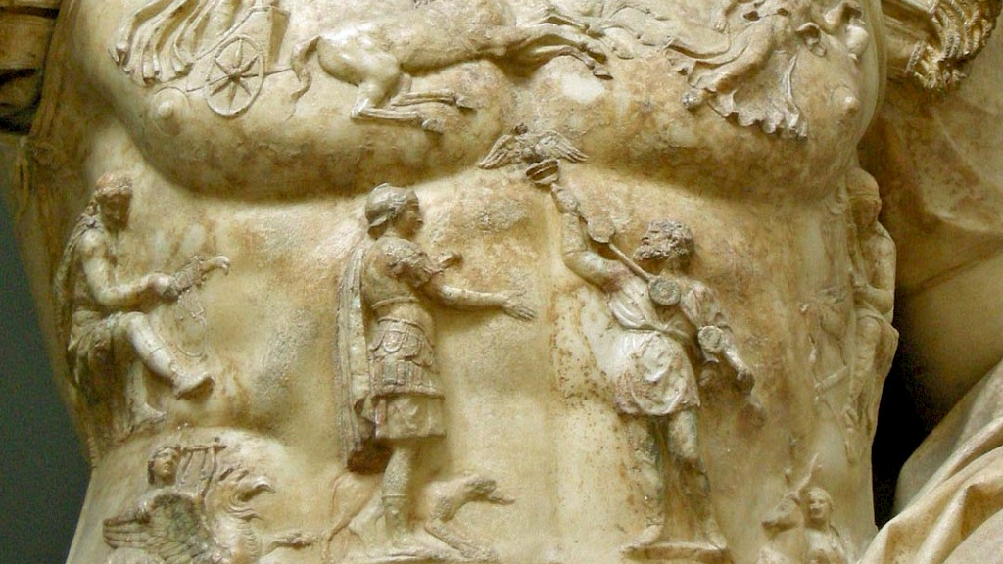

Slide 12
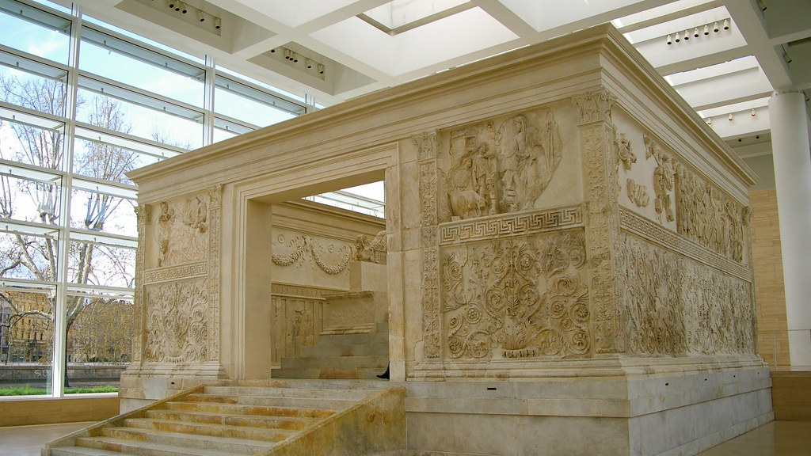
The key theme here is Peace
Augustus presented himself as the bringer of peace.
It was referred to as the Pax Romana, but also as the Pax Augusta.
Augustus set up an altar in Rome which was known as the Ara Pacis Augustae.

Slide 13
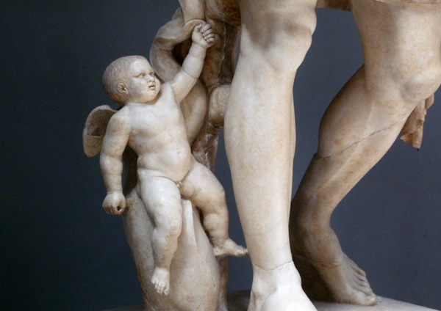

Slide 14
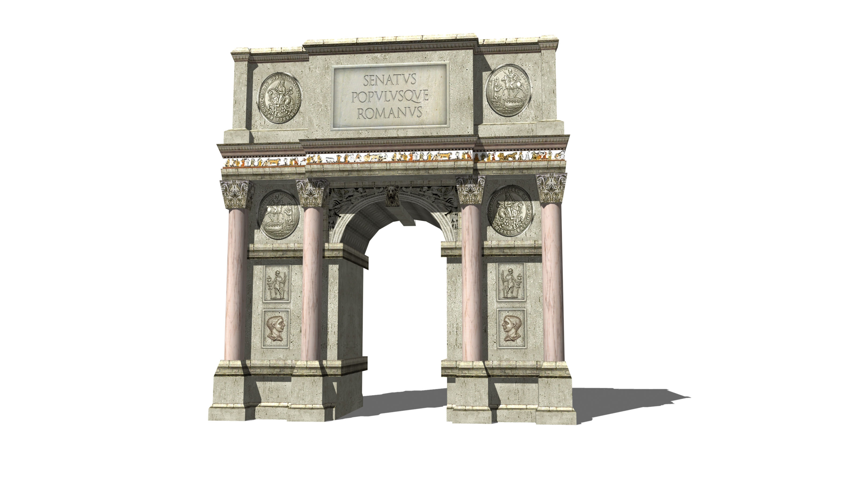
Next: what might a city of marble look like?

Slide 15
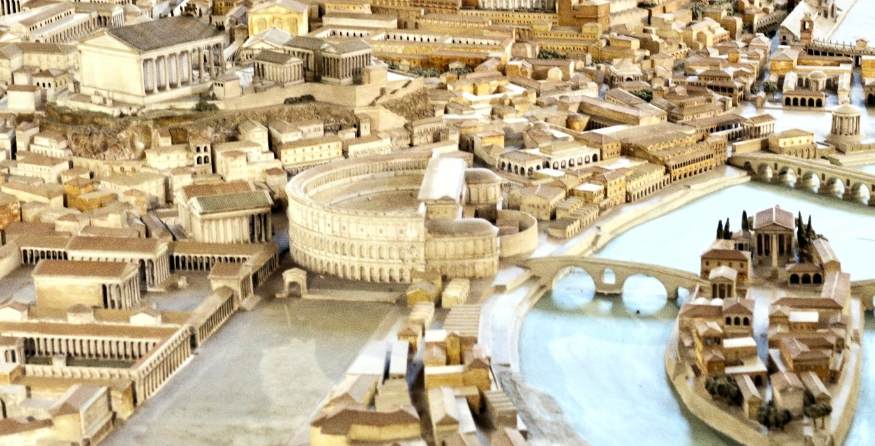

Slide 16
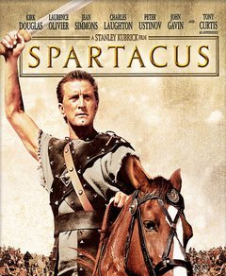
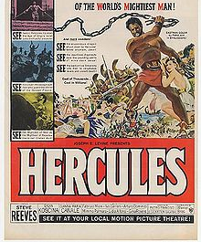
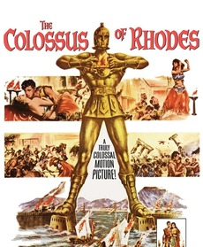
That shining white image isn’t accurate. It’s a fantasy sold to us over the centuries, through paintings, movies and the deliberate cleaning of monuments.

Slide 17
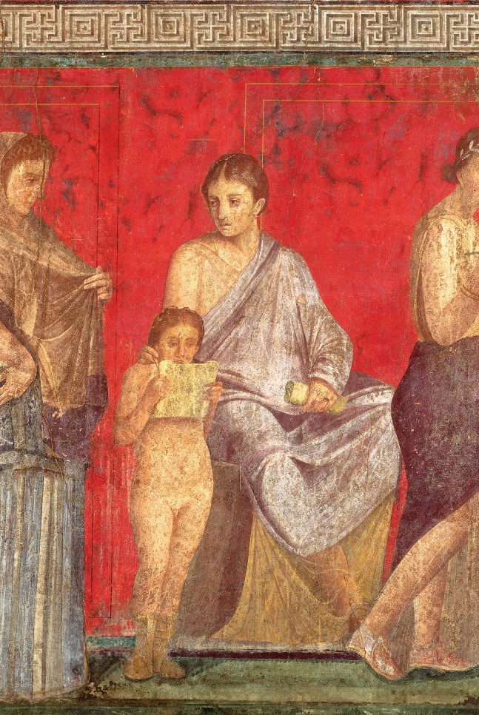
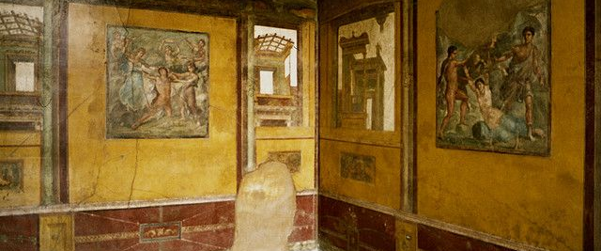
In reality, the Romans loved colour…

Slide 18
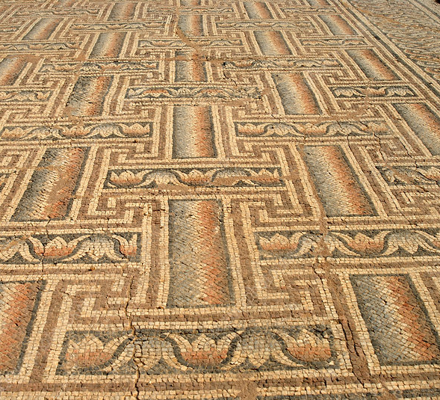
All of their statues and temples and walls and floors and ceilings were covered with colour and pattern and mosaics.
People in the ancient world wouldn’t think of marble as white. A city built of marble would be glossy, clean, strong – and very bright!

Slide 19
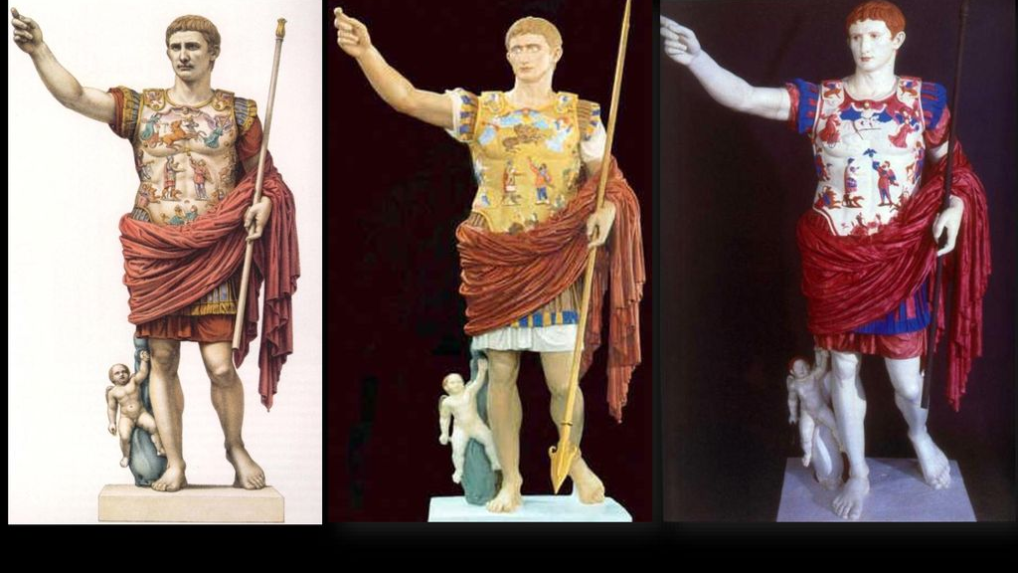
What is your reaction to these versions of the Prima Porta statue?

Slide 20
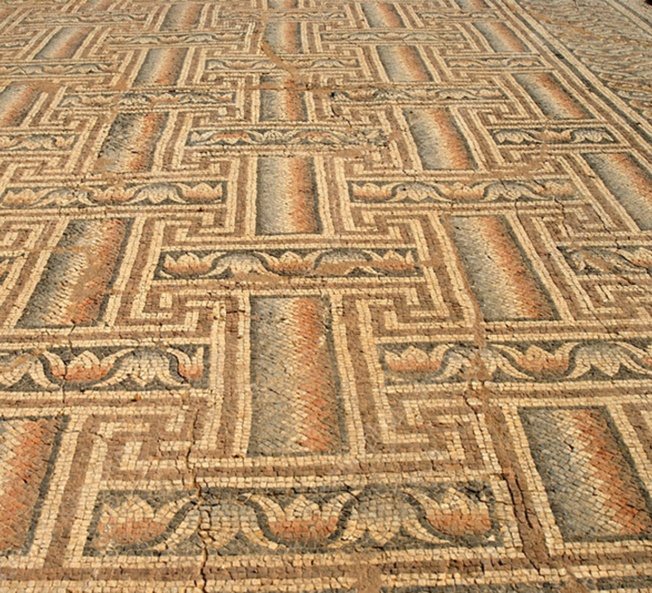
This is not a new discovery.
We’ve always known about the colours.
We’ve known since they were first discovered that Greek and Roman statues and buildings used to be painted.
But we’ve chosen to ignore it and destroy it, and we’ve pretended instead that everything was shiny white.
Why?

Slide 21
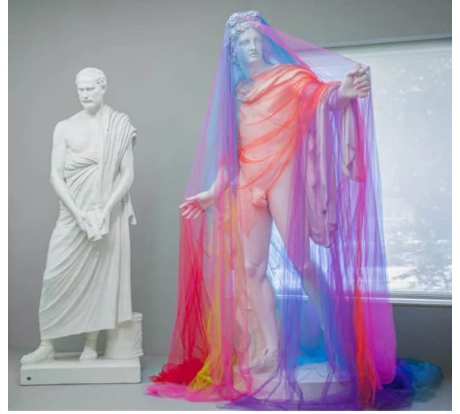
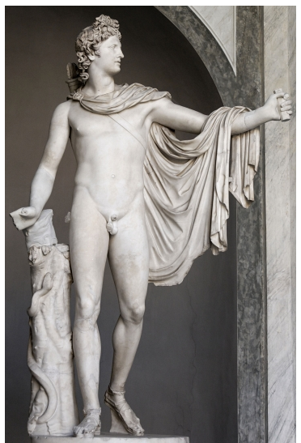
In the Blanton exhibition “Lily Cox-Richard: She-Wolf + Lower Figs,” one of many ideas questioned by the artist is exactly who has an interest in maintaining the view of white marble as more beautiful and why are we so reluctant to let go of it?

Slide 22
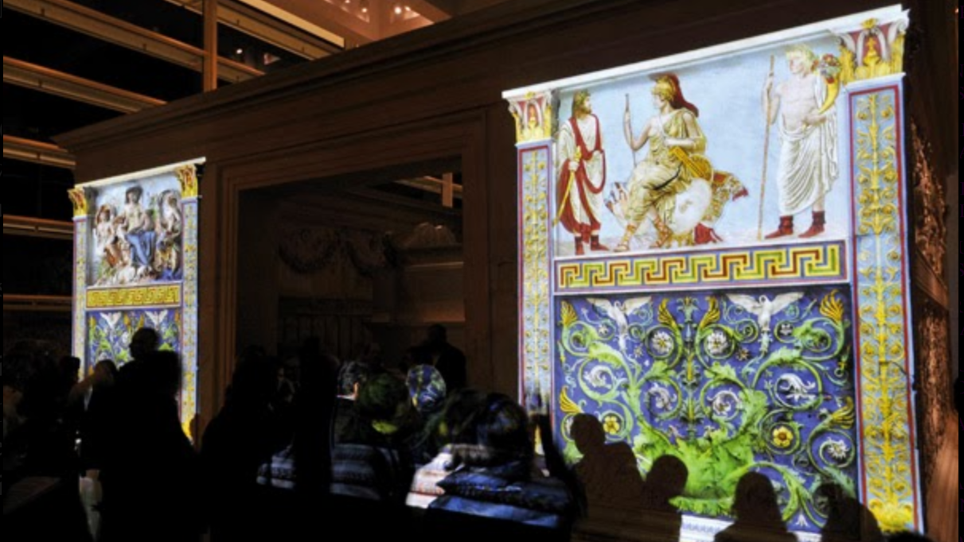

Slide 23
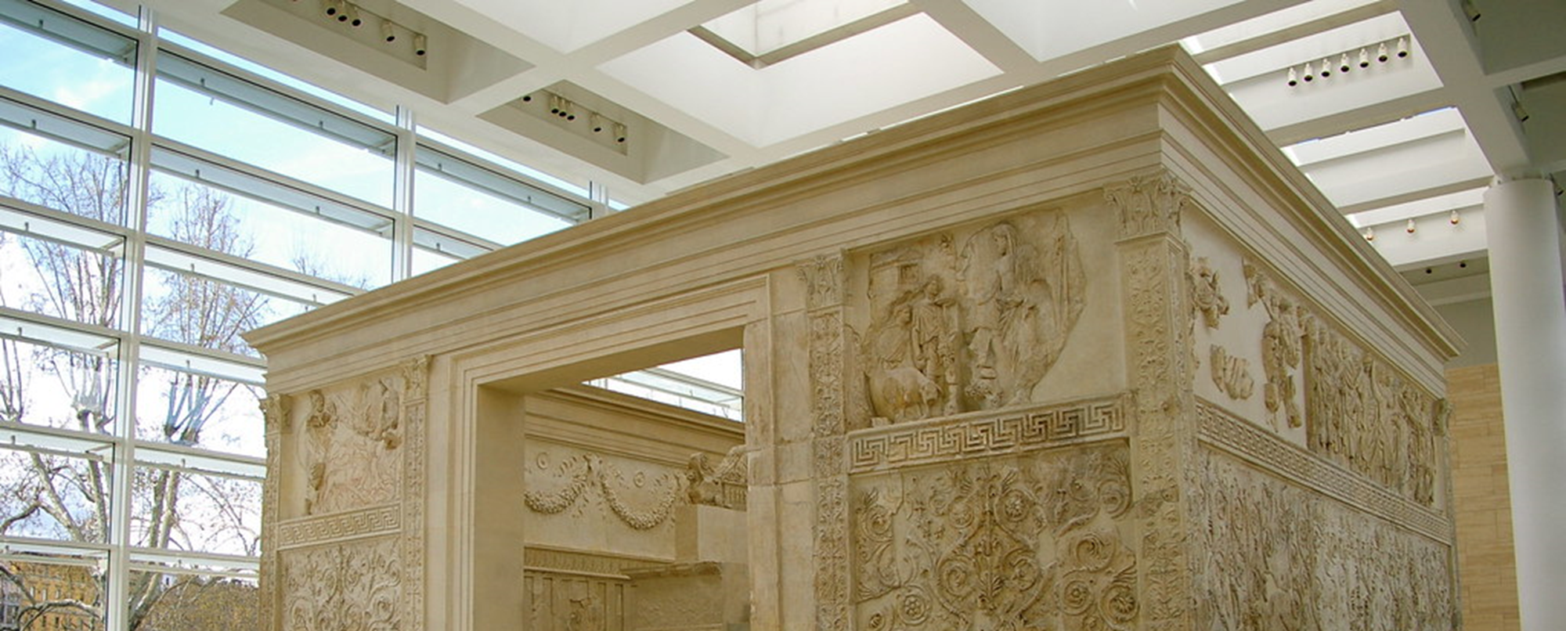
https://youtu.be/8P023rBHU84

Slide 24
Further reading
‘The white lie…’, a video from Vox: https://www.vox.com/2019/12/23/21013071/colorful-roman-statues-white-marble
‘Lily Cox-Richard: Re-casting the Blanton’s Battle casts’, from Sight Lines Magazine: https://sightlinesmag.org/lily-cox-richard-re-casting-the-blantons-battle-casts
‘Why we need to start seeing the Classical World in color’, from Hyperallergic: https://hyperallergic.com/383776/why-we-need-to-start-seeing-the-classical-world-in-color/

Slide 25
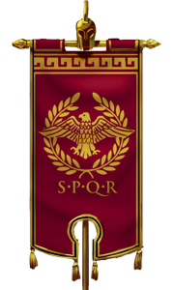

https://classicalstudiessupport.files.wordpress.com/2017/05/faces-of-rome.pdf

