Slide 1
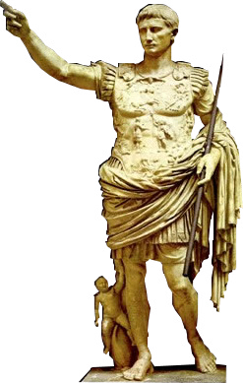
The Authority of Sharing: postgraduate blogging in Classics
Dr Cora Beth Knowles
The Open University, UK

Slide 2
Or…

Slide 3
Blogito ergo sum

Slide 4
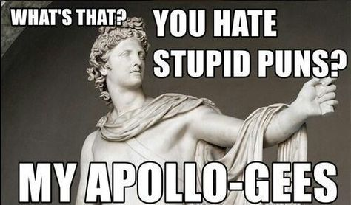

Slide 5
The Authority of Sharing: postgraduate blogging in Classics

Slide 6

Why don’t academics blog?
The most common audience was academic (73%) followed by professional (38%), and the least common was researchers (6%), followed by students (15%). The educated public was marginally more common than students at 17% of blogs. We concluded from this analysis that most academic bloggers were actually writing for themselves – or people like themselves – rather than explicitly trying to reach a group of people differently circumstanced.
Mewburn and Thomson 2013 p.1113

Slide 7

Why do postgraduates blog?
Control
Identity
Authority

Slide 8
Control
Professional insecurity as a built-in feature of postgraduate recruitment…
‘There is a good possibility that you will never obtain a permanent position teaching Classics at a college or university, even if you successfully complete a PhD in Classics in a first-rate program’ (Washington University in St. Louis 2019)
‘…luck plays a large role in most careers, which is another way of saying that even with hard work a classicist may fail to complete a degree, or fail to find a job after completing a degree, for reasons that are completely beyond his or her control’ (University of Florida 2019).

Slide 9
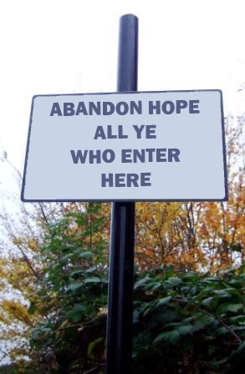
WHICH TRANSLATES AS…

Slide 10
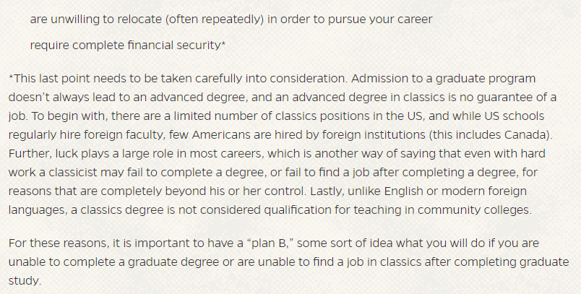
Identity
Stay away from postgraduate Classics if you:
https://classics.ufl.edu/programs-2/graduate/applying_graduate_schools/

Slide 11

Authority
Moral authority?
Educative authority
Authority through vulnerability

Slide 12
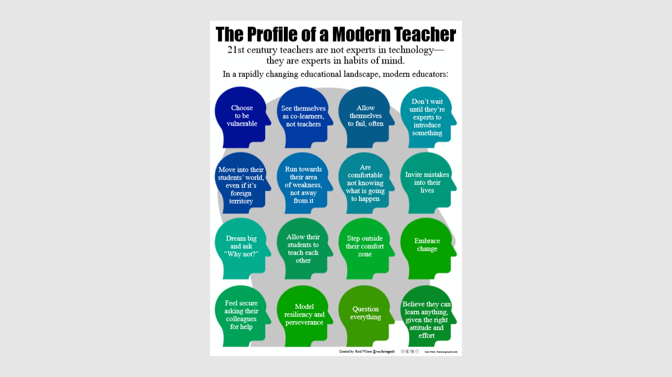
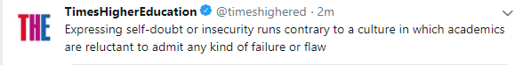
postgraduate bloggers and the ‘modern educator’
From Reid Wilson at https://wayfaringpath.coetail.com/2014/10/14/the-profile-of-a-modern-teacher/ https://creativecommons.org/licenses/by-nc-nd/3.0/

Slide 13

Blogs to check out…
My website, including postgraduate articles: https://classicalstudies.support/
Classical Fix:
https://classicalfix.Com/
Le Temps Revient:
https://letempsrevientblog.Wordpress.Com/
Classics and Coffee:
http://www.classicsandcoffee.co.uk/about/

