Slide 1
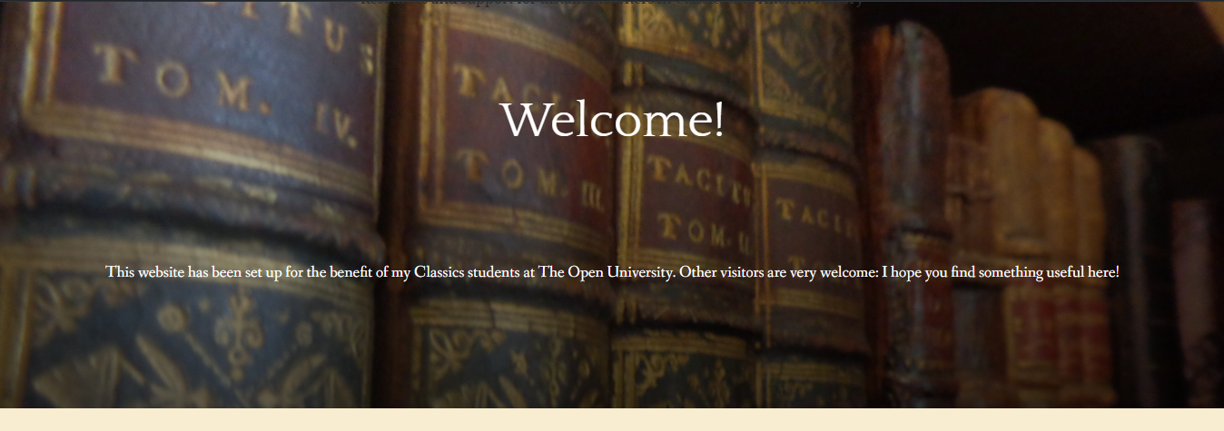
Classical Studies Support
A quick tour…

Slide 2
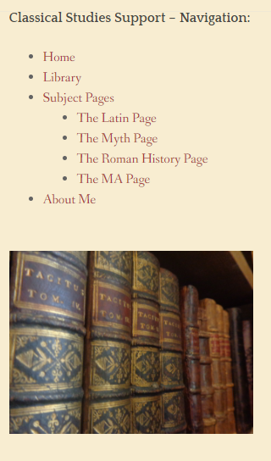
Subject Pages
Covering A276, A330, A340 and the MA
Include tutorial slides, links to useful articles, videos and other additional material
Feel free to use – or to contribute!

Slide 3
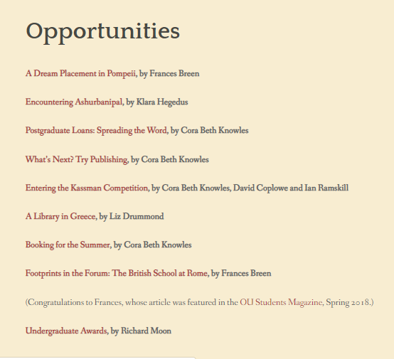
Library
Archive of posts on all kinds of things, including:
  Opportunities (e.g. Undergraduate Awards, studentships)
  Study skills (eg. referencing, writing an abstract)
  Student life (eg. applying for loans, studying overseas)
  Classical stuff (eg. Classics on TV, Playmobil Romans)
Articles by current and former students, and links to student blogs
Some podcasts and videos – still working on those!

Slide 4
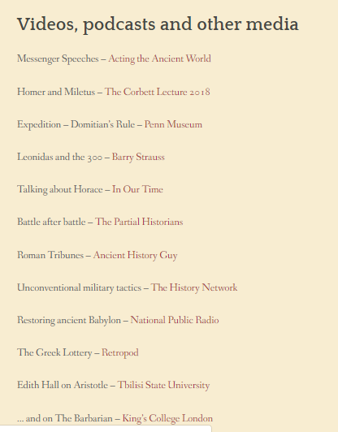
Weekend Reading
Weekly list of links to material of classical interest from the internet
Lots of links to podcasts, which are becoming increasingly popular
Helps new students to find their feet in Classics
Point of contact for former students who still have an interest

Slide 5
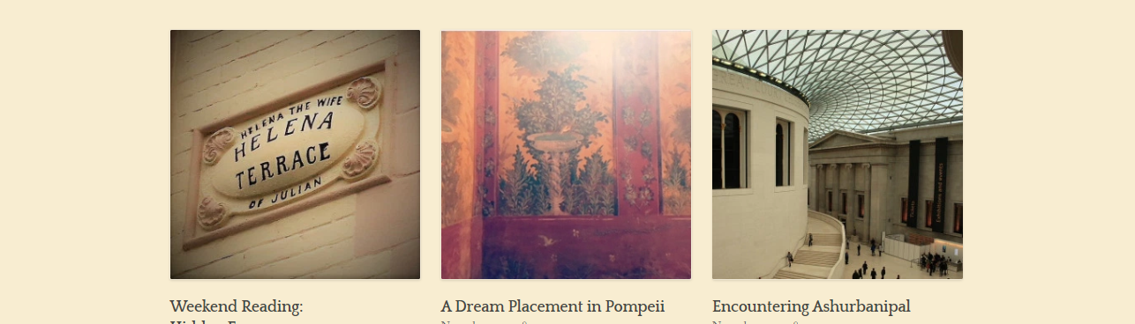
Do get involved…
By telling your students,
By contributing an article or spare tutorial materials,
By suggesting things I could add.

Slide 6
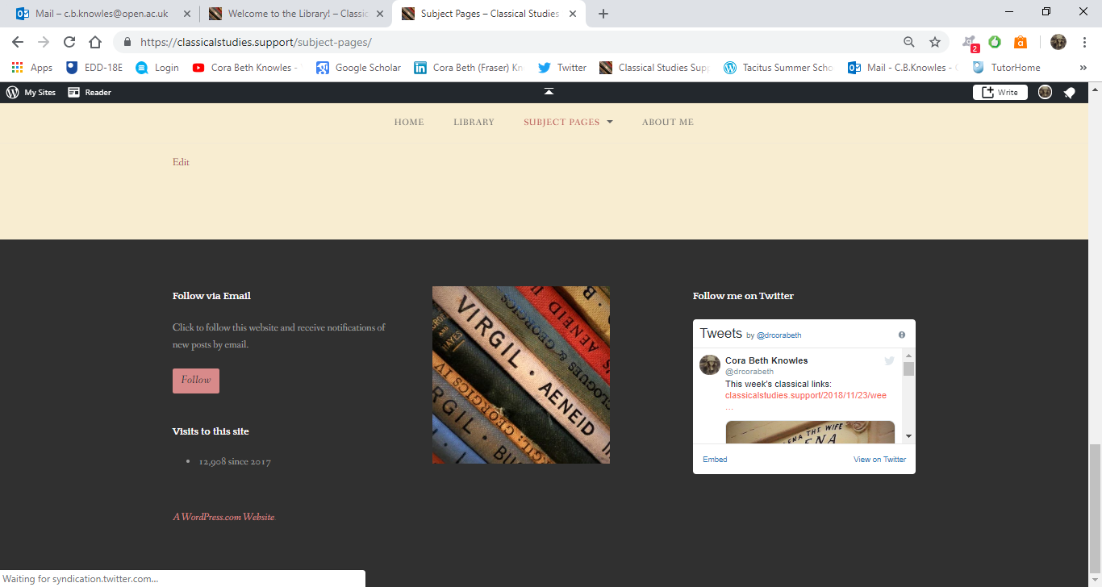
Contact
c.b.knowles@open.ac.uk
Twitter: @drcorabeth
https://classicalstudies.support

