Slide 1

Learning Event Summaries:
What’s the point?

Slide 2
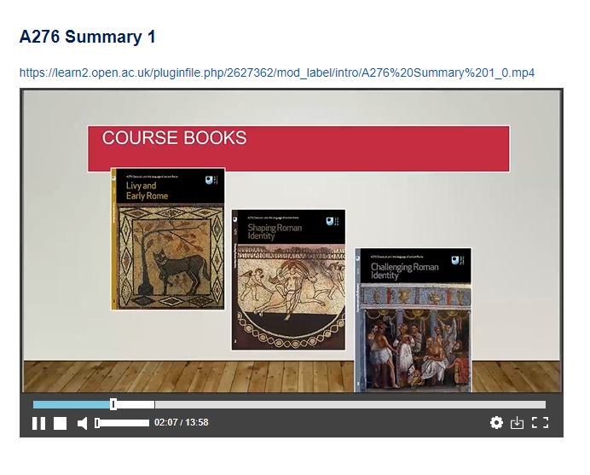
Learning Event Summaries
Available on some modules under the ‘Resources’ tab
10-minute summaries of tutorial themes and questions
Meant to be useable in other presentations
Supposed to be ‘engaging’…!

Slide 3
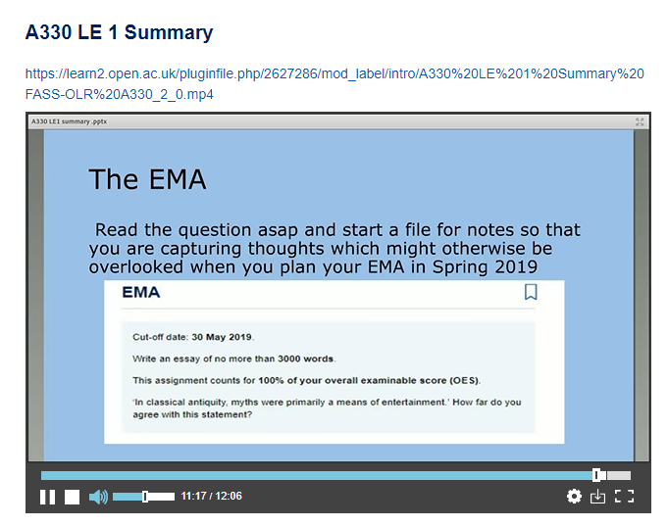
Production
Need to be selective
Focus on most important elements of the Block
Outline necessary study skills
Point towards sources of help
Produced in the Adobe Connect Workspace, then uploaded
Upload scheduled for a time after all tutorials for the LE have been completed.

Slide 4
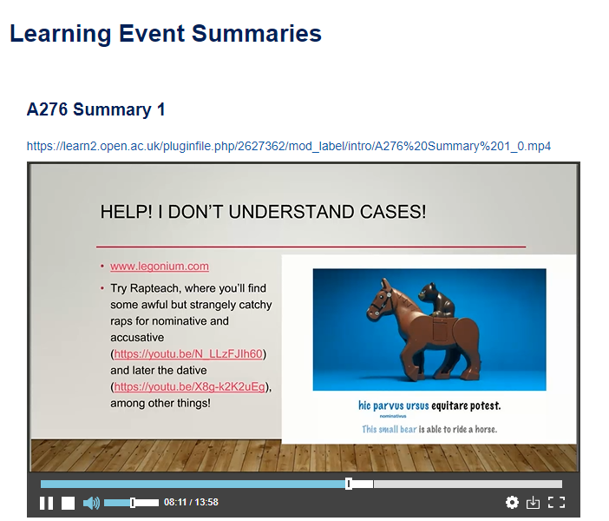
What are the positives for students?
Links to useful resources
Additional materials
Chance to hear a different perspective
Help with key skills
Answers to common questions
Catching up.

Slide 5
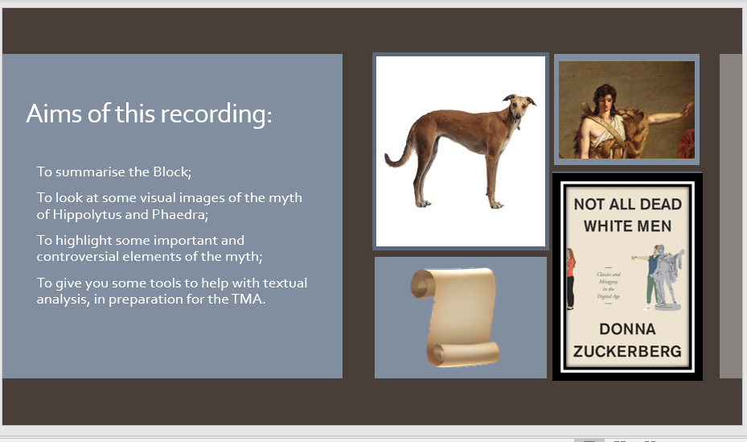

What are the problems?
Impossible to do a lot in 10 minutes
Can’t focus on specific TMA advice
Difficult to make a solo session ‘engaging’
Collaborative sessions take a lot of planning
Tricky to decide which points to prioritise
Certainly not equivalent to a 90-minute interactive tutorial!

