Slide 1
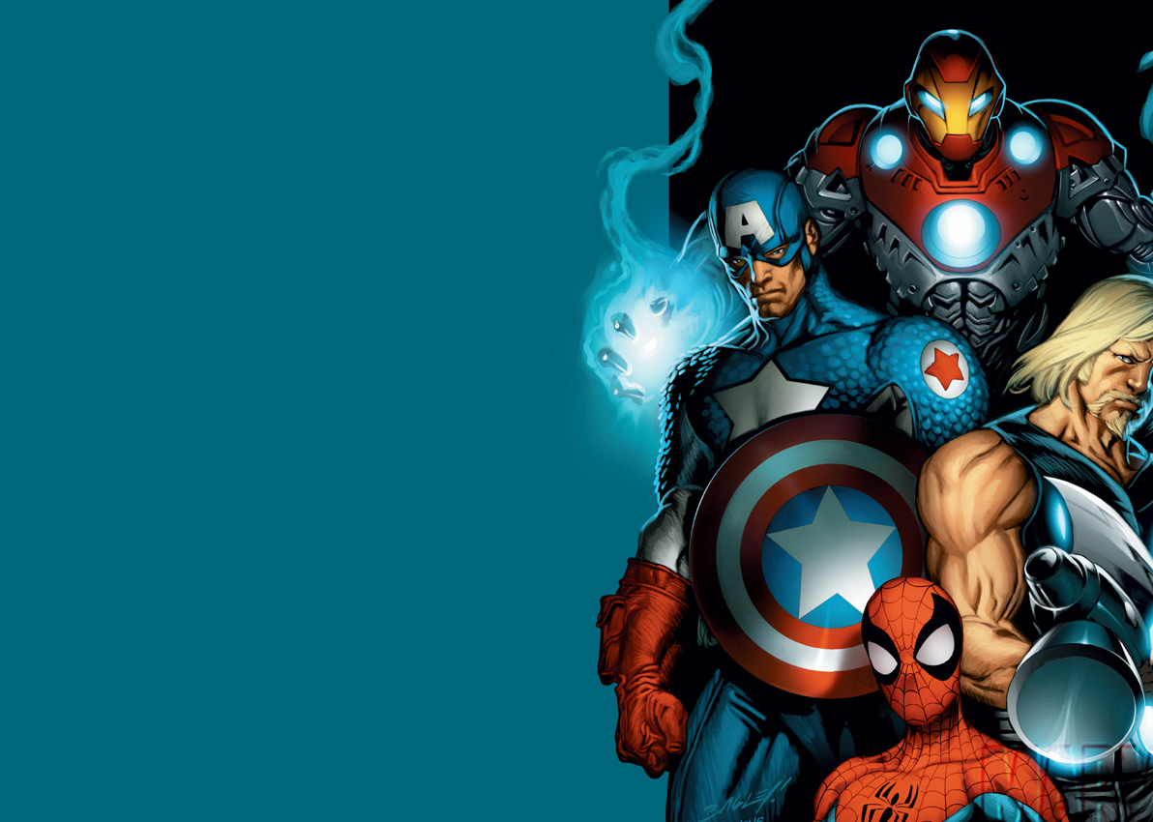
The rise of the Superhero

Slide 2
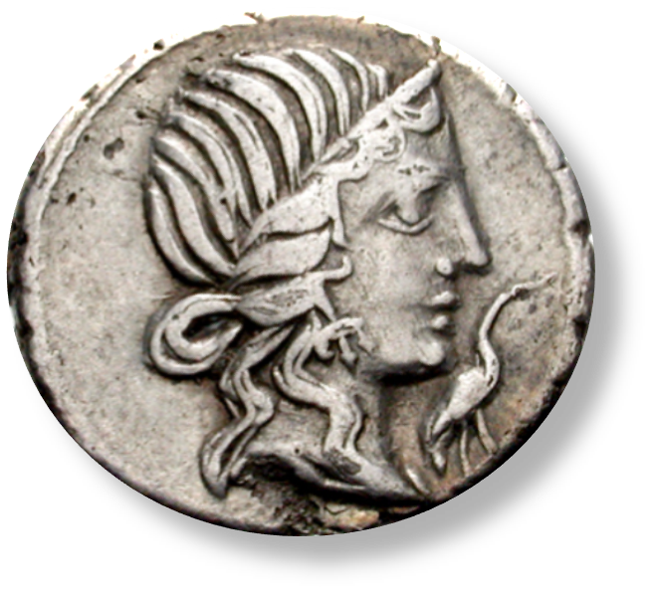
In which we will…
…think about what makes a hero
…look at some extracts from Virgil’s Aeneid
…debate important questions like ‘What do Aeneas and Spiderman have in common?’ and ‘Why does this lady have a stork up her nose?’

Slide 3
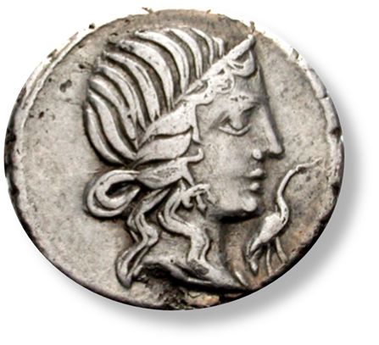
Greek heroes
The earliest heroes were notable for their response to supernatural ‘challenges’, usually involving monsters.
They were usually either the children or grandchildren of gods.
They took on challenges to gain rewards; while a sense of duty was sometimes involved, it was rarely the primary motivation.
These monster-battling heroes illustrated concerns of the time, about dangerous and unexplained natural phenomena which no ordinary man could handle.

Slide 4
The Fatal Flaw
A little later the Greek tragedians questioned the role of the hero within the family; Theseus’ family falls apart, Jason leaves Medea with tragic consequences, and Hercules kills his wife. The suggestion is that heroes, because they are not ordinary men, cannot have the domestic lives of ordinary men.
The tragedians encourage us to ask whether heroes actually make dependable men: their heroism consists of a series of independent acts, so they do not function well within society.

Slide 5
Moving on to Augustan Rome...
In the wake of generations of civil war, Roman writers were looking for a new type of role model: a dependable hero and a leader to be trusted.
The hero had to resolve the problem of the demigod who cannot lead a normal life.
Such heroes were developed with great success by Livy and Virgil, who emphasised the importance of virtue.
The key virtue in Virgil’s reconstruction of heroism was pietas.

Slide 6
Pius and Pietas
Homeric heroes have epithets: adjectives commonly attached to their names which define who they are.
  Swift-footed Achilles
  Gigantic Ajax
  Hector of the shining helm
  Odysseus the great teller of tales, man of many resources
  https://en.wikipedia.org/wiki/Epithets_in_Homer
  Virgil gives Aeneas two main epithets: pater and pius.
  Frequent references are made to Aeneas’ pietas, the noun
  which comes from pius. Like many value words, however, pietas is not easy to define or understand.

Slide 7
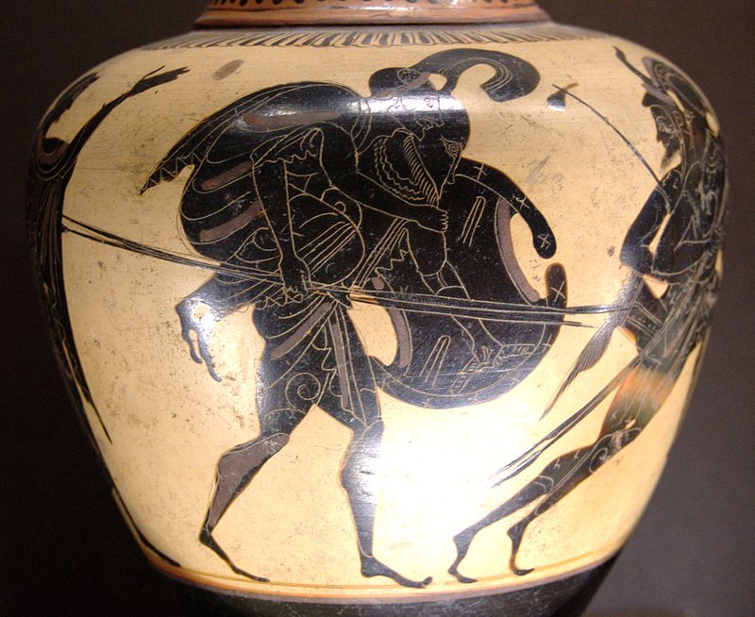
Aeneas carrying Anchises. Attic black-figure oinochoe, ca. 520–510 BC.

Slide 8
Pietas is composed of several elements…
Subordinating one’s own desires…
  1. to the gods and their requirements (piety)
  2. to one’s country (patriotism)
  3. to one’s family (including ancestors)
  4. to one’s friends
  5. to one’s subordinates
  A man who has pietas is not motivated by personal ambition, greed or the desire for fame. He is a valuable member of society, reliable and respected.
  Why does Odysseus not qualify? What about Achilles, or
  Hercules, or Theseus?

Slide 9
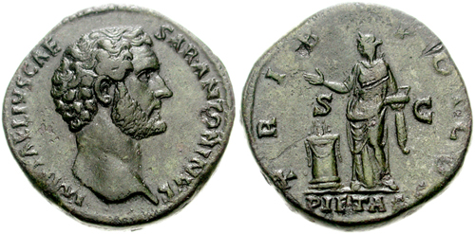
Pietas as a religious figure

Slide 10
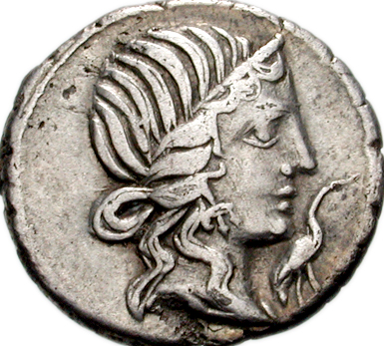
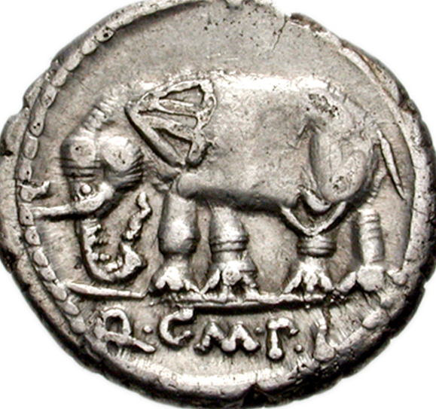
Picturing pietas
This is a coin minted in 81 BCE by Quintus Caecilius Metellus, who took the last
name ‘Pius’ in recognition on his acts on behalf of his father. An indication
of ‘pietas’ is the stork, a bird sometimes called ‘pietaticultrix’ because it was
said to return to the same nest each year and to take care of its parents.

Slide 11
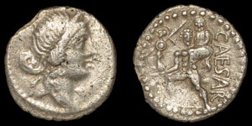
Julius Caesar

Slide 12
Aeneas and Amor
Relationships and family life are the downfall of many a Greek hero: so how does Aeneas handle them? His perfect relationship with his father and his son are all part of the core Aeneas legend … but what about falling in love?
Virgil does something fabulous here: he creates Dido. Dido isn’t just a place-holder; she’s a powerful character who has achieved what Aeneas himself aspires to achieve, by founding a new city in a new land.
Aeneas loves Dido; but pietas requires him to move on, because his people have a destiny. He does the right thing, but Virgil does not make it easy for either Aeneas or the reader.

Slide 13
Virgil, Aeneid 4.393-6
At pius Aeneas, quamquam lenire dolentem
solando cupit et dictis avertere curas,
multa gemens magnoque animum labefactus amore,
iussa tamen divum exsequitur, classemque revisit.
But good Aeneas, tho' he much desir'd
To give that pity which her grief requir'd;
Tho' much he mourn'd, and labor'd with his love,
Resolv'd at length, obeys the will of Jove;
    (Dryden)
Here Aeneas has told Dido that he must leave, to carry out his divine mission. She rants, prays for vengeance and collapses. After this passages he leaves. The smoke from her pyre follows his ships as they sail away.

Slide 14
Aeneas and Furor
For Aeneas, pietas wins out over amor, although the battle is a close-fought one.
However, furor comes much closer to overcoming Aeneas’ pietas, to the extent that the outcome is debatable: that’s the fascinating thing about the Aeneid.
Aeneas’ furor at the death of his protégé Pallas dominates the last three books of the Aeneid, as Aeneas goes on a murderous rampage and ultimately kills a brave man who begs for his life.
Does furor prevail over Aeneas’ pietas in the end, or did Turnus need killing? And why does it matter?
Well, for that we need to go back to Book 1…

Slide 15
Virgil, Aeneid 1.291-6
Aspera tum positis mitescent saecula bellis;
cana Fides, et Vesta, Remo cum fratre Quirinus,
iura dabunt; dirae ferro et compagibus artis
claudentur Belli portae; Furor impius intus,
saeva sedens super arma, et centum vinctus aenis
post tergum nodis, fremet horridus ore cruento.
Then dire debate and impious war shall cease,
And the stern age be soften'd into peace:
Then banish'd Faith shall once again return,
And Vestal fires in hallow'd temples burn;
And Remus with Quirinus shall sustain
The righteous laws, and fraud and force restrain.
Janus himself before his fane shall wait,
And keep the dreadful issues of his gate,
With bolts and iron bars: within remains
Imprison'd Fury, bound in brazen chains;
High on a trophy rais'd, of useless arms,
He sits, and threats the world with vain alarms.

Slide 16
Furor impius
When the gates of War are closed, inside will be Furor impius with his bloody mouth, bound and broken but no less vicious.
Furor here is impius, the antithesis of pietas, and has no place in the new world order, according to Jupiter’s prophecy.
So Aeneas, for Virgil, is a new type of hero, but he is not the ultimate hero: he has a flaw that does not belong in the Rome of Jupiter’s visions.

Slide 17
And we’re still working on it…
…trying to figure out how to reconcile the superhuman with the human. How can you be a mild-mannered hero? How can you be a semi-divine family man?

Slide 18
Think of some twentieth century superheroes...
How do they resolve the Greek problem of the hero who cannot lead a normal life?

Slide 19
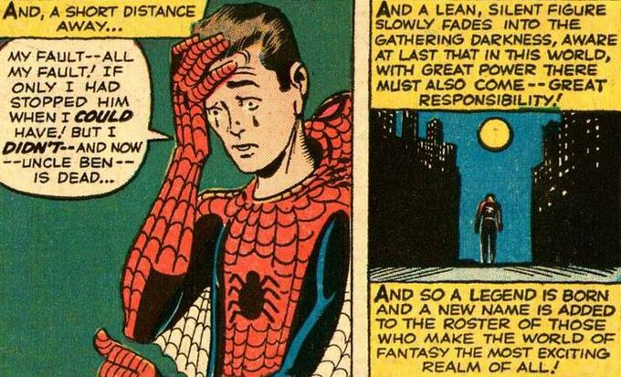
The Iconic Superhero Statement…
Amazing Fantasy #15, August 1962

